Slide 1
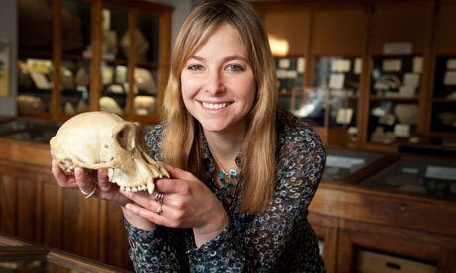
Dr Alice Roberts is lovely
http://www.bbc.co.uk/learningzone/clips/anatomy-and-physiology-of-the-kidneys/5370.html
Urine
Kidney
Blood
Filtration
Renal

Slide 2
Objectives You should be able to…
11.3.1 Define excretion .
11.3.2 Draw and label a diagram of the kidney.
11.3.3 Annotate a diagram of a glomerulus and associated nephron to show the function of each part.
11.3.4 Explain the process of ultrafiltration, including blood pressure, fenestrated blood capillaries and basement membrane.
11.3.5 Define osmoregulation .

Slide 3
Why is defecation NOT excretion?

Slide 4
http://www.kidneypatientguide.org.uk/HKWanim.php

Slide 5
Diagram of kidney
http://subscription.echalk.co.uk/Science/biology/UrinarySystem/urinarySystemAndKidney.html

Slide 6
Describe the structure of a nephron, to include Bowman’s capsule and glomerulus, convoluted tubules, loop of Henlé and collecting duct
http://www.biologymad.com/resources/kidney.swf
Microscope?

Slide 7
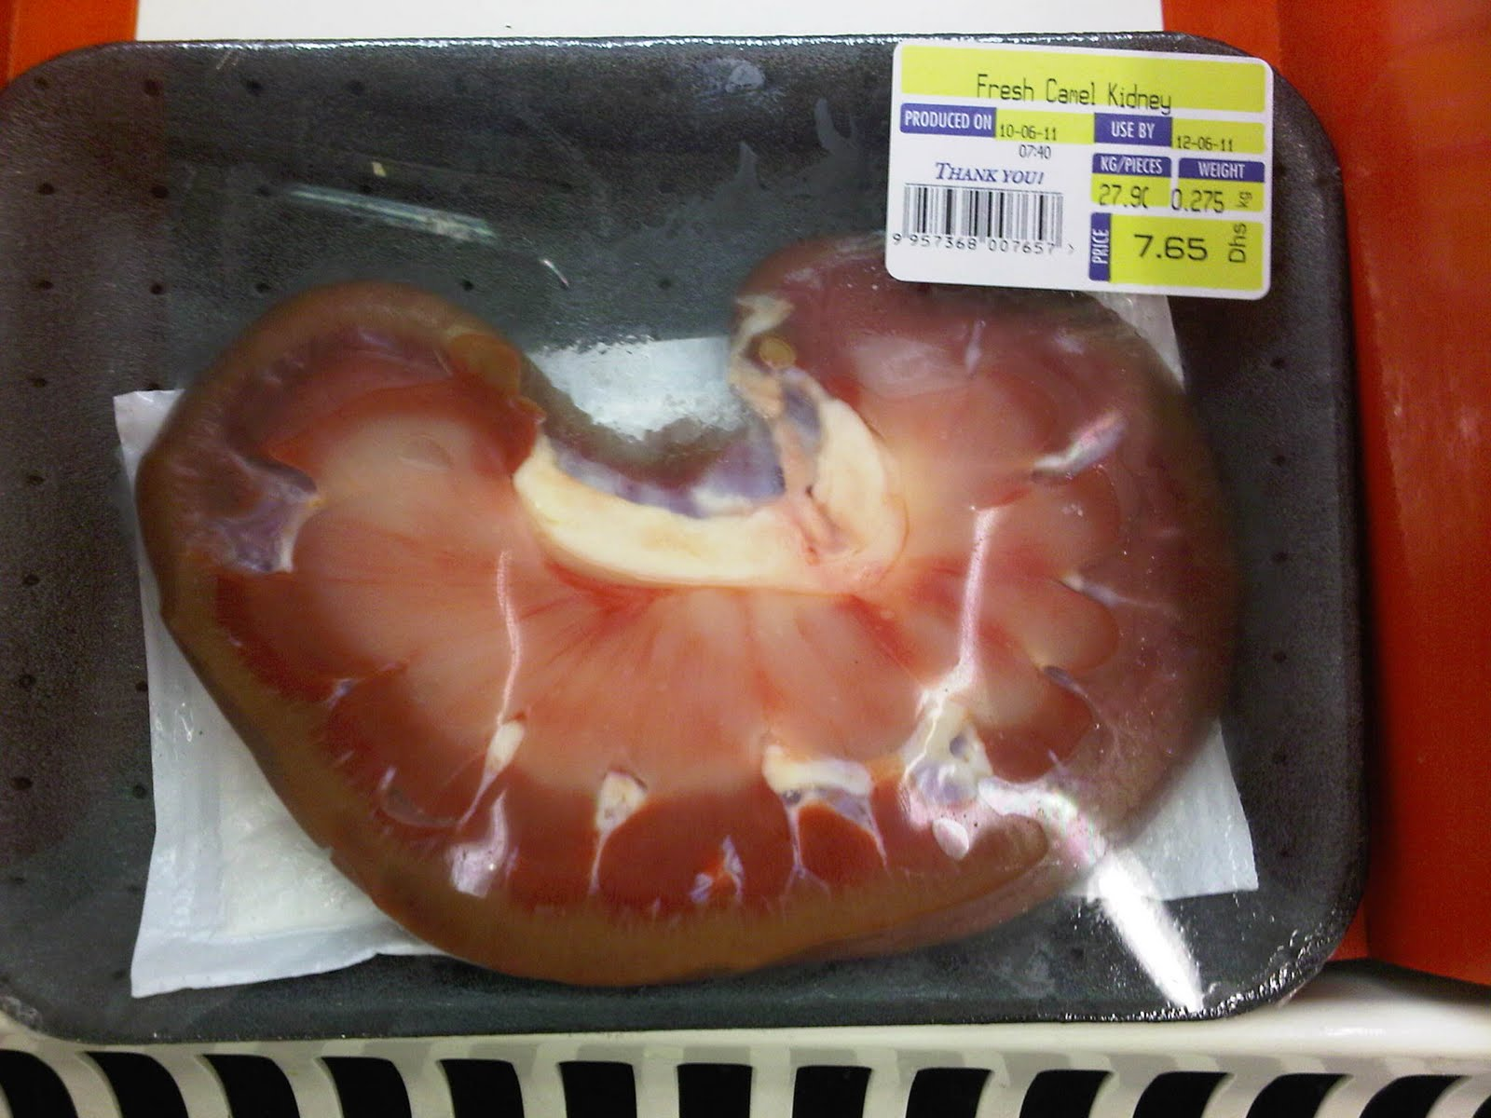

Slide 8
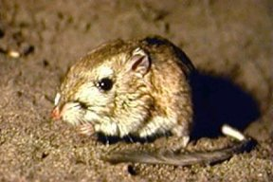
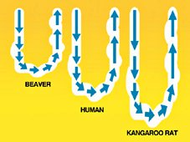

Slide 9
http://www.colorado.edu/intphys/Class/IPHY3430-200/countercurrent_ct.swf

Slide 10
Plenary
http://www.zerobio.com/target_practice_quiz/target_practice_quiz_kidney.swf

Slide 11
Use for revision…
http://www.sumanasinc.com/webcontent/animations/content/kidney.html
http://cd1.edb.hkedcity.net/cd/science/biology/resources/animation/Topic16.swf

Slide 12
Homework Watch this…
http://www.youtube.com/watch?v=WtrYotjYvtU&feature=player_embedded

Slide 13
Objectives I should be able to…
11.3.6 Explain the reabsorption of glucose, water and salts in the proximal convoluted tubule, including the roles of microvilli, osmosis and active transport.
11.3.7 Explain the roles of the loop of Henle, medulla, collecting duct and ADH (vasopressin) in maintaining the water balance of the blood.
11.3.8 Explain the differences in the concentration of proteins, glucose and urea between blood plasma, glomerular filtrate and urine.
11.3.9 Explain the presence of glucose in the urine of untreated diabetic patients.

Slide 14
Dr Alice Roberts is lovely

Slide 15
http://www.bbc.co.uk/learningzone/clips/the-effect-of-high-sugar-intake-on-blood-sugar-levels/5371.html
Watch the Video and then answer the questions
How many people have diabetes in the UK?
1 in ____________ people are walking around with diabetes without being aware of it.
What are 5 symptoms of diabetes?
How does high sugar levels damage the kidneys?
What is the average blood sugar level (in millimoles per litre)?
What do kidneys do with the sugar in your blood?
How long did it take for the blood sugar levels of the scientist in the video to start decreasing after her high sugar meal?

Slide 16
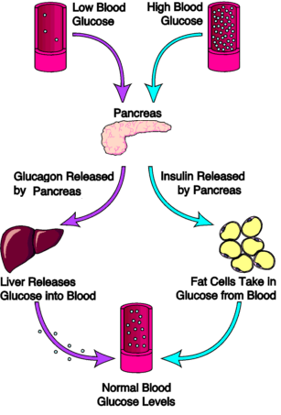

Slide 17
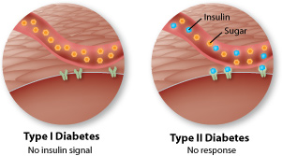

Slide 19
Multi choice questions

