Slide 1
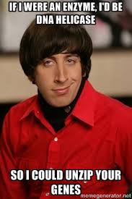
3.4 The genetic code and cell function

Slide 2
http://genome.pfizer.com/zipunzip.cfm

Slide 3
You should be able to…
3.4.1 Explain DNA replication in terms of unwinding the double helix and separation of the strands by helicase, followed by formation of the new complementary strands by DNA polymerase.
3.4.2 Explain the significance of complementary base pairing in the conservation of the base sequence of DNA.
3.4.3 State that DNA replication is semi-conservative.

Slide 4
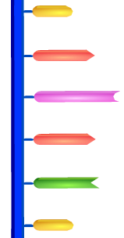
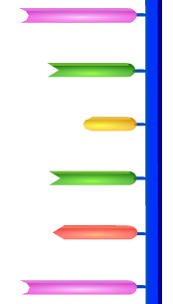
DNA helicase unzips the 2 strands
The enzymes breaks the hydrogen bonds holding the base pairs together.

Slide 5
Free Nucleotides Bind
Complementary base pairing
DNA helicase completes the splitting of the strand.
Meanwhile, free nucleotides that have been activated are attracted to their complementary bases.
Each chain acts as a template.

Slide 6
DNA Polymerase
Once in placed the activated nucleotides are joined together by DNA polymerase.
DNA polymerase joins the new nucleotides to each other by strong covalent bonds, forming the phosphate-sugar backbone.

Slide 7
Replication Finished
The result is that there are two DNA molecules, each with one new synthesised strand of DNA and one strand from the original.
The DNA is then rewound by another enzyme.

Slide 8
A winding enzyme winds the new strands up to form double helices.
DNA helicase unwinds and unzips DNA, breaking the hydrogen bonds that join the base pairs, and forming two separate strands.
DNA polymerase joins the new nucleotides to each other by strong covalent bonds, forming the phosphate-sugar backbone.
Replication starts at a specific sequence on the DNA molecule.
The new DNA is built up from the four nucleotides (A, C, G and T) that are abundant in the nucleoplasm.
The two new molecules are identical to the old molecule.
These nucleotides attach themselves to the bases on the old strands by complementary base pairing. Where there is a T base, only an A nucleotide will bind, and so on.

Slide 9
Steps of Replication
Replication starts at a specific sequence on the DNA molecule.
DNA helicase unwinds and unzips DNA, breaking the hydrogen bonds that join the base pairs, and forming two separate strands.
The new DNA is built up from the four nucleotides (A, C, G and T) that are abundant in the nucleoplasm.
These nucleotides attach themselves to the bases on the old strands by complementary base pairing. Where there is a T base, only an A nucleotide will bind, and so on.
DNA polymerase joins the new nucleotides to each other by strong covalent bonds, forming the phosphate-sugar backbone.
A winding enzyme winds the new strands up to form double helices.
The two new molecules are identical to the old molecule.

Slide 10
http://www.youtube.com/watch?v=bee6PWUgPo8&feature=player_embedded

Slide 11
Semi-Conservative Model

Slide 12
Two theories existed...
Conservative Hypothesis
The complete parent DNA molecule acts as a template for the new daughter molecule, which is assembled from new nucleotides. The parent molecule is unchanged.
Semi-conservative Hypothesis
The parent DNA molecule separates into its two component strands, each of which acts as a template for the formation of a new complementary strand. The two daughter molecules therefore contain half the parent DNA and half new DNA (semi-conservative hypothesis).

Slide 13
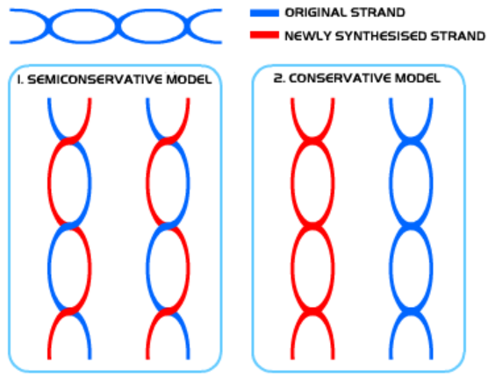
2 models

Slide 14
http://www.learnerstv.com/animation/biology/con20ani.swf

Slide 15
Explain how the base sequence of DNA is conserved during replication. 5 marks

Slide 16
DNA replication is semi-conservative; DNA is split into two single/template strands; nucleotides are assembled on/attached to each single/template strand; by complementary base pairing; adenine with thymine and cytosine with guanine / A with T and C with G; strand newly formed on each template strand is identical to other template strand; DNA polymerase used; Marks may be awarded for any of the above points if clearly presented in a well-annotated diagram. 5 max

