Slide 1
Shell video of enzyme models

Slide 2
Objectives You should be able to...
3.6 Enzymes
3.6.1 Define enzyme and active site .
3.6.2 Explain enzyme–substrate specificity.
3.6.3 Explain the effects of temperature, pH and substrate concentration on enzyme activity.
3.6.4 Define denaturation .
3.6.5 Explain the use of lactase in the production of lactose-free milk.
7.6 Enzymes
7.6.1 State that metabolic pathways consist of chains and cycles of enzyme catalysed
reactions.
7.6.2 Describe the induced-fit model.
7.6.3 Explain that enzymes lower the activation energy of the chemical reactions
that they catalyse.
7.6.4 Explain the difference between competitive and non-competitive inhibition,
with reference to one example of each.
7.6.5 Explain the control of metabolic pathways by end-product inhibition, including
the role of allosteric sites.

Slide 3
Objectives You should be able to...
3.6 Enzymes
3.6.1 Define enzyme and active site .
3.6.2 Explain enzyme–substrate specificity.
7.6 Enzymes
7.6.1 State that metabolic pathways consist of chains and cycles of enzyme catalysed reactions.
7.6.2 Describe the induced-fit model.
7.6.3 Explain that enzymes lower the activation energy of the chemical reactions that they catalyse.

Slide 4
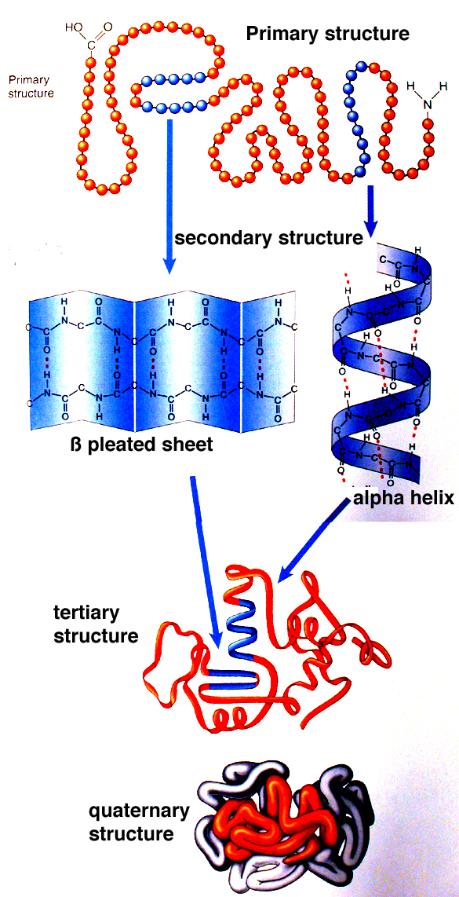
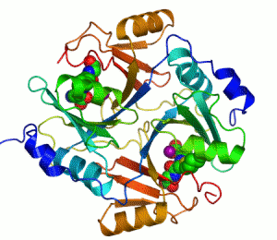
Structure of Enzymes:
All enzymes are tertiary globular proteins, where the protein chain is folded back on itself into a spherical or globular shape.
Each enzyme has its own sequence of amino acids and is held in its tertiary structure by hydrogen bonds, disulfide bridges and ionic bonds.
This complex 3D shape gives the enzyme many of its properties.

Slide 5
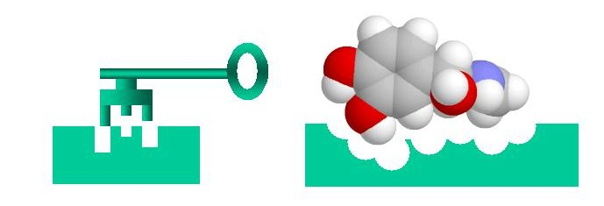
How Enzymes Work:
Enzymes are biological catalysts that speed up the rate of metabolic reactions, without being used up themselves. These reactions can be of two types:
Reactions where larger molecules are broken down into smaller molecules.
Reactions where small molecules are built up into larger, more complex, molecules.
Enzymes react with another molecule called the SUBSTRATE.
Each enzyme has its own special shape, with an area, the ACTIVE SITE, onto which the substrate molecules bind.
This is known as the lock and key theory.

Slide 6
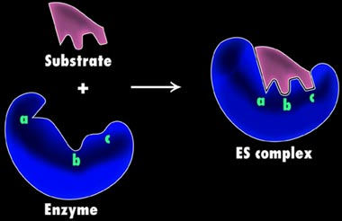
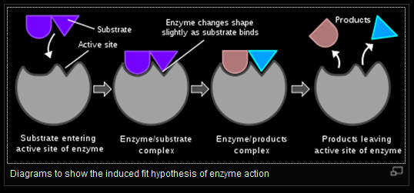
How Enzymes Work:
Modern interpretations of the lock and key theory suggest that in the presence of the substrate, the active site may change in order to select the substrate’s shape.
This is called the INDUCED FIT HYPOTHESIS, e.g. illustrated by the enzyme, lysozyme (structural details aren’t important).
Enzyme + Substrate → Enzyme-Substrate complex → Enzyme + Product

Slide 7
http://www.elmhurst.edu/~chm/vchembook/571lockkey.html
http://course1.winona.edu/sberg/ANIMTNS/ind-fit.htm

Slide 8
Objectives You should be able to...
3.6 Enzymes
3.6.3 Explain the effects of temperature, pH and substrate concentration on enzyme activity.
3.6.4 Define denaturation .
7.6 Enzymes
7.6.3 Explain that enzymes lower the activation energy of the chemical reactions that they catalyse.

Slide 9
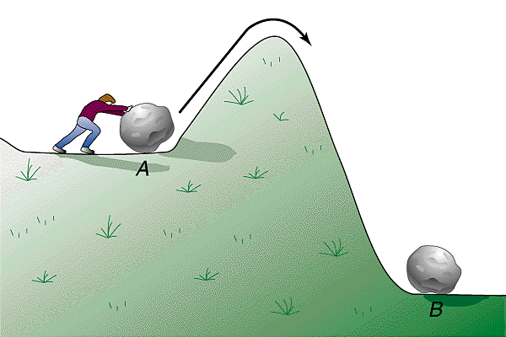
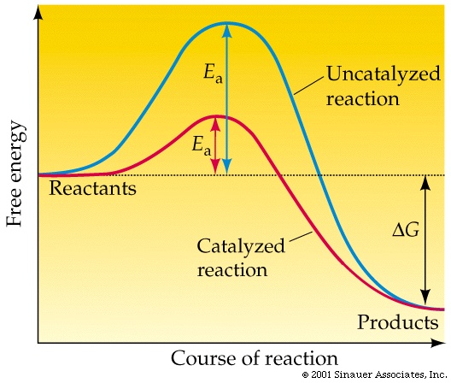
Properties of Enzymes:
Enzymes are specific i.e. each enzyme will catalyse only one particular reaction, for example, sucrASE acts on the sugar, sucrOSE.
Enzymes are very efficient and have a high TURNOVER NUMBER.
This means that they can convert many molecules of substrate per unit time, for example, catalase, which breaks down the waste product hydrogen peroxide in the body, has a turnover number of several million!
Chemical reactions need energy to start them off and this is called ACTIVATION ENERGY.
This energy is needed to break the existing chemical bonds inside molecules.
In the body enzymes lower the activation energy of a reaction and so reduce the input of energy needed and allow reactions to take place at lower temperatures.

Slide 10
Factors Affecting the Rate of Enzyme Action:
Enzymes are made inside living cells but may act inside the cell (INTRAcellular) or outside (INTERcellular, EXTRAcellular) such as the digestive enzymes of the alimentary canal.
Environmental conditions can change the 3D structure of enzyme molecules.
Bonds are broken and hence the configuration of the active site is altered.
TEMPERATURE
SUBSTRATE CONCENTRATION
pH
ENZYME CONCENTRATION

Slide 11
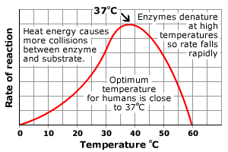
Effect of Temperature:
Increase in temperature gives molecules greater kinetic energy and they move around more quickly increasing the chance of molecules colliding. This causes an enzyme controlled reaction to increase its rate of reaction.
As a general rule, the rate of reaction doubles for each 10⁰C rise in temperature until an OPTIMUM temperature is reached. For most enzymes this is 40⁰C.
Above this temperature the increasing vibration of the molecules cause the hydrogen bonds to break and cause a change in the tertiary structure of the enzyme. This alters the active site of the enzyme.
The enzyme is then said to be DENATURED. This is a permanent change in the structure . At low temperatures, the enzyme in inactivated as the molecules have no kinetic energy. However, the enzyme can work again if the temperature is raised!

Slide 12
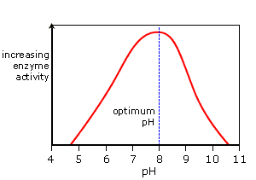
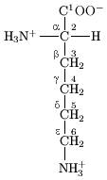
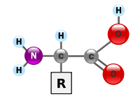
Effect of pH:
The rate of an enzyme catalysed reaction will vary with changes in pH. Enzymes have a narrow optimum range and small changes in pH can affect the rate of reaction without affecting the structure of the enzyme.
Small changes in pH outside the optimum can cause small reversible changes in enzyme structure and results in inactivation. Extremes of pH can denature the enzyme.
The charges on the amino acid side-chains of the enzyme’s active site are affected by free hydrogen ions or hydroxyl ions.
In the formation of an enzyme substrate complex the charge on the active site must match those of the substrate. E.g. if the active site has too many H⁺ ions, the active site and the substrate may both have the same charge and the enzyme will repel the substrate.
At extremes of pH, the hydrogen bonding is affected and the 3D shape of the enzyme is altered and so is the shape of the active site.

Slide 13
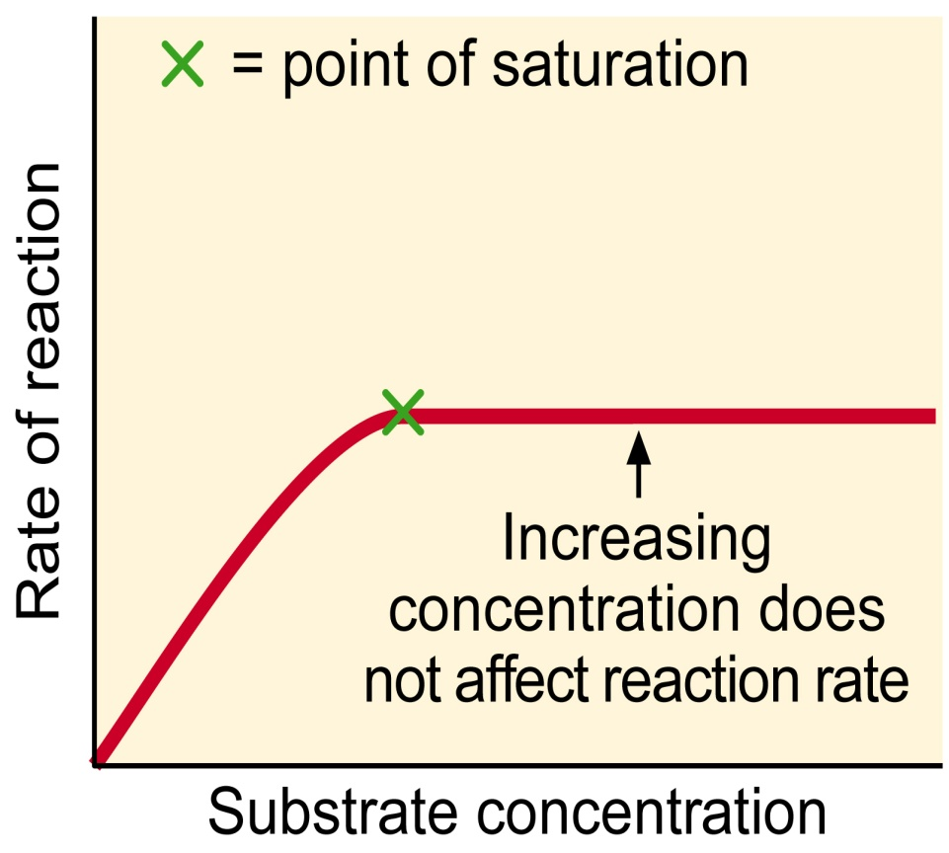
Concentration:
SUBSTRATE CONCENTRATION – the rate of an enzyme catalysed reaction will vary with changes in substrate concentrations.
If the amount of enzyme is constant the rate of reaction will increase as the substrate increases.
But there must come a point when all the enzyme’s active sites are working to full capacity i.e. all the active sites are filled.
ENZYME CONCENTRATION – the rate of an enzyme catalysed reaction will vary the changes in enzyme concentration.
Increasing the enzyme concentration will increase the rate of reaction.

Slide 14
YOU ARE GOING TO FIND OUT HOW TEMPERATURE AFFECTS AMYLASE ACTIVITY
Method
Place 2 cm³ of the starch solution into a test tube
Add 1 cm³ saliva (containing amylase) to a second test tube
Place both test tubes into the water bath at the temperature you are using
Leave them there for 2 minutes (THINK: WHY?)
Carefully pour the saliva into the starch solution starting the stop clock at the same time
At 30 second intervals, use a pipette to remove a few drops of the reaction mixture from the test tube and add it to the iodine in one of the dimples in the spotting tile
Record the time when the iodine does not change colour i.e. stays yellow / brown when you add the reaction mixture
In your book, draw a table to show all the class results
Compare the activity of the amylase enzyme at each temperature. Plot a graph of temperature of the reaction against time taken to digest all the starch

Slide 15
Questions
What is the independent variable in this experiment?
Why is it important to have a range of values for the independent variable?
What is the dependent variable in this experiment?
How did you make sure that the measurements of the dependent variable were reliable?
Measurement of the dependent variable was a quantitative measure. What does this mean?
Variable which could affect the result
Why it would have this effect
What other variables could have affected how well the amylase worked? Why would they have this effect? (fill in the table below)
What control should you have done for this experiment? What would this have shown you?

Slide 16
http://www.youtube.com/watch?v=GHNs4NuuF5k

Slide 17
Objectives You should be able to...
3.6 Enzymes
3.6.1 Define enzyme and active site .
3.6.2 Explain enzyme–substrate specificity.
3.6.3 Explain the effects of temperature, pH and substrate concentration on enzyme activity.
3.6.4 Define denaturation .
3.6.5 Explain the use of lactase in the production of lactose-free milk.
7.6 Enzymes
7.6.1 State that metabolic pathways consist of chains and cycles of enzyme catalysed
reactions.
7.6.2 Describe the induced-fit model.
7.6.3 Explain that enzymes lower the activation energy of the chemical reactions
that they catalyse.
7.6.4 Explain the difference between competitive and non-competitive inhibition,
with reference to one example of each.
7.6.5 Explain the control of metabolic pathways by end-product inhibition, including
the role of allosteric sites.

Slide 18
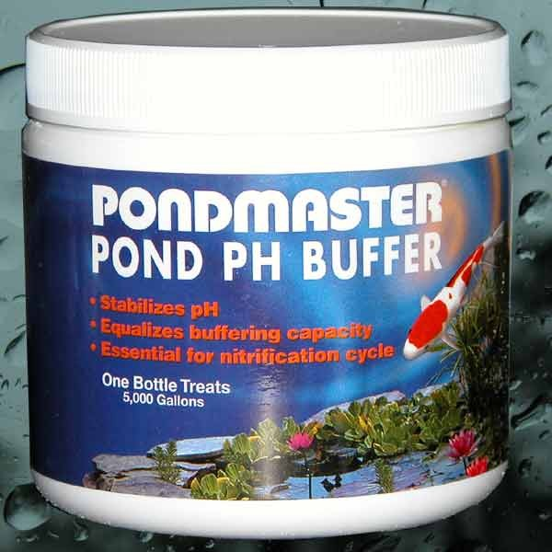
Enzyme Experiments:
In enzyme experiments it is essential that buffers and controls are used.
BUFFERS – maintain a constant pH. When a buffer is used in an experiment the pH changes little when a small quantity of acid or alkali is added.
It can be said that a buffer ‘soaks up hydrogen ions (H⁺)’.
CONTROL – controls are duplicate experiments, identical in every respect to the actual experiment, except for the variable being investigated, which is kept constant.
For example, boiled enzyme may be used in a control experiment instead of the enzyme.

Slide 19
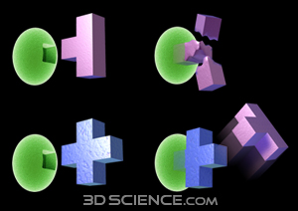
Enzyme Inhibitors:
Inhibition occurs when enzyme action is slowed down or stopped by another substance. The inhibitor combines with the enzyme and stops it forming an enzyme-substrate complex.
There are two types of inhibitor:
COMPETITIVE INHIBITOR
NON-COMPETITIVE INHIBITOR

Slide 20
Competitive Inhibitors:
The inhibitor is structurally similar to the substrate and competes with the active site for the enzyme.
I.e. the inhibitor has a shape that lets it fit into the active site of the enzyme in place of the substrate.
For example, malonic acid competes with succinate for the active sites of succinic dehydrogenase, an important enzyme in the Krebs cycle in respiration.
If the substrate concentration is increased it will reduce the effect of the inhibitor.
This is because the more substrate molecules present the greater the chance of finding active sites, leaving fewer to be occupied by the inhibitor.

Slide 21
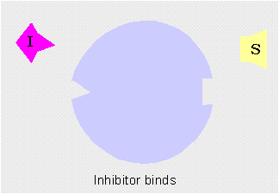
Non-Competitive Inhibitors:
These inhibitors bind to the enzyme at a site away from the active site.
This alters the overall shape of the enzyme molecule, including the active site, in such a way that the active site can no longer accommodate the substrate.
As the substrate and inhibitor molecules attach to different parts of the enzyme they are not competing for the same sites.
The rate of reaction is therefore unaffected by substrate concentration.
For example, cyanide (a respiratory poison) attached itself to part of the enzyme, cytochrome oxidase, and inhibits respiration.

Slide 22
Objectives I should be able to…
3.6.5 Explain the use of lactase in the production of lactose-free milk.

Slide 23
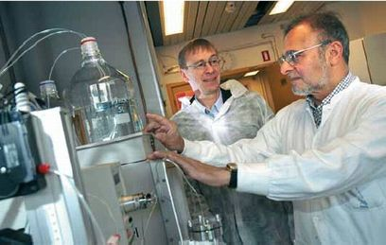
Enzymes in Industry
describe how enzymes can be immobilised;
explain why immobilised enzymes are used in large-scale production;

Slide 24
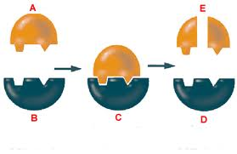
Enzymes as Catalysts
Enzymes are used to speed up chemical (metabolic) reactions e.g. respiration or photosynthesis- so why use enzymes in industry?
They are specific
can catalyse reactions between specific chemicals, even in a large mixture
form fewer bi-products
less purification needed
Function well at relatively low temperatures saving money on fuel costs
Enzymes from thermophilic bacteria can be extracted and used at high temperatures

Slide 25
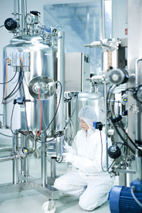
Isolating Enzymes
In some biotechnological processes, whole organisms are cultured to generate products, however when you need a single product, it is more efficient to isolate the enzyme
They can be isolated in large quantities
The extraction of enzymes from a fermentation mixture is known as downstream processing which is the separation and purification of any product of large scale fermentations

Slide 26
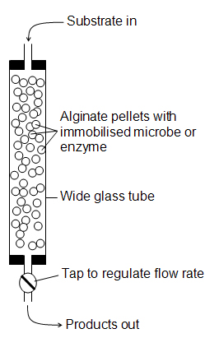
Immobilising Enzymes
Enzyme-substrate complexes must be formed in order to gain the products
The easiest way is to mix the isolated enzyme with the substrate, however the product must then be separated which can be a costly process
It is therefore possible to immobilise enzymes so they can catalyse the reaction without mixing freely

Slide 27
Advantages of Immobilised Enzymes
Enzyme not mixed with products so purification/ downstream processing costs are low
Enzymes available immediately for re-use which is good for continuous processes
The enzymes are more stable as the immobilising matrix protects the enzyme molecules

Slide 28
Disadvantages of Immobilised Enzymes
Additional time, equipment and materials needed, so expensive to set up
Can be less active as they do not mix freely with the substrate
Contamination can be costly if it occurs as the whole system needs to be stopped

Slide 29
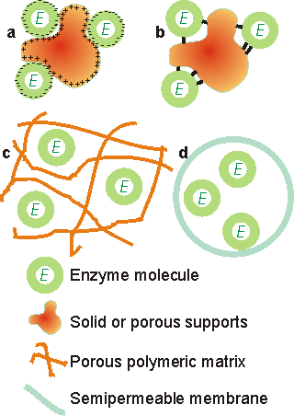
There are four principal methods available for immobilising enzymes
adsorption
covalent binding
entrapment
membrane confinement
Figure 3.1. Immobilised enzyme systems. (a) enzyme non-covalently adsorbed to an insoluble particle; (b) enzyme covalently attached to an insoluble particle; (c) enzyme entrapped within an insoluble particle by a cross-linked polymer; (d) enzyme confined within a semipermeable membrane.

Slide 30
Immobilisation in a Nutshell
Method | Description
Adsorption | Enzyme mixed with immobilising supports e.g. porous carbon, glass beads, clay & resins with hydrophobic interactions and ionic links*. Detachment is possible due to weak bonds but reaction rates are high if active site is displayed.
Covalent Bonding | Enzymes covalently linked to insoluble material e.g. clay using cross linking agent (gluteraldehyde/sepharose) Binding is strong, so very little enzyme leakage, but small quantities only
Entrapment | Enzymes trapped in a gel bead or cellulose fibre network. Active sites are not affected, but reaction rates reduced if substrate can’t get through trapping barrier
Membrane Separation | Enzymes separated by a partially permeable membrane. Enzyme on one side, substrate on another. Substrate molecules and products can pass across the membrane.
*An ionic bond is a type of chemical bond formed through electrostatic attraction between two oppositely charged ions.

Slide 31
PPT
Weird cat

Slide 32
Cut and stick the advantages and disadvantages of immobilised enzymes
advantages | disadvantages
cost of development is very high | products need less purification as they don't contain the used enzyme
easier to separate the enzyme from the product | reaction can be continuous and so cheaper
enzyme can become detached from its solid support | shape of the active site might be changed when immobilised
enzymes can be reused | shape of the enzyme might be changed when immobilised

Slide 33
advantages | disadvantages
products need less purification as they don't contain the used enzyme | shape of the enzyme might be changed when immobilised
enzymes can be reused | shape of the active site might be changed when immobilised
easier to separate the enzyme from the product | cost of development is very high
reaction can be continuous and so cheaper | enzyme can become detached from its solid support

Slide 34
Timeline of enzyme discovery
1835:
Breakdown of starch to sugar by malt
1877:
Name enzyme coined to describe chemicals in yeast that ferment sugars
1897:
Eduard Buchner extracted enzyme from yeast and showed it could work outside cells
1905:
Otto Rohm exyracted pancreatic proteases to supply enzymes for tanning
1926:
James B Sumner produced first pure crystalline enzyme (urease) and
showed enzymes were proteins
1930-1936:
Protein nature of enzymes finally established when digestive enzymes
crystallised by John H Northrop
1946: Sumner finally awarded Nobel prize

Slide 35
You should be able to…
7.6.4 Explain the difference between competitive and non-competitive inhibition, with reference to one example of each.
7.6.5 Explain the control of metabolic pathways by end-product inhibition, including the role of allosteric sites.

Slide 36
Properties of Enzymes:
Enzymes are specific i.e. each enzyme will catalyse only one particular reaction, for example, sucrASE acts on the sugar, sucrOSE.
Enzymes are very efficient and have a high TURNOVER NUMBER.
This means that they can convert many molecules of substrate per unit time, for example, catalase, which breaks down the waste product hydrogen peroxide in the body, has a turnover number of several million!
Chemical reactions need energy to start them off and this is called ACTIVATION ENERGY.
This energy is needed to break the existing chemical bonds inside molecules.
In the body enzymes lower the activation energy of a reaction and so reduce the input of energy needed and allow reactions to take place at lower temperatures.

Slide 37
Factors Affecting the Rate of Enzyme Action:
Enzymes are made inside living cells but may act inside the cell (INTRAcellular) or outside (INTERcellular, EXTRAcellular) such as the digestive enzymes of the alimentary canal.
Environmental conditions can change the 3D structure of enzyme molecules.
Bonds are broken and hence the configuration of the active site is altered.
TEMPERATURE
SUBSTRATE CONCENTRATION
pH
ENZYME CONCENTRATION

Slide 38
Effect of Temperature:
Increase in temperature gives molecules greater kinetic energy and they move around more quickly increasing the chance of molecules colliding. This causes an enzyme controlled reaction to increase its rate of reaction.
As a general rule, the rate of reaction doubles for each 10⁰C rise in temperature until an OPTIMUM temperature is reached. For most enzymes this is 40⁰C.
Above this temperature the increasing vibration of the molecules cause the hydrogen bonds to break and cause a change in the tertiary structure of the enzyme. This alters the active site of the enzyme.
The enzyme is then said to be DENATURED. This is a permanent change in the structure . At low temperatures, the enzyme in inactivated as the molecules have no kinetic energy. However, the enzyme can work again if the temperature is raised!

Slide 39
Effect of pH:
The rate of an enzyme catalysed reaction will vary with changes in pH. Enzymes have a narrow optimum range and small changes in pH can affect the rate of reaction without affecting the structure of the enzyme.
Small changes in pH outside the optimum can cause small reversible changes in enzyme structure and results in inactivation. Extremes of pH can denature the enzyme.
The charges on the amino acid side-chains of the enzyme’s active site are affected by free hydrogen ions or hydroxyl ions.
In the formation of an enzyme substrate complex the charge on the active site must match those of the substrate. E.g. if the active site has too many H⁺ ions, the active site and the substrate may both have the same charge and the enzyme will repel the substrate.
At extremes of pH, the hydrogen bonding is affected and the 3D shape of the enzyme is altered and so is the shape of the active site.

Slide 40
Concentration:
SUBSTRATE CONCENTRATION – the rate of an enzyme catalysed reaction will vary with changes in substrate concentrations.
If the amount of enzyme is constant the rate of reaction will increase as the substrate increases.
But there must come a point when all the enzyme’s active sites are working to full capacity i.e. all the active sites are filled.
ENZYME CONCENTRATION – the rate of an enzyme catalysed reaction will vary the changes in enzyme concentration.
Increasing the enzyme concentration will increase the rate of reaction.

Slide 41
Inhibition of enzymes
Inhibitors slow down the rate of a reaction
Competitive inhibitors: these molecules have a similar structure to the actual substrate and so will bind temporarily with the active site.
Non-competitive inhibitors: these molecules are not necessarily anything like the substrate in shape. They bind with the enzyme, but not at the active site.

Slide 42
Enzyme Inhibitors:
Inhibition occurs when enzyme action is slowed down or stopped by another substance. The inhibitor combines with the enzyme and stops it forming an enzyme-substrate complex.
There are two types of inhibitor:
COMPETITIVE INHIBITOR
NON-COMPETITIVE INHIBITOR

Slide 43
Competitive Inhibitors:
The inhibitor is structurally similar to the substrate and competes with the active site for the enzyme.
I.e. the inhibitor has a shape that lets it fit into the active site of the enzyme in place of the substrate.
For example, malonic acid competes with succinate for the active sites of succinic dehydrogenase, an important enzyme in the Krebs cycle in respiration.
If the substrate concentration is increased it will reduce the effect of the inhibitor.
This is because the more substrate molecules present the greater the chance of finding active sites, leaving fewer to be occupied by the inhibitor.

Slide 44
Non-Competitive Inhibitors:
These inhibitors bind to the enzyme at a site away from the active site.
This alters the overall shape of the enzyme molecule, including the active site, in such a way that the active site can no longer accommodate the substrate.
As the substrate and inhibitor molecules attach to different parts of the enzyme they are not competing for the same sites.
The rate of reaction is therefore unaffected by substrate concentration.
For example, cyanide (a respiratory poison) attached itself to part of the enzyme, cytochrome oxidase, and inhibits respiration.

Slide 45
http://www.stolaf.edu/people/giannini/flashanimat/enzymes/allosteric.swf
http://www.heartfailurematters.org/EN/Animation/Pages/animation_7.aspx
http://www.wiley.com/college/pratt/0471393878/student/animations/enzyme_inhibition/index.html

Slide 46
http://www.kscience.co.uk/animations/model.swf

Slide 47
Plenary
Inhibition q

Slide 48
