Slide 1
Chloroplasts
07/02/2014
Starter
What does a chloroplast do?
What features do you think a chloroplast needs to effectively do it’s job?

Slide 2
Objectives
3.8.1 State that photosynthesis involves the conversion of light energy into chemical energy.
3.8.2 State that light from the Sun is composed of a range of wavelengths (colours).
3.8.3 State that chlorophyll is the main photosynthetic pigment.
3.8.4 Outline the differences in absorption of red, blue and green light by chlorophyll.
8.2.1 Draw and label a diagram showing the structure of a chloroplast as seen in electron micrographs.
3.8.7 Explain that the rate of photosynthesis can be measured directly by the production of oxygen or the uptake of carbon dioxide, or indirectly by an increase in biomass.

Slide 3
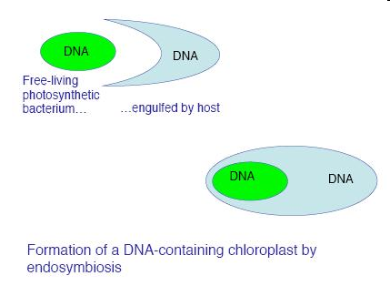
Evolution of the chloroplast
It is believed that photosynthetic bacteria were acquired by eukaryotic cells
By endocytosis (engulfing)
To produce the first algal/plant cell
This is called the “endosymbiont theory”
They were then passed on to the next generation

Slide 4
Current organisms trying endosymbiosis to get chloroplasts
Two types of marine molluscs currently engulf algae and incorporate their chloroplasts to allow them to make complex molecules
However, they have not yet found a way of passing these to the next generation

Slide 5
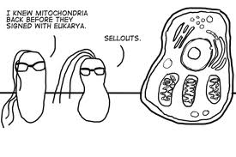
http://www.youtube.com/watch?v=5T3U51yzdEg
Sea slugs

Slide 6
Echalk bouncing ph.syn. quiz

Slide 7
Photosynthetic pigments
Absorb certain wavelengths of light
Reflect other wavelengths (these are the colours we see)
Arranged in photosystems in thylakoid membranes

Slide 9
Chlorophylls
Chlorophyll a
Is in the “Primary pigment reaction centre”
Two forms
P₆₈₀ – in photosystem 2
P₇₀₀ – in photosystem 1
Appears yellow-green
Absorbs red light (and blue at 450nm)
contains a Mg atom – when light hits this, a pair of electrons become excited

Slide 10
Accessory pigments
Chlorophyll b
Absorbs light at wavelengths between 500-640nm
It appears blue-green
Is one of the accessory pigments
Carotenoids
Absorb blue light
Reflects yellow (xanthophyll) and orange (carotene) light
They absorb light not normally absorb by chlorophylls – then pass

Slide 11
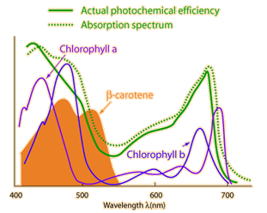

Slide 12
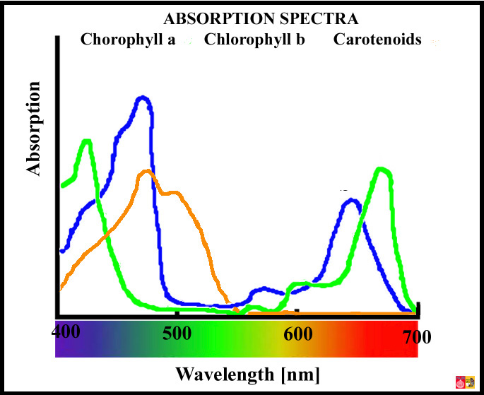

Slide 13
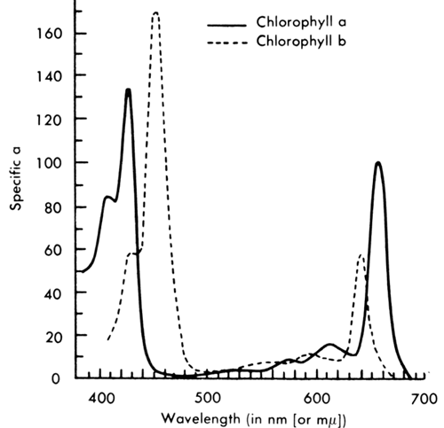

Slide 14
Separation of Chlorophyll Pigments by Paper Chromatography
Immerse a few spinach leaves in boiling water. Remove and dry.
Grind up the leaves in a pestle and mortar with a small quantity of pure acetone.
Draw a pencil line 30mm from one end of the chromatography paper and use a capillary tube to put a drop of the chlorophyll solution on the centre of the line (do this carefully).
Allow this to dry (try placing it near a heat source e.g. lamp, or using a fan).
Add a second drop on top of the first, again let it dry. Then repeat this for at least 15 minutes (20 is better). The smaller and more concentrated the spot the better.
Pour approximately 20mm of chromatography solvent (solvent 2 – acetone and petroleum ether) into a boiling tube and suspend the chromatography paper into it, so that the bottom is immersed (but the pencil line is not).
The solvent will ascend rapidly and the pigments should separate in 10 minutes. When the solvent front is approximately 20mm from the top remove the paper and draw a line to show the solvent front and dry the paper.

Slide 15
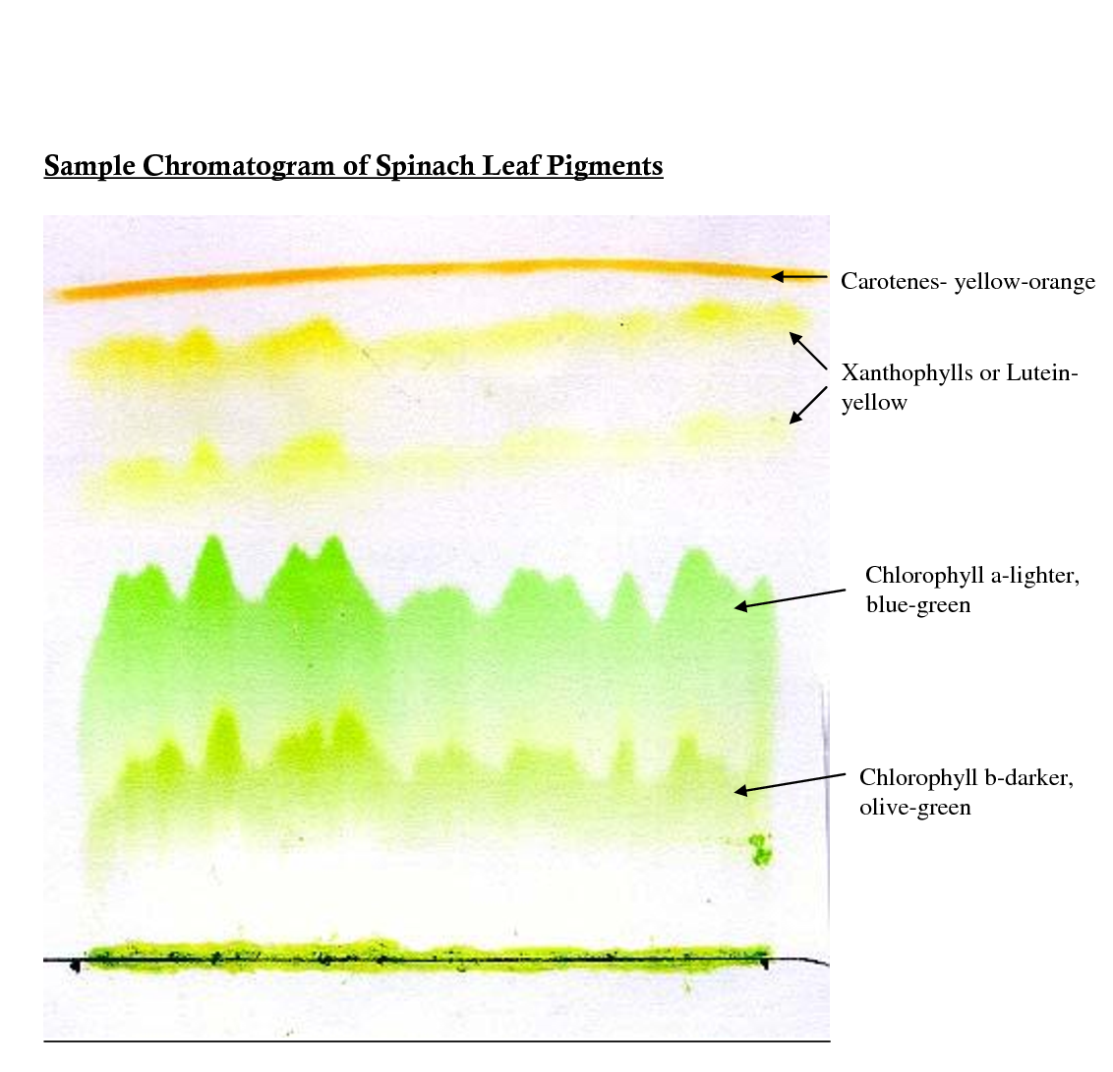
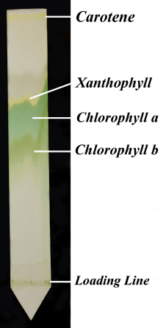

Slide 17
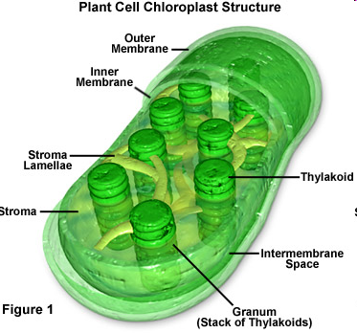
Chloroplast structure

Slide 18
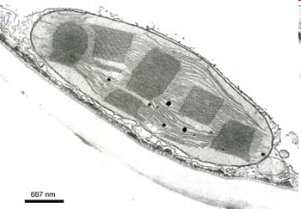
Size and Shape
Can vary
Usually between 2-10µm in length
Usually disc shaped

Slide 19
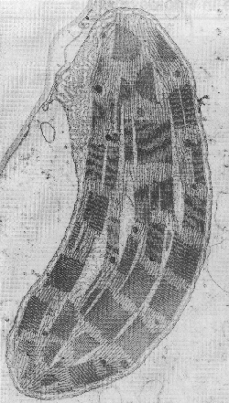
Electron micrograph

Slide 20
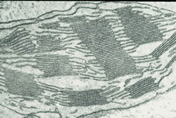

Slide 21
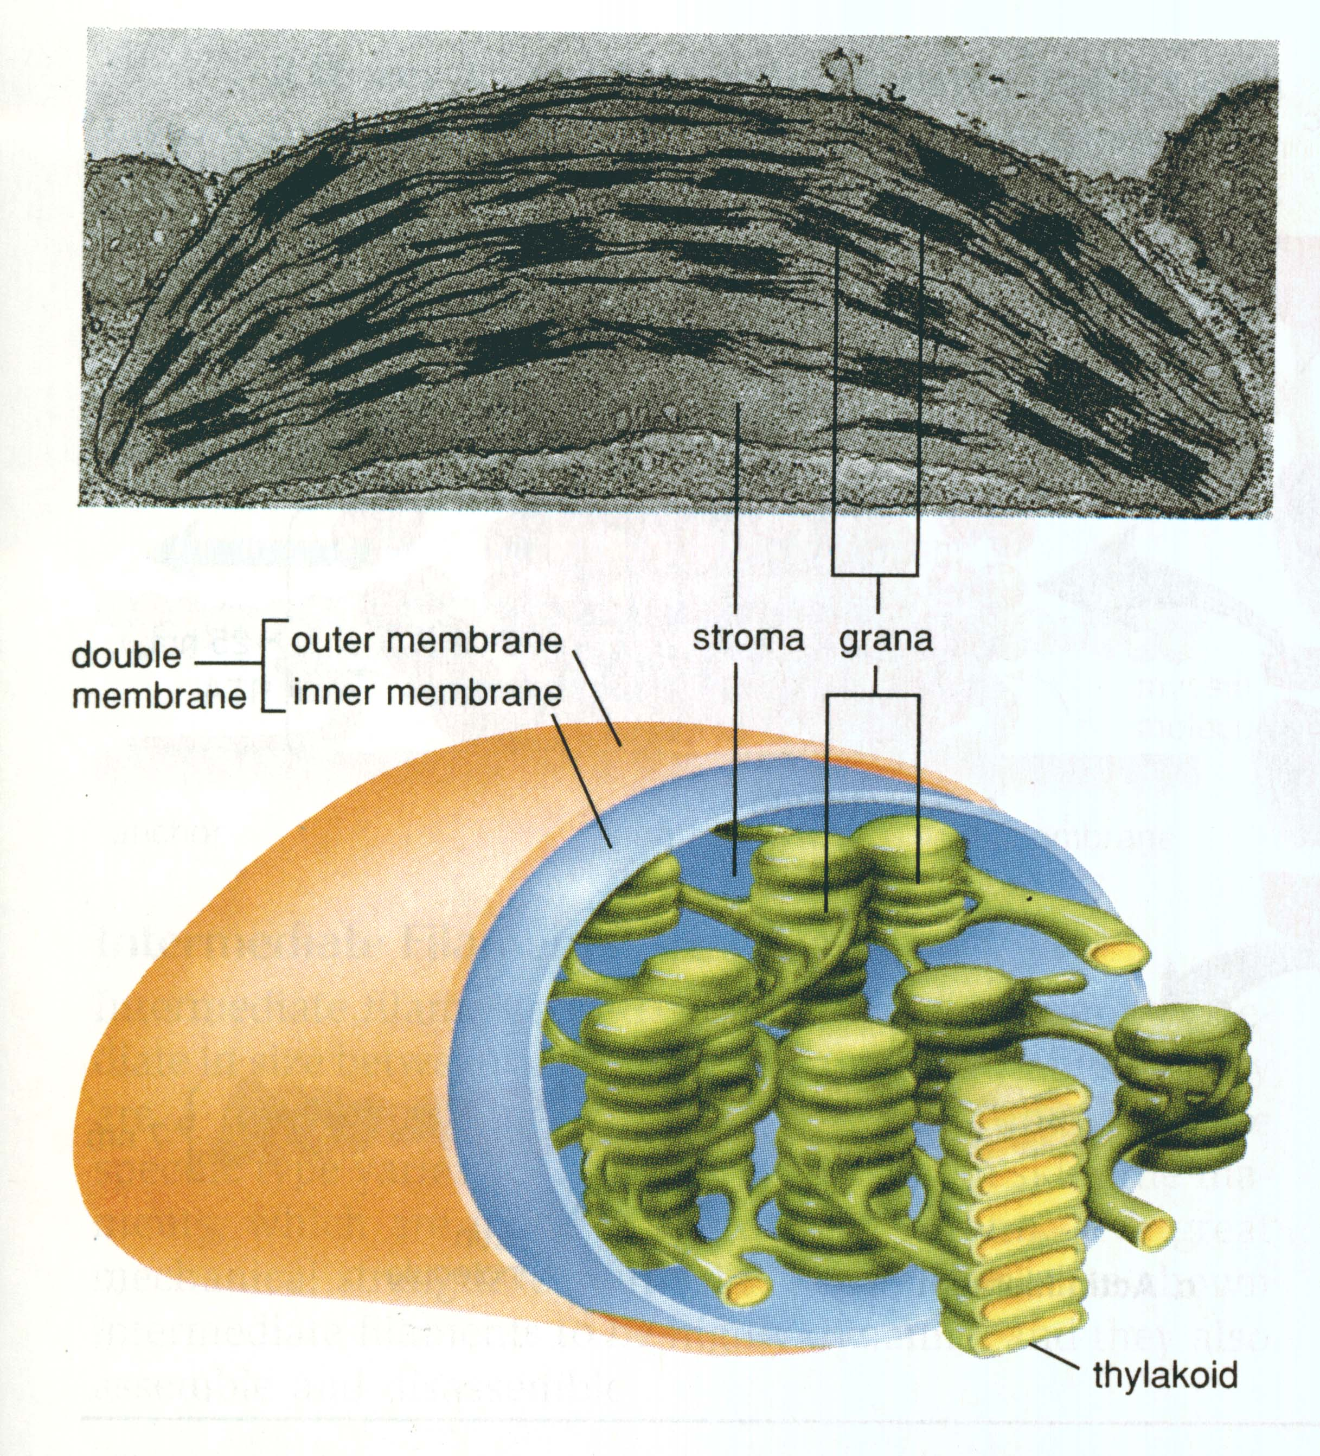

Slide 22
Membranes
Double (phospholipid) membrane;
Outer membrane – permeable to many small ions
Inner membrane – less permeable and has transport proteins embedded in it
Intermembrane space is 10–20nm wide between the inner and outer membrane

Slide 23
Lamellae and thylakoids
The inner membrane is folded into lamellae (thin plates) aka thylakoids
The lamellae (thylakoids) are stacked in piles called granum
Between the grana are intergranal lamellae

Slide 24
Stroma
Fluid-filled matrix
The light-independent stage of photosynthesis occurs here
Contains starch grains, oil droplets, DNA and ribosomes

Slide 25
Grana
Contains stacks of thylakoids
Where the light-dependant stage of photosynthesis takes place
Absorb light and make ATP

Slide 26
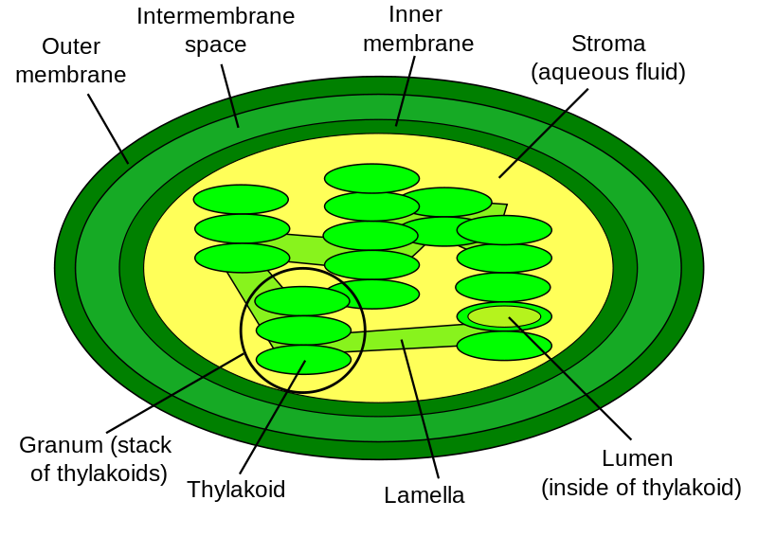
Diagram labelling quick-draw
B
C
A
D
E
H
F
G

Slide 27
Diagram labelling quick-draw

Slide 28
You should be able to…
3.8.5 State that light energy is used to produce ATP, and to split water molecules (photolysis) to form oxygen and hydrogen.
3.8.6 State that ATP and hydrogen (derived from the photolysis of water) are used to fix carbon dioxide to make organic molecules. 8.2.2 State that photosynthesis consists of light-dependent and light-independent reactions.

Slide 29
Oxidation and reduction – always take place together
Oxidation
Reduction
Addition of oxygen
Loss of electrons
Loss of hydrogen
Energy given out
Loss of oxygen
Gains electrons
Gains hydrogen
Energy taken in

Slide 31
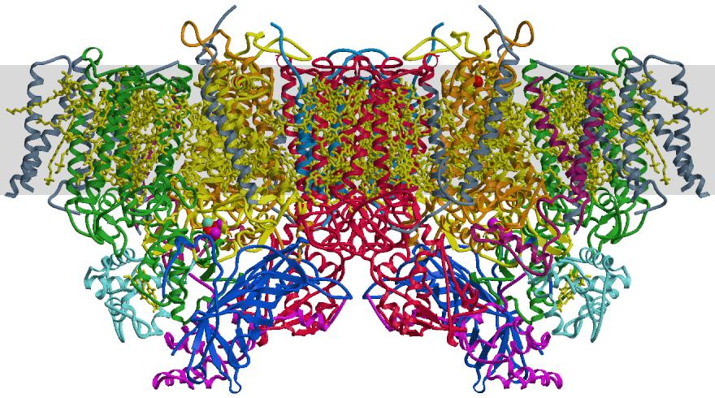

Slide 32
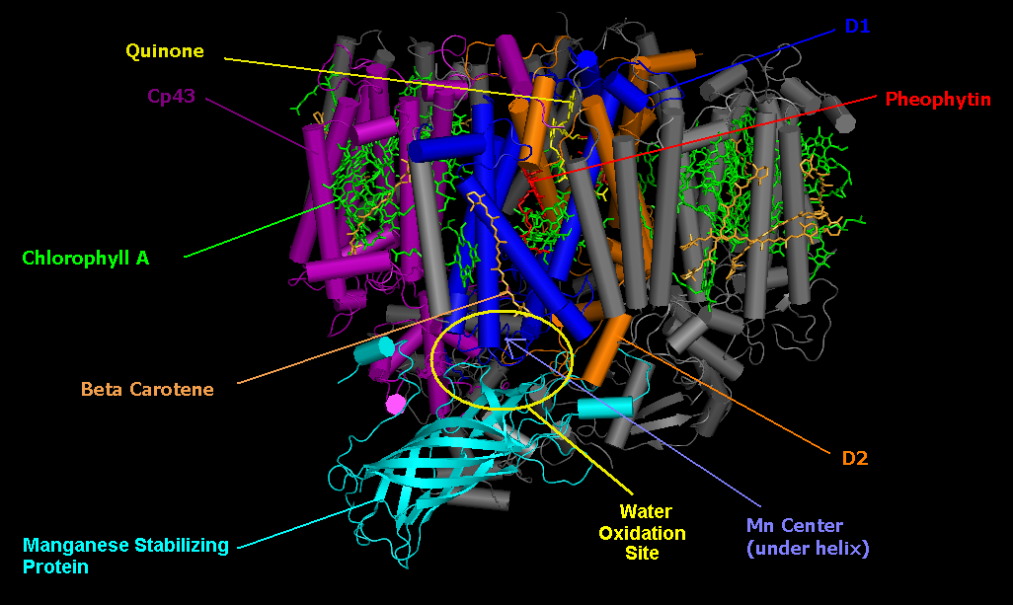

Slide 33
Pigments and photosystems
Chloroplasts contain photosynthetic pigments to absorb the light energy
Pigments are chlorophyll a, chlorophyll b and carotene
The pigments are found in the thylakoid membranes attached to proteins.
The protein and pigment are called a photosystem
Two photosystems used by plants to absorb light are PSI ( 700nm wavelength) and PSII ( 680nm wavelength)

Slide 34
Photosynthesis
Photosynthesis can be split into two stages
The light-dependent reaction
The light-independent reaction – AKA the Calvin Cycle

Slide 35
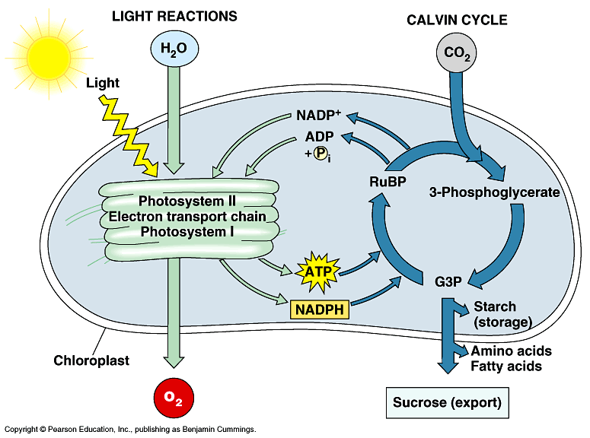

Slide 36
Light dependent reaction
This reaction needs light energy
Takes place in the thylakoid membranes
Light energy absorbed by photosynthetic pigments in the photosystems and converted to chemical energy
Light energy is used to add inorganic phosphate to ADP to form ATP
And reduce NADP to form reduced NADP
ATP transfers energy and reduced NADP transfers hydrogen to the light independent reaction
During the process H₂O is oxidised to O₂

Slide 37
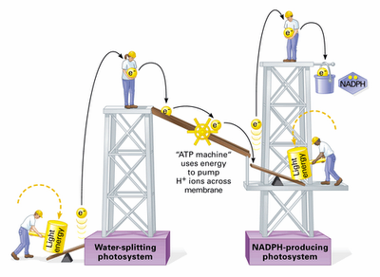
Analogy

Slide 38
Photosynthesis Animations

Slide 39
Photophosphorylation and photolysis
In the light-dependent reaction, the light energy absorbed by the photosystems is used for three things:
Making ATP from ADP and P_{i} – this is known as photophosphorylation
Making reduced NADP from NADP
Splitting water into protons( H⁺ ions), electrons and oxygen. This is called photolysis

Slide 40
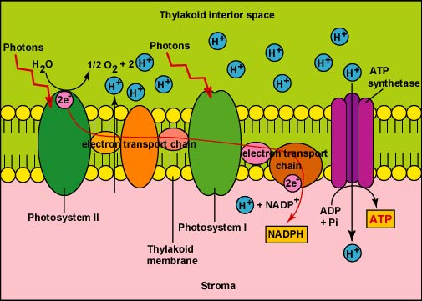
Light-dependent reaction

Slide 41
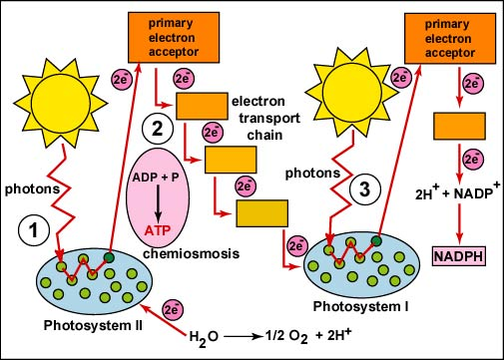
1

Slide 42
Non-cyclic photophosphorylation
Produces ATP, reduced NADP and O₂
Photosystems in the thylakoid membranes are linked by electron carriers
Electron carriers are proteins that transfer electrons
The photosystems and their electron carriers form an electron transport chain – a chain of proteins through which excited electrons flow

Slide 43
Light energy excites electrons in chlorophyll
Light energy is absorbed by PSII
Light energy excites electrons in chlorophyll
The electrons move to a higher energy level
These high energy electrons move along the electron transport chain to PSI

Slide 44
Photolysis of water produces protons ( H⁺ ions), electrons and O₂
As the excited electrons from chlorophyll leave PSII to move along the electron transport chain, they must be replaced
Light energy splits water into protons (H^{+ ions}), electrons and oxygen
H₂O 2H⁺ + 1/2 O₂

Slide 45
Energy from the excited electrons makes ATP
The excited electrons lose energy as they move along the electron transport chain
This energy is used to transport protons into the thylakoid so that the thylakoid has a higher concentration of protons than the stroma. This forms a proton gradient across the membrane
Protons move down their concentration gradient, into the stroma, via an enzyme ATP synthase. The energy from this movement combines ADP and P_{i} to form ATP
Chemiosmosis is the name of the process where the movement of H⁺ ions across a membrane generates ATP – this also occurs in respiration

Slide 46
Generation of reduced NADP
Light energy is absorbed by PSI, which excites the electrons again to an even higher energy level
Finally, the electrons are transferred to NADP, along with a proton (H⁺ ion) from the stroma, to form reduced NADP

Slide 47
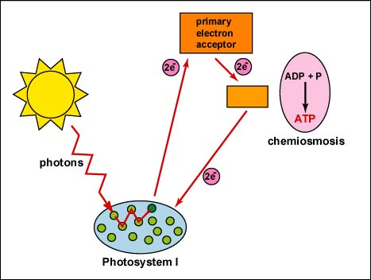
Cyclic photophosphorylation
Only uses PSI
Cyclic because the electrons used aren’t passed to NADP, but passed back to PSI via electron carriers
Electrons recycled and used repeatedly to flow through PSI
Produces small amounts of ATP

Slide 48
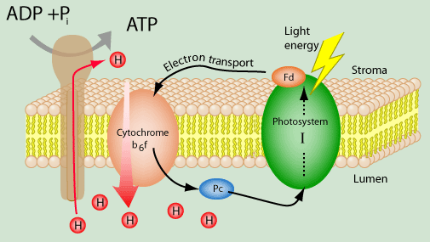
Cyclic photophosphorylation

Slide 49
Exam question
Outline the light-dependent reactions of photosynthesis.
(6)

Slide 50
(b) (chlorophyll/antenna) in photosystem II absorbs light; absorbing light/photoactivation produces an excited/high energy/ free electron; electron passed along a series of carriers; reduction of NADP⁺ / generates NADPH + H⁺; absorption of light in photosystem II provides electron for photosystem I; photolysis of water produces H⁺ / O₂; called non-cyclic photophosphorylation; in cyclic photophosphorylation electron returns to chlorophyll; generates ATP by H⁺ pumped across thylakoid membrane / by chemiosmosis / through ATP synthetase/synthase; 6 max

Slide 51
Photosynthesis
with algal balls

Slide 52
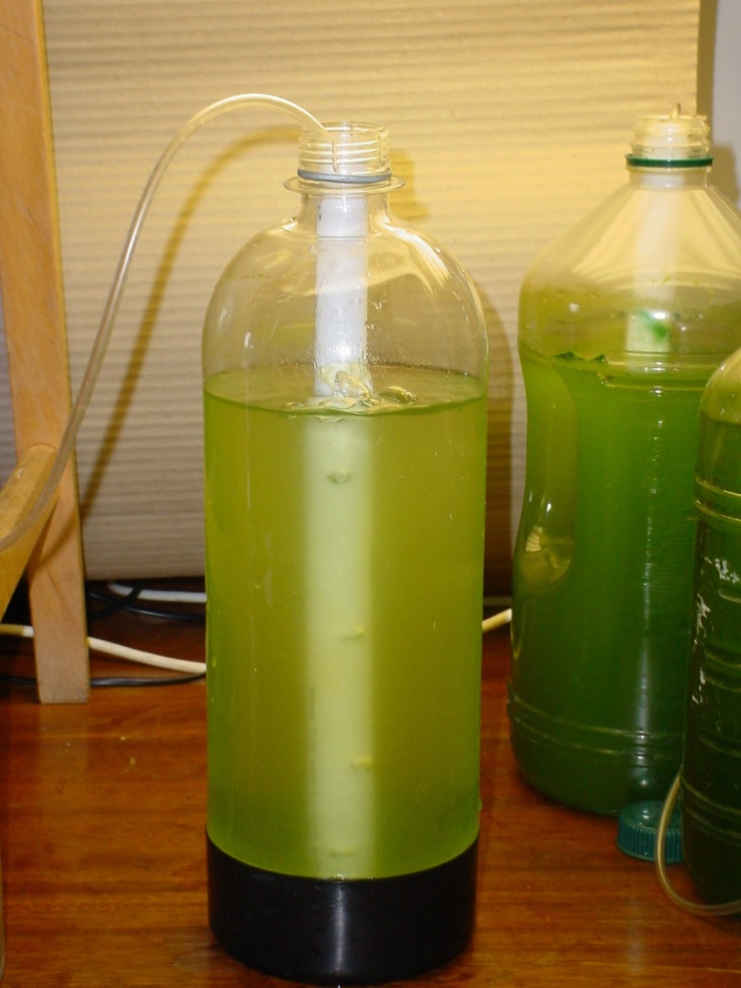
Algae
Scenedesmus and Chlorella -successfully cultured in the laboratory

Slide 53
Algae
Immobilised algae to demonstrate rates of photosynthesis
Algae ‘trapped’ in sodium alginate so that:
numbers can be regulated
they can be separated from the medium

Slide 54
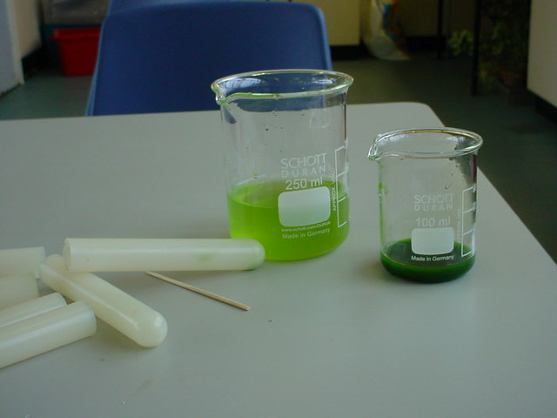

Slide 55
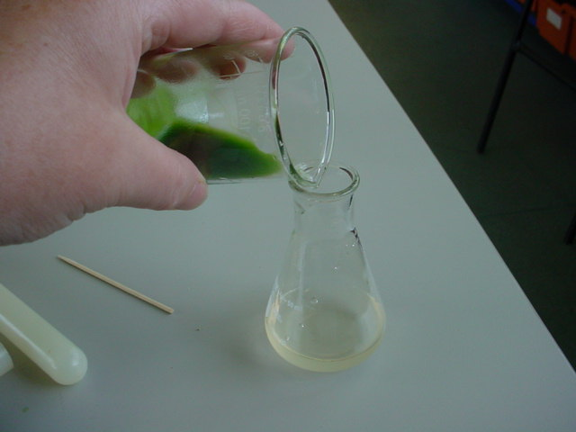

Slide 56
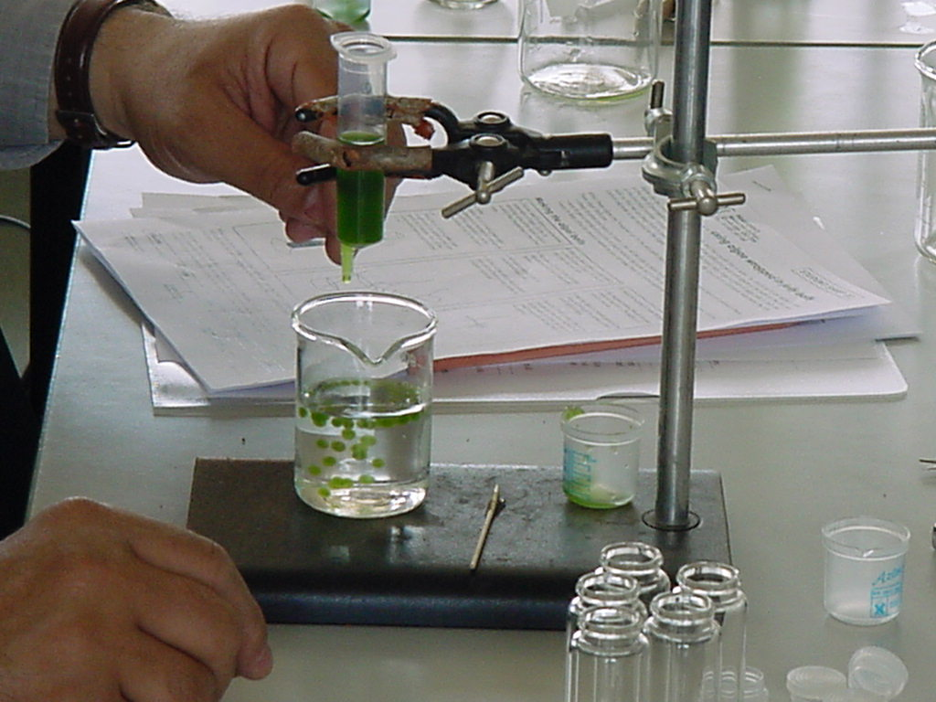
Notes:
Preparing the algal balls

Slide 57
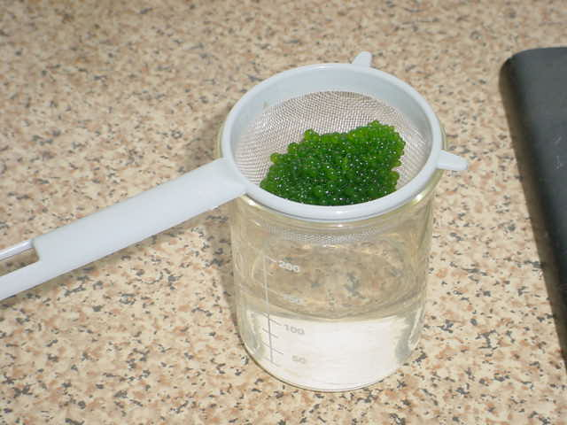

Slide 58
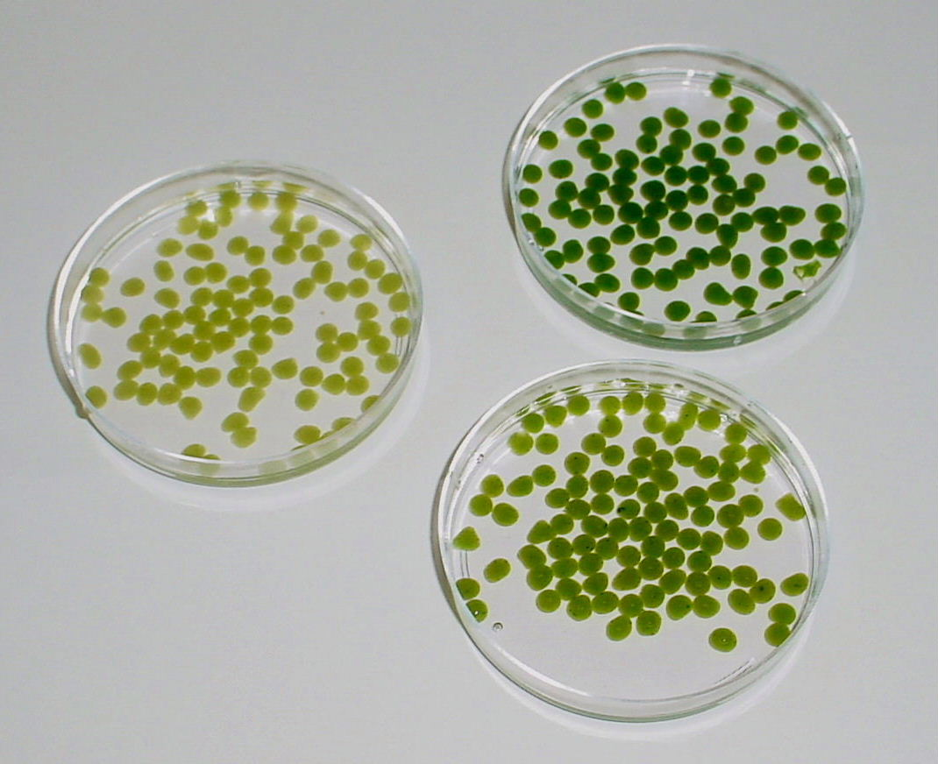

Slide 59
Hydrogencarbonate indicator
Hydrogen carbonate indicator:
routinely used to measure CO₂ levels in aquatic systems.
red in equilibrium with atmospheric air
becomes more orange/yellow with increased CO₂
changes from red through magenta to deep purple as CO₂ is removed.

Slide 60
Hydrogencarbonate indicator
Notes:
Buffers 7.6 –9.2

Slide 61
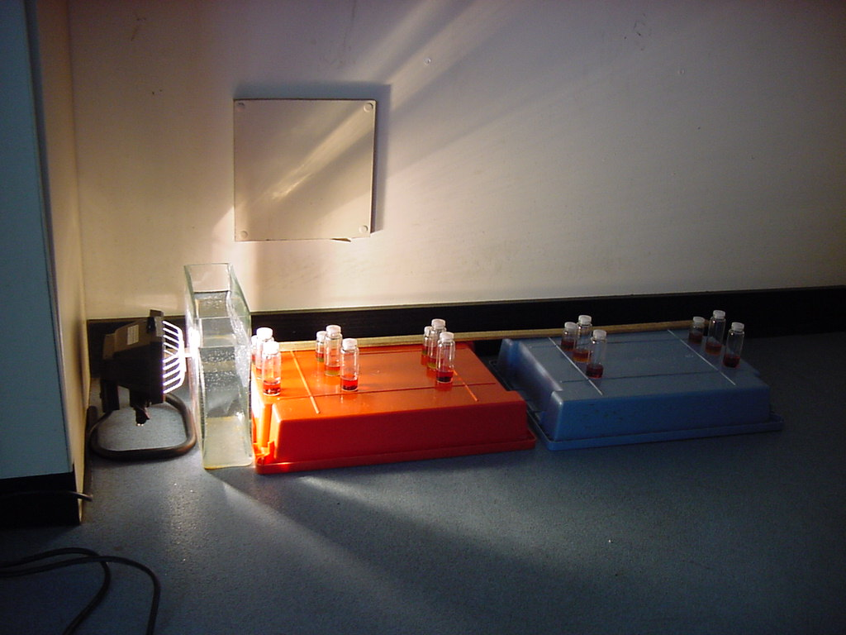
Notes:
Placing the tubes at different distances from the light source

Slide 62
Variables?
Colour of light
Light Intensity
Distance from lamp
Neutral density experiment
Number of balls
Ball size
Concentration of algae
Temperature
Starting [CO₂] etc...
Notes:
The colorimeter we recommend for key stage 4 use is the WPA colorimeter

Slide 63
Can we quantify the colour change?
Yes!
By measuring the absorbance using a colorimeter
By comparing the colours to a range of prepared buffer solutions.
Notes:
The colorimeter we recommend for key stage 4 use is the WPA colorimeter

Slide 64
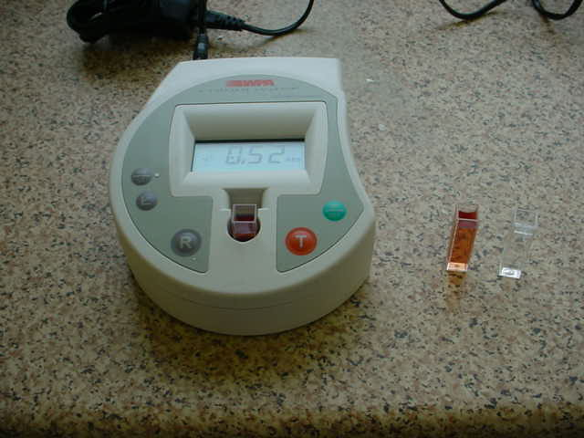

Slide 65
QUESTIONS
What tips would you have for someone making algal beads like this?
What does your graph tell you about photosynthesis and light intensity?
How could you improve this investigation? Do you think the results are valid? Could you make them more reliable?
What do you think about using algal beads in this way?
What else would you like to investigate about photosynthesis? How would you do it?

Slide 66
Answers
Students may have noticed several things important to them. You might have told them about different concentrations of alginate, or different bores of dripping tube.
The rate of photosynthesis depends on light intensity. At low light intensities, the rate of photosynthesis is proportional to light intensity. At higher light intensities, other limiting factors are important.
Students may have a range of ideas how to improve this investigation. The procedure is reliable if there is a good connection between pH change, indicator change and carbon dioxide uptake. The procedure is seen to be reliable if all groups get similar results, if the results are similar when repeated, or if you get the same result in two (or more) containers treated in the same way.
Allow student personal response. Sources say many students think it is a lot of fun!
Open for students to devise and design their own procedures for coursework, or interest.

Slide 67
http://www.thebiologyfaculty.org/a-levels/item/79-harvesting-the-sun-light-dependent-reactions-pt1
http://www.thebiologyfaculty.org/a-levels/item/110-harvesting-the-sun-light-dependent-reactions-pt2

Slide 68
Objectives I should be able to…
8.2.5 Explain the light-independent reactions.

Slide 70
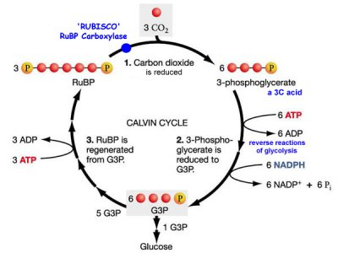
The light-independent reaction AKA The Calvin cycle
Glycerate 3-phosphate
Triose phosphate

Slide 71
The Calvin cycle or carbon fixation
Takes place in the stroma of chloroplasts
Makes a molecule called triose phosphate from carbon dioxide and ribulose bisphosphate – a 5 carbon compound
Triose phosphate can be used to make glucose and other useful organic substances
It needs ATP and H⁺ ions to keep the cycle going
The reactions are linked in a cycle which means the starting compound, ribulose bisphosphate is regenerated

Slide 73
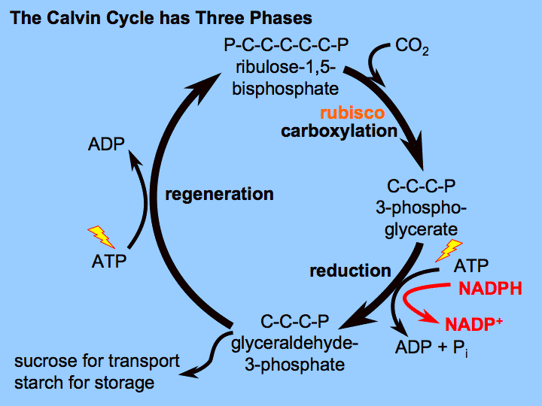
Glycerate 3-phosphate
Triose phosphate

Slide 74
Phase 1 – Carbon dioxide combines with ribulose bisphosphate (RuBP)
CO₂ enters the leaf through stomata and diffuses into the stroma of chloroplasts
Here, it’s combined with RuBP, a 5-carbon compound. This gives an unstable 6-carbon compound which quickly breaks down into two molecules of a 3-carbon compound called glycerate 3-phosphate (GP)
The enzyme Rubisco ( Ribulose bisphosphate carboxylase) catalyses the reaction between the two

Slide 76
Phase 2 – ATP and reduced NADP reduces GP to triose phosphate (TP)
ATP from the light-dependent reaction provides energy to turn the 3-carbon GP into a different 3-carbon compound called triose phosphate (TP)
This reaction also requires H⁺ ions which come from reduced NADP (also from the light-dependent reaction. Reduced NADP is recycled to NADP
TP is then converted into many useful organic compounds such as glucose

Slide 77
Glycerate 3-phosphate
Triose phosphate

Slide 78
Phase 3 – RuBP is regenerated
Five out of every six molecules of TP is used to regenerate RuBP
Regenerating RuBP takes the rest of the ATP produced by the light-dependent reaction

Slide 79
Glycerate 3-phosphate
Triose phosphate

Slide 80
Useful organic substances
Calvin cycle is the starting point for making all organic substances a plant needs
TP and GP are used to make carbohydrates, lipids and proteins
Hexose sugars – two TP
Starch – many hexose sugars
Lipids – fatty acids from GP and glycerol from TP
Proteins – some amino acids from GP

Slide 81
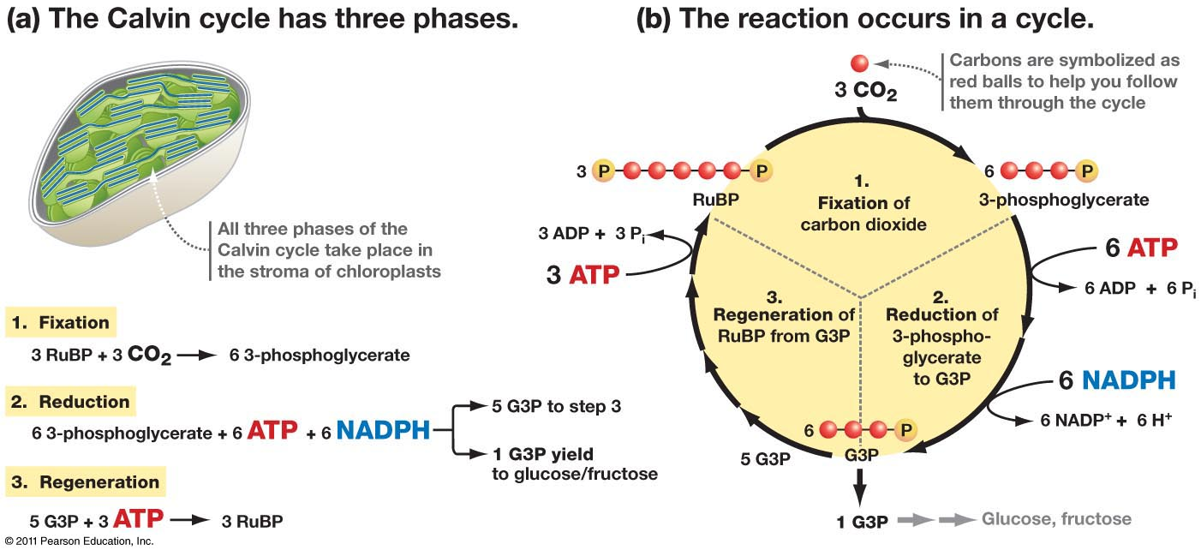
How many turns does the Calvin cycle need to make one hexose sugar?
The Calvin cycle needs six turns to make one hexose sugar
Why?
Three turns of the cycle produces six molecules of TP – two molecules of TP are made for every one CO₂ used
Five out of six of these TP molecules are used to regenerate RuBP
So, for three turns, only one TP is produced that’s used to make a hexose sugar
A hexose sugar has six carbon atoms, so two TP molecules are needed to make one hexose sugar
This means the cycle must turn six times to produce two TP molecules to make one hexose sugar
Six turns of the cycle need 18 ATP and 12 reduced NADP from the light-dependent reaction
Glycerate 3-phosphate
Triose phosphate

Slide 82
http://highered.mcgraw-hill.com/sites/9834092339/student_view0/chapter39/calvin_cycle.html

Slide 83
light strikes the photosynthetic pigments of photosystem II on grana membrane
Light energy is focussed on electrons in a chlorophyll A molecule
The electrons rise in energy content and leave PSII
Light stimulates an enzyme to break a molecule of water in photolysis
The 2 electrons from this molecule replace the electrons lost from PSII
The electrons that left PSII pass down electron carriers; energy is tapped off to join a phosphate group from the stroma to an ADP molecule to make ATP
Light hits PSI; the energy is passed down accessory pigments to chlorophyll on the grana membrane
The electrons from PSII replace the electrons that have left PSI
The electrons in this chlorophyll molecule in PSI absorb the energy, rising them to a higher energy level
The electrons pass down a sequence of electron carriers; energy is tapped off and used to join H+ from water to NADP to make NADPH
Two oxygens from photolysis combine and are evolved as 0₂
The light independent stage now occurs. It uses 2 products from the light dependent stage
These are ATP and NADPH
CO₂ binds with 5 C RuBP
This makes a 6 C molecules which immediately breaks down to 2 3 C molecules
These are called G 3 P or glycerate 3 phosphate
ATP provides energy and NADPH provides H to reduce G 3 P to triose phosphate
5 out of 6 triose phosphates reform 3 RuBP
The sixth triose phosphate is the building block of carbohydrates
These can be modified into proteins or fats

