Slide 1
4.1 The Importance of ATP
Adenosine Tri-Phosphate

Slide 2
You should be able to discuss…
(a) The importance of chemical energy in biological processes. The central role of ATP as an energy carrier and its use in the liberation of energy for cellular activity. Structure of ATP
(b) The synthesis of ATP by means of a flow of protons through the enzyme ATP synthetase. Chemiosmosis and electrochemical gradient. The similarity between mitochondrial and chloroplast membrane function in providing a proton gradient for ATP synthesis.
(c) The maintenance of the proton gradient by proton pumps driven by electron energy. The alternate arrangement of pumps and electron carriers to form the electron transport chain. (Names of proton pumps and electron carriers in the electron transport system are not required).

Slide 3
Energy
“energy can be neither created nor destroyed. However, energy can change forms, and energy can flow from one place to another”
In what forms can you find energy?

Slide 4
Energy’s many forms
There are many different forms of energy.
Can you name some of them:
Light
Heat
Sound
Atomic
Electrical
Kinetic
Magnetic
potential
Chemical potential
Elastic potential
Gravitational potential

Slide 5
Green Plants can convert light into chemical energy
All living organisms can convert energy in one form into another
Energy is measured in Joules

Slide 6
What, specifically, do living things need energy for?
A year 7 answer would be “for growth & repair”.
An A2 answer would be:
Metabolism (particularly anabolism).
Movement (within an organism & of the organism).
Active transport.
Maintenance, repair & cell division.
Homeostasis (particularly of body temperature).
Secretion of chemicals (Eg. Hormones).

Slide 7
If you had to “buy” energy, how much would you pay?
Around £0.79 - £0.81
Its all about ATP!!!
(hee hee hee)

Slide 8
ATP
Adenosine Triphosphate (ATP) is the main energy currency of living cells.
ATP is a small, water soluble molecule.
It is therefore easily transported around the cell.
ATP stores energy as chemical potential energy.
Think of it as a tiny loaded spring.
“Universal Energy Currency” in all living things

Slide 9
The Structure of ATP
Think back to the work on nucleic acids.
This is RNA with its sugar-phosphate backbone and nitrogenous bases.
The sugar is ribose and the bases are Adenine, Uracil, Cytosine or Guanine.

Slide 10
The structure of ATP
Phosphate
Phosphate
Phosphate
Ribose
Sugar
Adenine
Adenosine
Adenosine monophosphate, AMP
Adenosine diphosphate, ADP
Adenosine triphosphate, ATP

Slide 11
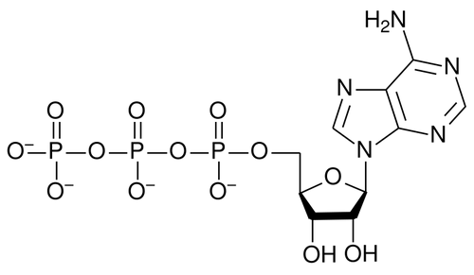

Slide 12
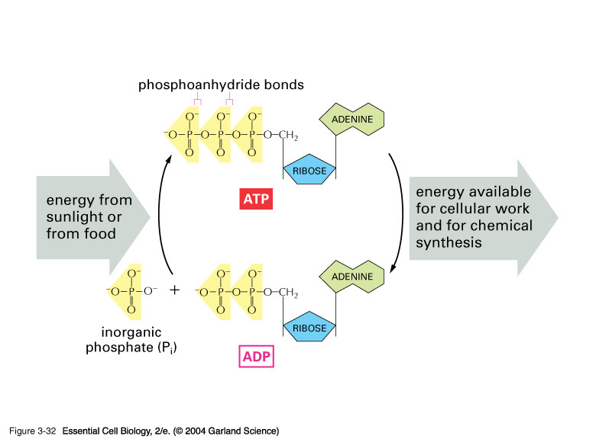
http://www.accessexcellence.org/RC/VL/GG/ecb/ATP_ADP.php

Slide 13
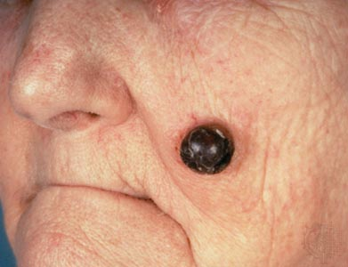
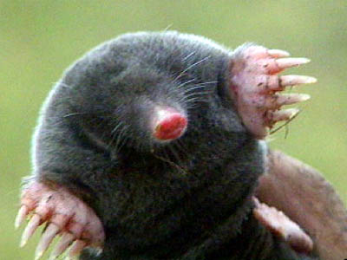
What’s a mole?

Slide 14
The energy released from hydrolysis of ATP
adenosine diphosphate
adenosine monophosphate
Notes:
14

Slide 15
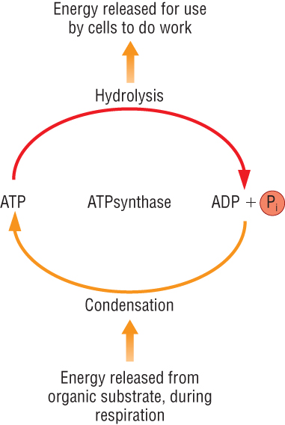
ATP is useful as an energy carrier (currency) because it cycles.
It also “packages” the energy released from respiration into useful packages.
Notes:
15

Slide 16
Respiration provides the energy required for the condensation reaction that converts ADP → ATP
i.e. For each 30.5KJ mol⁻¹ of energy that is released by hydrolysis of ATP the same energy must also be input from respiration to reform the ATP.
The energy for condensation reaction comes from the chemical energy stored in glucose or from sunlight.
Notes:
16

Slide 17
How does ATP store energy?
Each phosphate group is very negatively charged.
So they are all straining to get away from each other.
The covalent bonds holding them together are easily broken.
When they break, P_{i} is released along with 30.6kJmol⁻¹ of energy for each of the first two phosphates removed.
it is literally like a loaded spring waiting to be released.

Slide 18
Synthesis of ATP
The conversion of ATP to ADP is reversible.
Energy from respiration can be used to combine ADP with P_{i} to re-from ATP.
This reaction is called phosphorylation and is an example of a condensation reaction.
It is catalysed by ATP synthase.
Energy out
exergonic
Hydrolysis
ATP
ADP + P_{i}
Condensation
Energy in
endergonic

Slide 19
Organelles
ATP is produced in mitochondria and chloroplasts
It all happens on those internal membranes that separate:
In mitochondria, the intermembrane space from the matrix
In chloroplasts, the stroma from the thylakoid component

Slide 20
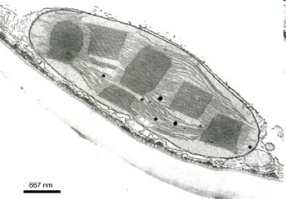
Size and Shape
Can vary
Usually between 2-10µm in length
Usually disc shaped

Slide 21
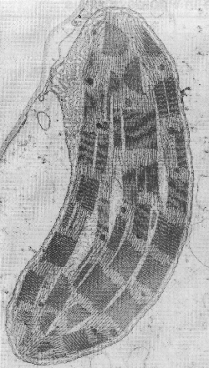
Electron micrograph

Slide 22
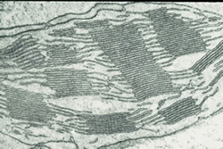

Slide 23
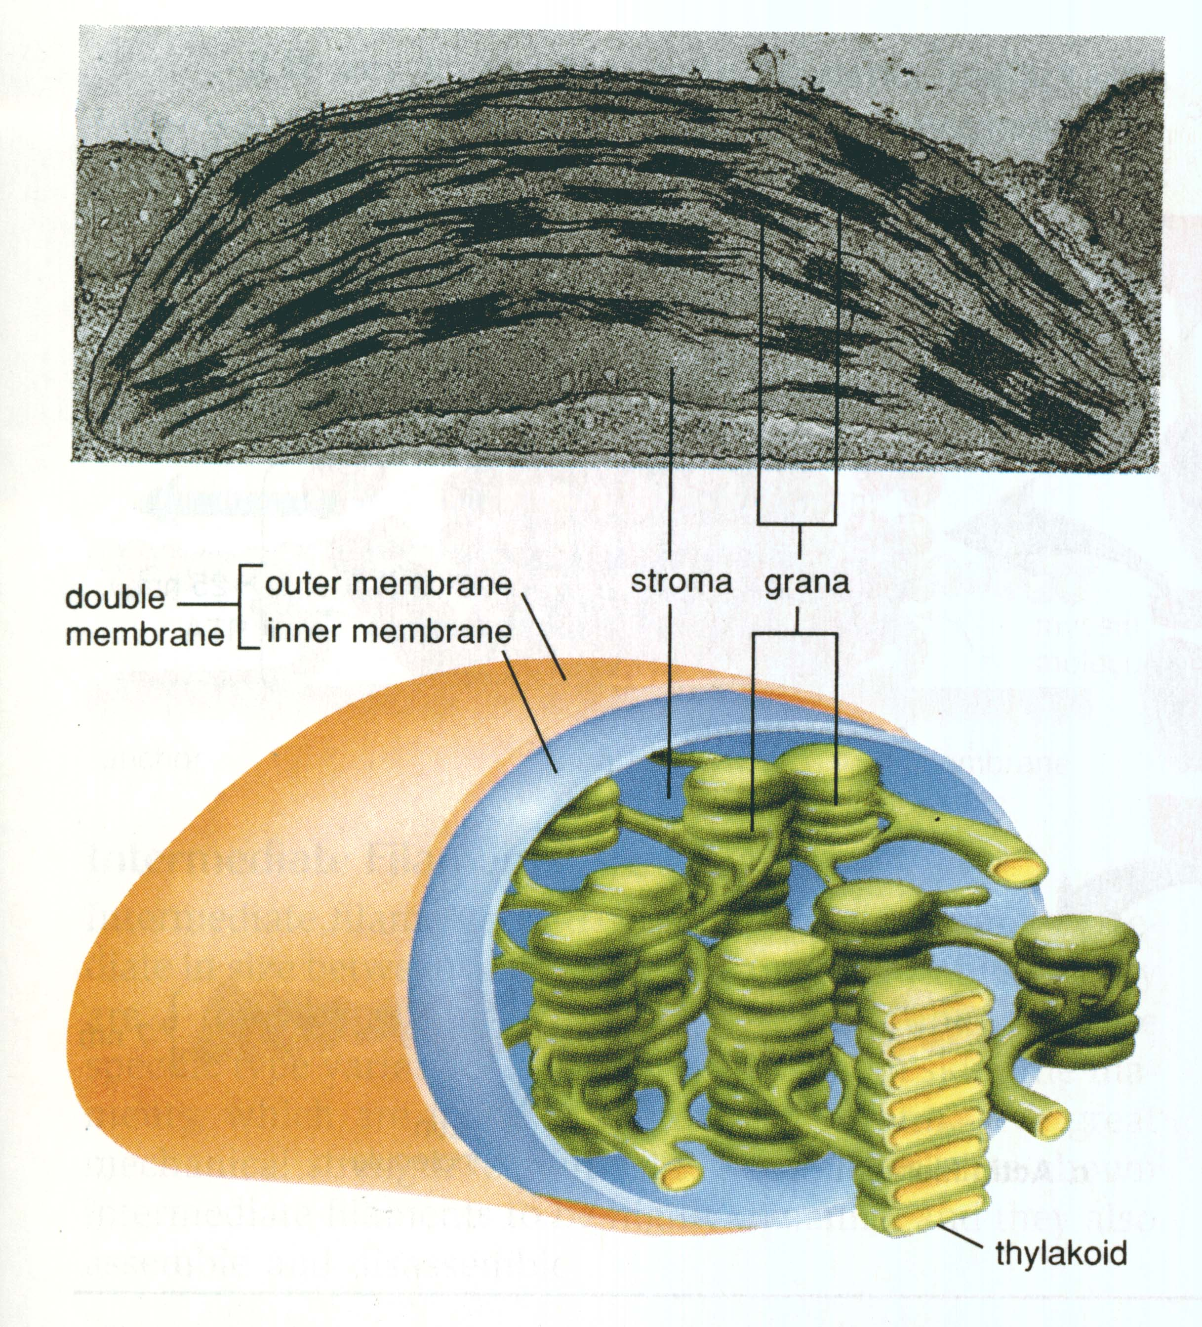

Slide 24
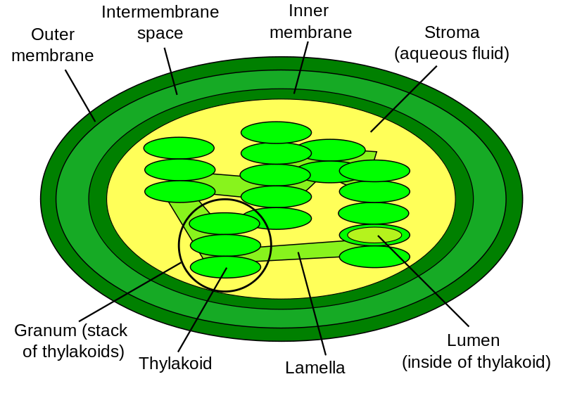
Diagram labelling quick-draw

Slide 25
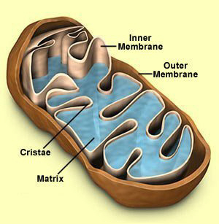
Mitochondria

Slide 26
http://www.nobelprize.org/nobel_prizes/chemistry/laureates/1978/mitchell-speech.html

Slide 27
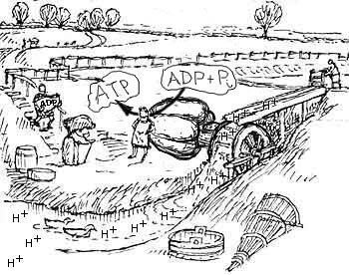

Slide 28
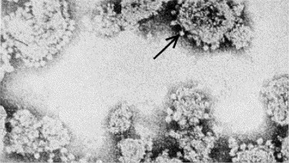
Fig. 2. Electron micrograph of sub-mitochondrial particles. Everted inner mitochondrial membranes lined with lollipop structures, later shown to be the ATP synthase. From [12].

Slide 29
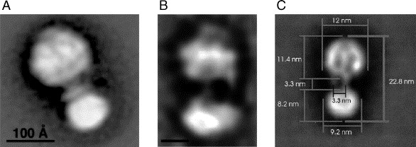
Electron microscopic images of ATP synthase from various organisms. The images were obtained by averaging negatively stained single particles. The peripheral stalk can be seen in each image from (left) bovine mitochondria [45], from E. coli[46], and (right) chloroplasts [47].

Slide 30
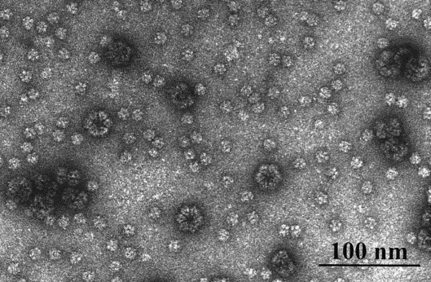

Slide 31
http://www.sciencedirect.com/science/article/pii/S0005272806000028

Slide 32
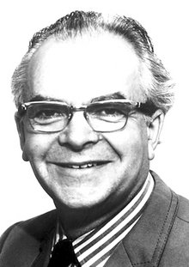
http://www.its.caltech.edu/~skopf/ESE_Bi168/files/2A.%20Mitchell%201961.pdf Cited by 2569!!!!
Peter D. Mitchell proposed the chemiosmotic hypothesis in 1961. The theory suggests essentially that most ATP synthesis in respiring cells comes from the electrochemical gradient across the inner membranes of mitochondria by using the energy formed from the breaking down of energy-rich molecules such as glucose.

Slide 33
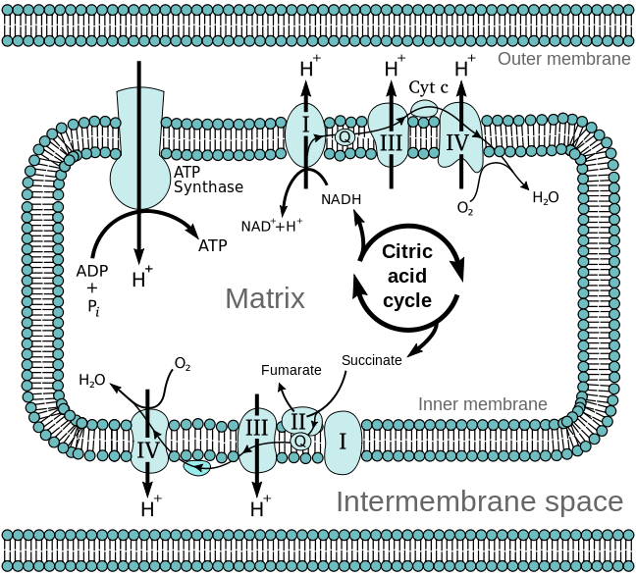
This was a radical proposal at the time, and was not well accepted. The prevailing view was that the energy of electron transfer was stored as a stable high potential intermediate, a chemically more conservative concept.

Slide 34
The problem with the older paradigm is that no high energy intermediate was ever found, and the evidence for proton pumping by the complexes of the electron transfer chain grew too great to be ignored. Eventually the weight of evidence began to favour the chemiosmotic hypothesis, and in 1978, Peter Mitchell was awarded the Nobel Prize in Chemistry.

Slide 35
Chemiosmotic Theory of ATP production http://www.nobelprize.org/nobel_prizes/chemistry/laureates/1978/mitchell-bio.html
Mitchell (1961)
He proposed protons are actively pumped into the inter-membrane space of the mitochondria
Done using the energy produced by electron transport chain
Results in a concentration gradient
(and as they are H+ ions also a pH difference and an electrochemical gradient)

Slide 36
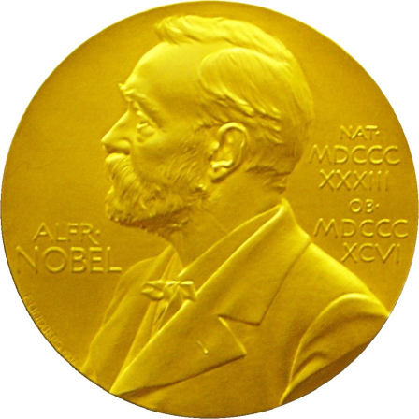
This means there is a tendency for the H+ ions to move back into the matrix
But they cant get across the membrane
They have to go through special pores which are linked to ATPsynthetase enzymes
The energy from the gradient drives the synthesis of ATP.
It is a universal mechanism found in all living things.
Won him the Nobel Prize in 1978

Slide 38
Brian Cox
https://www.youtube.com/watch?v=qtyP3zkZYlE

Slide 39
Origin of life?
http://www.newscientist.com/article/mg20427306.200-was-our-oldest-ancestor-a-protonpowered-rock.html
http://www.newscientist.com/video/45319855001-lifes-origins.html

Slide 40
The role of ATP
The instability of ATP’s phosphate bonds makes it a rubbish long term energy storage molecule.
Imagine a garage full of loaded mousetraps all set to snap closed at the slightest touch…
Fats and carbohydrates are better for this.
ATP is the intermediate energy source.
So the cell does not need large quantities of ATP.
It maintains only a few seconds supply.
ATP is rapidly reformed so a little goes a long way.

Slide 41
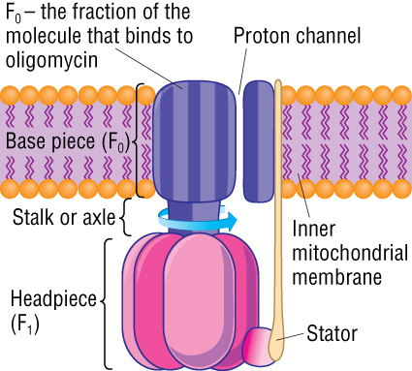
http://www.dnatube.com/video/104/ATP-synthase-structure-and-mechanism

Slide 42
http://www.youtube.com/watch?v=BGU-g4IYD7c

Slide 43
Summary
Draw a review poster to summarise the work on Energy & ATP.
Use diagrams, mind maps, flowcharts or any other method you like.

