Slide 1
GCSE respiration
http://www.bbc.co.uk/learningzone/clips/inhaled-and-exhaled/113.html

Slide 2
Objectives You should be able to discuss…
4.2 Respiration releases chemical energy from organic molecules
(a) All living organisms carry out respiration in order to provide energy in the cell.
(b) Glycolysis as a source of triose phosphate, pyruvate, ATP and reduced NAD. The formation of acetyl CoA. (The names of intermediates are not required.)
(c) The Krebs cycle as a means of liberating energy from carbon bonds to provide ATP and reduced NAD with release of carbon dioxide. The role of reduced NAD as a source of electrons and protons for the electron transport system. The energy budget of the breakdown of glucose under aerobic and anaerobic conditions. Fat and amino acid utilisation.

Slide 3
A Summary of Respiration
C₆H₁₂O₆ + 6O₂ 6CO₂ + 6 H₂O + 36ATP
This is a summary of several metabolic pathways and the process by which most ATP molecules are made.
These are:
Glycolysis
Link Reaction
Krebs’ cycle
Electron Transport Chain

Slide 4
Outline
Respiration takes place in 2 distinct phases:
The first one does not require oxygen (anaerobic)
It only makes a small amount of ATP
But does start the splitting of the respiratory substance
It is called Glycolysis

Slide 5
The link reaction does just that, it links the first stage (glycolysis), with the second stage
The second stage needs oxygen (aerobic respiration)
This involves the Krebs cycle and the electron transport chain
The respiratory substrate is usually glucose but others can be used.
Oxygen is also needed for cellular respiration to go to completion and produced the maximum amount of ATP

Slide 6
Many organisms depend on aerobic respiration meaning they need an almost constant supply of oxygen to survive.
However, some organisms survive without oxygen undertaking anaerobic respiration

Slide 7
Where does cellular respiration take place?
Glycolysis does not occur in any organelle
The enzymes for this stage are found in the cytoplasm
The rest of cellular respiration takes place in the mitochondria
?
?
?
?

Slide 8
Glycolysis
glucose (6C)
2ADP
bisphosphorylated hexose (6C)
2 x triose (3C)
2ADP + 2P_{i} 2NAD⁺
2NADH + 2H⁺
2x glycerate-3-phosphate
2ADP
2 x pyruvate
2 ATP
Glycolysis is the phosphorylation of glucose
The splitting of the 6C hexose phosphate formed into two triose phosphate
Oxidation of these into pyruvate
It yields a small amount of ATP and reduced NAD
2 ATP
2 ATP

Slide 9
Glycolysis

Slide 10
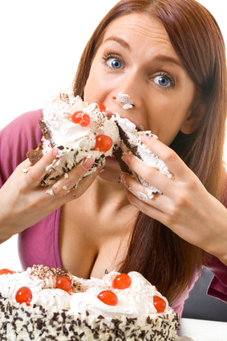
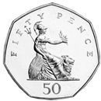
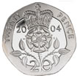
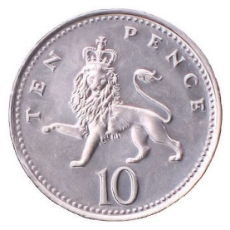
Once upon a time, there was a girl called Gloria who lived in a town called Foss. She was given 80p to buy some pie from the town fete but she was still hungry so she spent another 80p on some more pie. Gloria was now full right up (fru) c’er toes by Foss fete.
https://maps.google.co.uk/maps?hl=en&q=foss+town&ie=UTF-8

Slide 11
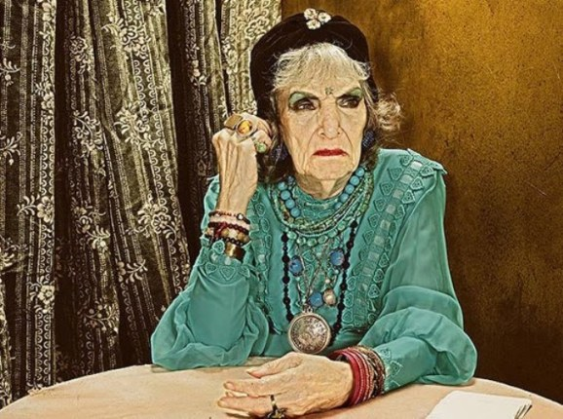
A travelling fortune teller saw fat Gloria walking past and shouted:
“Hex those, by Foss fete!” and off she went.

Slide 12
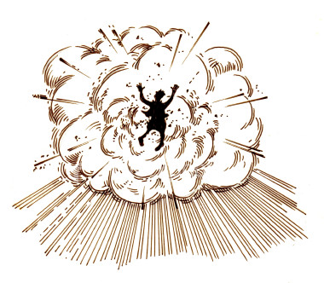
Gloria was so full she popped in half. People saw her lying on the ground and wondered how to clean her up. “Try the hose, Foss fete” someone suggested.

Slide 13
Nadine and Nadia, two local firewomen known as Nad and Nad, turned up to hose down the place and clean up the mess. Each cleared up one half of what was Gloria. They both received badges with a big ‘H’ for their efforts and were forever afterwards named NADH.

Slide 14
Andrew D. Privet, the local thief, noticed that some money had dropped out of Gloria when she exploded - £3.20 to be precise.

Slide 15
Because of the pie, Gloria rued her fate.

Slide 16
Glycolysis in the cytoplasm
The breakdown of a hexose sugar (usually glucose) into the 3-C compound pyruvate (pyruvic acid)

Slide 17
Where?
Glycolysis occurs in every cell.
In aerobic respiration it is the FIRST stage.
In anaerobic respiration it is the ONLY stage.

Slide 18
Stage 1
Glucose is insufficiently reactive and must be phosphorylated to become more reactive
The phosphate molecule comes from the conversion of ATP to ADP
This is ACTIVATION
Glucose (6-C)
ATP
ADP
Glucose Phosphate (6-C)

Slide 19
Stage 2
The glucose molecule is rearranged into its isomer, fructose phosphate
Glucose Phosphate (6-C)
Fructose Phosphate (6-C)

Slide 20
Stage 3
Further phosphorylation takes place
The phosphate molecule comes from the conversion of ATP to ADP
The sugar becomes even more reactive
Fructose Phosphate (6-C)
ATP
ADP
Fructose Bisphosphate
(6-C)

Slide 21
Stage 4
6-C Fructose Bisphosphate is split into 2 x 3-C sugars called Glyceraldehyde 3-phosphate
This is SPLITTING
Fructose Bisphosphate
(6-C)
2 x Glyceraldehyde 3-phosphate
(3-C)

Slide 22
Stage 5
2 pairs of hydrogen atoms are removed
This is OXIDATION
Further phosphorylation occurs
The source of the phosphates is inorganic and not ATP
2 x Glycerate 1,3-Bisphosphate (3-C) are formed
2 x Glyceraldehyde 3-phosphate (3-C)
2NAD
2NADH
Inorganic Phosphate
2 x Glycerate 1,3-Bisphosphate (3-C)

Slide 23
Stage 6
Both molecules of Glycerate 1,3-bisphosphate lose both phosphate molecules
2 molecules of ATP are generated from ADP
2 x Glycerate 1,3-Bisphosphate (3-C)
2ADP
2ATP
2 x Glycerate 3-phosphate (3-C)

Slide 24
Stage 7
A further pair of phosphates are removed
2ATP are generated from ADP
Each glycerate 3-phosphate molecule also has a H₂O molecule removed from it
This is CONVERSION
2 x pyruvate are produced
2 x Glycerate 3-phosphate(3-C)
2ADP
2ATP
H₂O
2 x Pyruvate (3-C)

Slide 25
Minimum you must know…
Occurs in cytoplasm
Glucose is made reactive by ATP
Net gain of 2ATP
2NADH go to ETC
2 Pyruvate go to Link Reaction
Glucose (6-C)
2 x Triose Phosphate (3-C)
2 x Pyruvate (3-C)
2ATP
2ADP
2NAD
4ADP
2NADH
4ATP

Slide 26
Glucose (6C)
Phosphorylated Fructose
(6C)
2 x 3C sugars
Triose Phosphate
2 x oxidised 3C sugars
2 x Pyruvate (3C)
2 x ATP
2 x ADP
“Investment or phosphorylation”
“Lysis”
2 NAD
2 NADH (reduced NAD)
“Oxidation”
NAD oxidises the 3C sugar by removing H+ + e. It is in turn reduced
From Cytoplasm 4Pi
+ 4 ADP
4ATP
“Conversion”
4 x Pi taken from cytoplasm

Slide 27
What Happens Next???
Aerobic Respiration
Anaerobic Respiration
2 x Pyruvate go into the Link Reaction
2 x Pyruvate (3C)
Lactate
‘Dead-end’: NADH from Glycolysis is used up!!!
Only 2 x ATP made – not much.
NADH
NAD

Slide 28
Plenary
Questions
Answers

Slide 29
Homework

Slide 30
Glycolysis recap
http://highered.mcgraw-hill.com/sites/0072507470/student_view0/chapter25/animation__how_glycolysis_works.html

Slide 31
Glycolysis
Glucose (6C)
Initial energy investment
2 ATP
phosphorylation
2 ADP
Fructose diphosphate (6C)
Glyceraldehyde 3-phosphate (3C)
Glyceraldehyde 3-phosphate (3C)

Slide 32
Glyceraldehyde 3-phosphate (3C)
Glyceraldehyde 3-phosphate (3C)
G3P is oxidised and NAD is reduced
NAD
NAD
Reduced NAD
Reduced NAD
Energy Production
2 ADP
2 ADP
2 ATP
2 ATP
Pyruvate (3C)
Pyruvate (3C)

Slide 33
Objectives You should be able to discuss…
4.2 Respiration releases chemical energy from organic molecules
(a) All living organisms carry out respiration in order to provide energy in the cell.
(b) Glycolysis as a source of triose phosphate, pyruvate, ATP and reduced NAD. The formation of acetyl CoA. (The names of intermediates are not required.)
(c) The Krebs cycle as a means of liberating energy from carbon bonds to provide ATP and reduced NAD with release of carbon dioxide. The role of reduced NAD as a source of electrons and protons for the electron transport system. The energy budget of the breakdown of glucose under aerobic and anaerobic conditions. Fat and amino acid utilisation.

Slide 34
http://www.youtube.com/watch?v=-LO9pP3dF3Q

Slide 35
Test yourself!
Can you draw and label a mitochondrion?

Slide 36
A mitochondrion

Slide 37
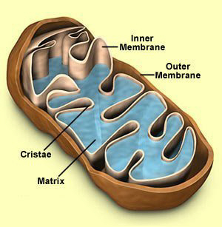
Mitochondria

Slide 38
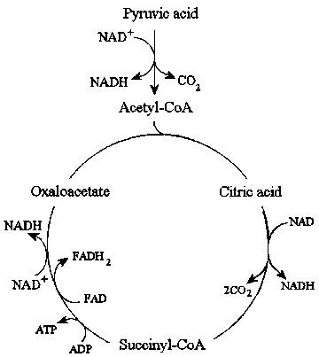
Matrix – Link Reaction
2
Krebs Cycle
2

Slide 39
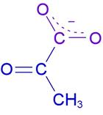
Glycolysis forms pyruvate (or pyruvic acid) in the cytoplasm. pyruvate is a polar molecule.
The link reaction takes place in the mitochondrial matrix

Slide 40
Link Reaction Basics
Connects Glycolysis to Krebs cycle (Respiration part 3)
Takes place in the mitochondrial matrix
Requires presence of oxygen (but does not use oxygen)
Overview:
Pyruvate is decarboxylated – a Carboxyl group is removed and forms CO₂.
2Hydrogen are removed from Pyruvate and used to reduce NAD
Produces Acetate (2 carbon molecule) that binds to Coenzyme A.

Slide 41
Link Reaction
Start
Pyruvate (3 carbon compound)
Step1
Pyruvate decarboxylase removes a carboxyl group
Formed =CO₂
Step 2
Pyruvate dehydrogenase removes hydrogen atoms from the pyruvate
Hydrogen atoms are accepted by NAD⁺ which is reduced to NADH
Formed = NADH + Acetate (2 carbon compound)

Slide 42
Step 3
Coenzyme A (CoA) accepts the Acetate to form Acetyl Coenzyme A
This carries acetate into the Krebs cycle
2 Pyruvate + 2NAD⁺+ 2CoA → 2CO₂+2NADH+2acetyl CoA
Why is there two of everything?
What is being oxidised, what is being reduced?

Slide 43
The Link Reaction
Pyruvate (3C)
Decarboxylation
NAD
CO₂
Reduced NAD
Happens in the matrix of the mitochondria
Acetyl
(2C)
Coenzyme A

Slide 44
Plenary
Make up a story that uses characters to describe the link reaction

Slide 45
The Krebs Cycle
Acetyl Coenzyme A
(2C)
Oxaloacetate (4C)
Citrate (6C)
NAD
Reduced NAD
FAD
NAD
Reduced FAD
Reduced NAD
ADP
(4C)
ATP
(5C)
CO₂
NAD
CO₂
Reduced NAD

Slide 46
Key Questions
Where does the link reaction and krebs cycle take place?
What is pyruvate converted to during the link reaction?
What is the final 4 carbon molecule called in the krebs cycle?
How many molecules of reduced NAD are produced per molecule of glucose?
How many molecules of FAD are produced per molecule of glucose?
How many molecules of ATP are produced per molecule of glucose?
What is the waste product of the two chemical pathways?

Slide 47
Summary of Link Reaction and Krebs Cycle
Per molecule of glucose:
8 molecules of reduced NAD are produced.
2 molecules of reduced FAD are produced.
2 molecules of ATP are produced.
6 molecules of CO₂ are produced as waste products.

Slide 48
Link Reaction + Krebs Cycle
Pyruvate
3C
2C
6C
4C
5C

Slide 49
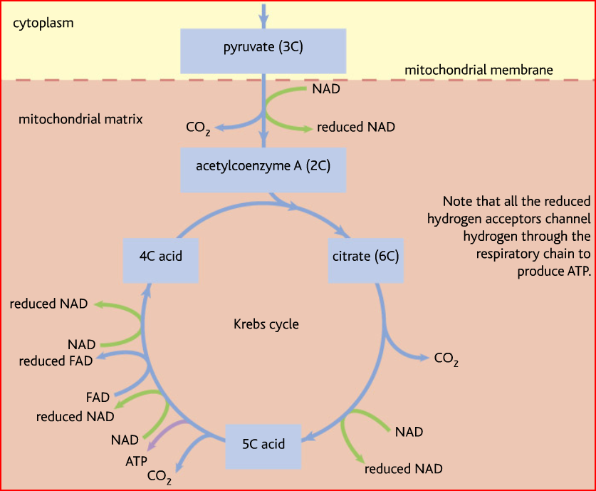

Slide 50
Link reaction turns 3C pyruvate into 2C acetyl coenzyme A
Removal of CO2 and a H (collected by NAD)
The 2C joins with a 4C to make 6C Citric Acid
The 6C is broken down back to the original 4C in a number of steps
Removal of 2 CO2s and 3Hs (two collected by NADs, one by FAD) also makes one ATP

Slide 51
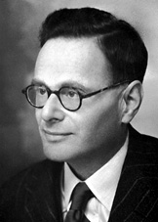
Krebs Cycle http://highered.mcgraw-hill.com/sites/0072507470/student_view0/chapter25/animation__how_the_krebs_cycle_works__quiz_1_.html Questions
Sir Hans Krebs

Slide 52
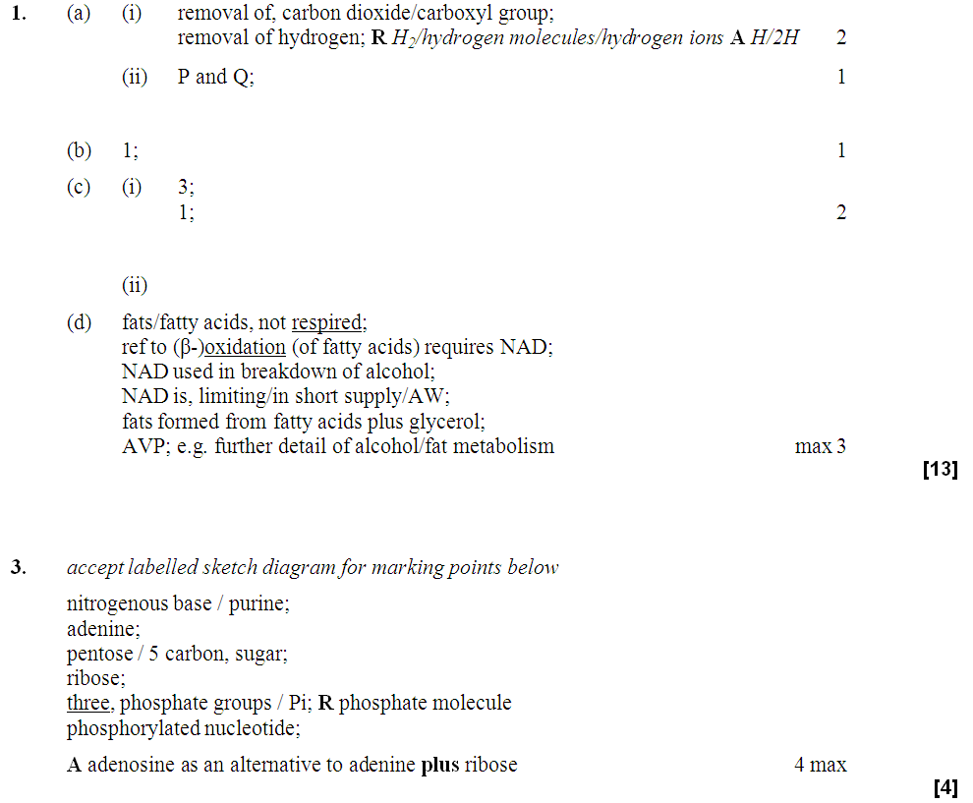

Slide 53
Objectives You should be able to discuss…
4.2 Respiration releases chemical energy from organic molecules
(a) All living organisms carry out respiration in order to provide energy in the cell.
(b) Glycolysis as a source of triose phosphate, pyruvate, ATP and reduced NAD. The formation of acetyl CoA. (The names of intermediates are not required.)
(c) The Krebs cycle as a means of liberating energy from carbon bonds to provide ATP and reduced NAD with release of carbon dioxide. The role of reduced NAD as a source of electrons and protons for the electron transport system. The energy budget of the breakdown of glucose under aerobic and anaerobic conditions. Fat and amino acid utilisation.

Slide 54
Hydrogens
The more hydrogens, the more ATP is produced in the electron transport chain
Some molecules have more hydrogens than others
The more hydrogen atoms there are in a respiratory substrate, the more ATP is produced
If there are more hydrogen atoms per mole (fixed amount) of substrate, the more oxygen is needed to be the final acceptor

Slide 55
Carbohydrates
Glucose is the most common substrate for most mammalian cells
Animals store glucose as glycogen, and plants as starch
Theoretical maximum energy yield for one mole of glucose is 2870 kJ
It takes 30.6 kJ to produce 1 mol ATP
How many moles of ATP are produced by 1 mole of glucose?
Respiration of 1 mol glucose should produce nearly 94 mol ATP, but the actual yield is more like 30, as it has an efficiency of 32%
Remaining energy used to generate heat

Slide 56
Protein
Excess amino acids are deaminated (removal of amine group converted to urea)
Rest is changed to glycogen or fat
Protein is then hydrolysed (split with water) to amino acids which can be respired
Some can be converted to pyruvate, or acetate and then is carried to Krebs cycle
Some can enter Krebs directly
Number of hydrogen atoms per mole accepted by NAD then used in electron transport chain is slightly more than the number of hydrogen atoms per mole of glucose, so proteins release slightly more energy than equivalent masses of glucose

Slide 57
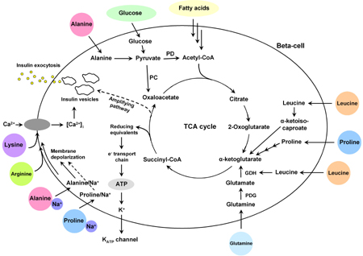

Slide 58
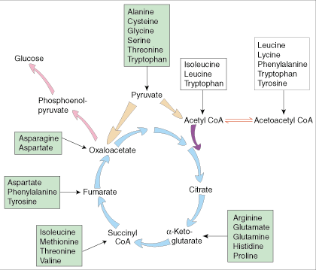

Slide 59
Lipids
Made of fatty acids and glycerol
Glycerol can be converted to glucose, fatty acids can’t
Contain many carbons and hydrogens
Fatty acids combined with CoA after ATP hydrolysed (split using water) to AMP (adenosine monophosphate)
Fatty acid CoA complex taken to matrix and broken down into 2C acetyl groups
Reduced NAD and FAD are formed
Acetyl groups are released from CoA and enter Krebs producing 3 NADH, 1 FADH and 1 ATP
NADH can then go to electron transport chain

Slide 60
Fatty Acid
Coenzyme A
Fatty Acid Coenzyme A complex
NAD + FAD
Reduced NAD + FAD
Many 2-carbon acetyl groups
2-carbon acetyl groups go to the Krebs Cycle
Coenzyme A

Slide 61
Respiratory Substrate | Mean energy value/kJ g⁻¹
Carbohydrate | 15.8
Lipid | 39.4
Protein | 17.0

Slide 62
http://clounagh.org/birchfieldmobile/biology/cellular/zone6p13dnd.html

Slide 63
Revision sheet

Slide 64
http://www.newscientist.com/article/dn12695-homesick-crocodiles-make-epic-return-swim.html

Slide 65
Anaerobic Respiration
explain why anaerobic respiration produces a much lower yield of ATP than aerobic respiration;
compare and contrast anaerobic respiration in mammals and in yeast;
Q. What is the final electron acceptor in oxidative phosphorylation?
A. Oxygen

Slide 66
No Oxygen?
Electron transport chain can’t function
Glycolysis is the only process that can function
The NAD that has been reduced (Hydrogen added) has to be re-oxidised (Hydrogen removed) so that it can keep accepting Hydrogens in glycolysis
There are two ways that NAD can be reoxidised
Fungi e.g. yeast use ethanol fermentation
Animals use lactate fermentation
Neither of these produce ATP, but two are made during glycolysis

Slide 67
Alcohol Fermenation
Pyruvate loses a carbon dioxide (decarboxylated) to ethanal with the help of the enzyme pyruvate decarboxylase (which also has a coenzyme)
Ethanal accepts hydrogen atoms from reduced NAD becoming reduced itself to ethanol with the help of the enzyme ethanol dehydrogenase
NAD goes back to accept more hydrogens from glycolysis

Slide 68
Alcohol Fermentation
Reduced NAD
NAD
Pyruvate
Ethanal
Ethanol
CO₂
2H
Pyruvate decarboxylase
Ethanol dehydrogenase

Slide 69
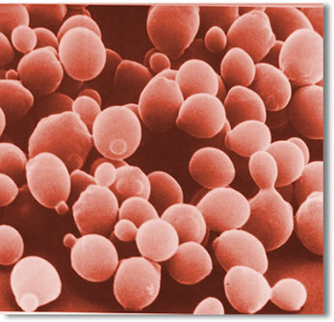
Yeast
Yeast can live without oxygen
It is killed if it remains in the ethanol it has produced if the concentration builds up to 15%
In brewing, yeast is normally grown aerobically at first and then anaerobically

Slide 70
Lactate Fermentation
Occurs in muscle tissue during vigorous activity
Pyruvate accepts Hydrogen from reduced NAD with help from the enzyme lactate dehydrogenase
Glycolysis can continue generating enough ATP to sustain muscle contraction

Slide 71
Lactate Fermentation
Reduced NAD
NAD
2H
Pyruvate
Lactate
Lactate dehydrogenase

Slide 72
Then what?
Lactate (lactic acid) carried away in blood to the liver
When more oxygen is available, lactate is converted back to pyruvate which can then go to the Krebs cycle
The whole point of anaerobic respiration is to reoxidise NAD (remove Hydrogen) to that glycolysis can continue

Slide 73
http://www.youtube.com/watch?v=s3MhJ7buOeA&feature=related
http://www.youtube.com/watch?v=j-C65hK5Lik&feature=related

Slide 74
Need for respiration in all organisms
ATP structure
ATP role
Coenzymes; NAD, FAD and coenzyme A
Glycolysis – site
Glycolysis – hexose, bisphosphate, pyruvate
Phosphorylation and substrate level phosphorylation
Reduced NAD
Active transport of pyruvate
Link reaction; where?
Link and reduced NAD
Decarboxylation and dehydrogenation
Acetyl coA and acetate
Acetate and oxaloacetate; citrate
Krebs – where
Krebs – ATP yield
Krebs – reduced NAD
Krebs – CO2
ECT
Chemiosmosis
Intermembrane space
Proton Gradient
Peter Mitchell
ATP synthase
Electron carriers
Oxidative phosphorylation
Oxygen
ATP yield
Yield less than 100%
Anaerobic in mammals; H acceptor?
Anaerobic in yeast; H acceptor?
Respiratory substrates
Energy values of carbs, proteins and fats.

Slide 75
The Electron Transport Chain

Slide 76
Hydrogen atoms that have been removed in glycolysis/Krebs will eventually combine with O₂ to form water
However, they break into H+ and e- first, the protons remaining in solution the electrons passing along a carrier system, hence the electron transport chain
Each carrier in the chain is at a slightly lower energy level and the electron is passed from highest to lowest.
Each “pass” releases energy powering production of ATP
The process is called oxidative phosphorylation as ADP is phosphorylated

Slide 77
Oxidative Phosphorylation
This is the process by which ATP is formed when electrons are transferred from NADH or FADH to oxygen using a series of electron carriers located on the inner membrane of the mitochondria.
The oxidation of NADH and H⁺ produces 3ATP molecules
The oxidation of FADH and H ⁺ produces 2ATP molecules

Slide 78
What happens in oxidative phosphorylation ?
The hydrogen atoms carried by NAD ⁺ or FAD ⁺ are split into H⁺ ions and electrons.
The H ⁺ are pumped across the inner membrane into the intermembranal space, where they accumulate. This is the chemiosmotic theory.
The electrons are passed from one electron carrier to another within the inner membrane in a series of reductions and oxidations (remember OILRIG). In the process, the electrons lose energy.
The final electron acceptor is oxygen.
The H ⁺ move down their concentration gradient via an ATPase, so that ATP is formed. These H ⁺ join with the oxygen and electrons to form the end-product water.

Slide 79
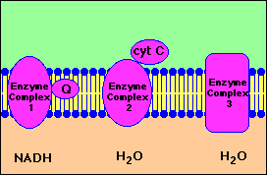
Electron transfer chain
NADH transfers H+ ions (i.e. protons) and electrons to the e.t.c.
Protons are translocated across the cell membrane, from the matrix to the intermembranal space
Electrons are transported along the membrane, through a series of carriers

Slide 80
There are 4 main carriers involved:
One molecule of ATP is produced when FAD accepts a hydrogen from NADH
Cytochromes: protein pigments containing iron
Cytochrome oxidase
Oxygen: the final hydrogen acceptor in the chain, when oxygen is reduced, water is formed

Slide 81
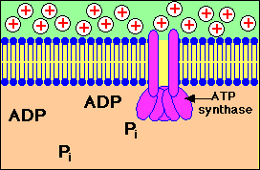
ATP synthesis in mitochondria

Slide 82
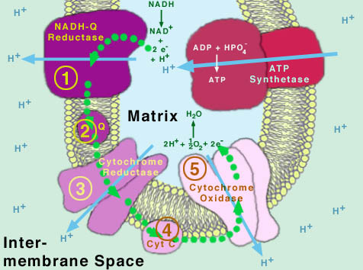
Diagrammatic Representation of Oxidative Phosphorylation

Slide 83
The following site has an animation that represents the loss of energy of the electrons as they pass along the electron transport chain.
http://student.ccbcmd.edu/~gkaiser/biotutorials/energy/ets.html
Remember!
Not all the energy from glucose is captured, some is lost as HEAT

Slide 84
Anaerobic Respiration
Glycolysis proceeds as usual, but there is no link reaction, Krebs’ cycle or oxidative phosphorylation when oxygen is not available. The total yield is 2 ATP.
Pyruvate cannot be allowed to accumulate or it would inhibit glycolysis.
Also if NADH ⁺ and H ⁺ were allowed to accumulate, there would be no NAD ⁺ available to accept H atoms during glycolysis, resulting in no glycolysis.
What happens to the resulting pyruvate molecules depends on what type of organism it is.

Slide 85
Anaerobic Respiration in Mammals
pyruvate
NADH + H ⁺ NAD ⁺
lactic acid (lactate)
Note – no CO₂ is given off.
NAD⁺ is recovered for recycling to glycolysis.
The only ATP made comes from glycolysis.
Lactic acid causes pain and fatigue in muscles, stopping exercise.
When oxygen is available, lactic acid is converted back to pyruvate, which then goes through aerobic respiration. The amount of oxygen needed to do this is the oxygen debt.

Slide 86
Anaerobic Respiration in Yeast (& Plants)
pyruvate
CO₂
ethanal
NADH + H ⁺ NAD ⁺
ethanol
This process is fermentation.
Note – CO₂ is given off.
NAD⁺ is recovered for recycling to glycolysis.
The only ATP made comes from glycolysis.
Ethanol is toxic. It cannot be converted into another molecule or broken down.
When it builds up to a high enough concentration, it kills the fungus.

Slide 87
Comparative yields of ATP
Aerobic Respiration
Glycolysis
2 ATP used up
4 ATP directly made
4 ATP made from oxidative phosphorylation
6 ATP net yield per glucose
Link Reaction & Krebs’ cycle
1 ATP directly made per turn of cycle
14 ATP made from oxidative phosphorylation
15 ATP per turn = 30 ATP per glu
Total = 36 ATP per glucose
Anaerobic Respiration
Glycolysis
2 ATP used up
4 ATP directly made
2 ATP net yield per glucose
Total = 2 ATP per glucose

Slide 88
Other respiratory substrates
Under some conditions, fats and proteins may be used in respiration
Lipids:
Glycerol is converted into a 3C sugar and this enters the Kreb cycle via triose phosphate
Fatty acid chains can be broken into 2C fragments, they then enter the system via acetyl co-enzyme A
Protein:
is broken into it’s amino acids.
AA’s are deaminated by removing NH₂
This leaves an organic acid that can feed into Krebs

Slide 89
Task
Draw a fully labelled diagram summarising the process of aerobic cellular respiration, starting with glucose as the respiratory substrate.
Make it large

Slide 90
Glycolysis http://www.youtube.com/watch?v=x-stLxqPt6E&feature=related
Krebs http://www.youtube.com/watch?v=-cDFYXc9Wko
http://www.youtube.com/watch?v=XVWdeKoiEOc&feature=related

