Slide 1
http://www.thebiologyfaculty.org/a-levels/item/79-harvesting-the-sun-light-dependent-reactions-pt1
http://www.thebiologyfaculty.org/a-levels/item/110-harvesting-the-sun-light-dependent-reactions-pt2

Slide 2
Objectives I should be able to describe…
(c) Reduced NADP as a source of reducing power and ATP as a source of energy for the following reactions.
The light independent stage and the formation of glucose; uptake of carbon dioxide by ribulose bisphosphate to form glycerate 3-phosphate catalysed by Rubisco.
Reduction of glycerate 3-phosphate to triose phosphate (carbohydrate), with the regeneration of ribulose bisphosphate.
Other carbohydrates, lipids and amino acids can be made from the triose phosphate. (No details of chemistry of these processes needed).

Slide 3
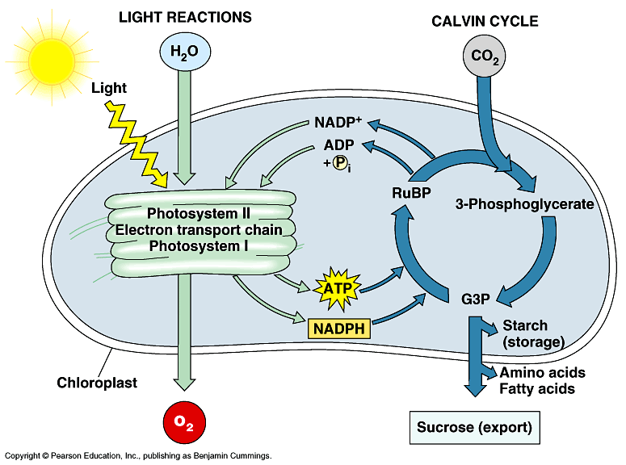

Slide 4
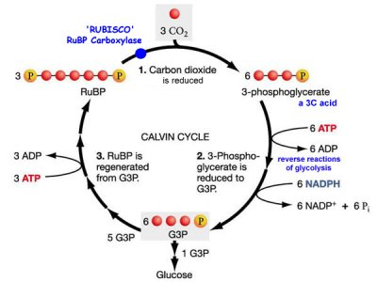
The light-independent reaction AKA The Calvin cycle
Glycerate 3-phosphate
Triose phosphate

Slide 5
The Calvin cycle or carbon fixation
Takes place in the stroma of chloroplasts
Makes a molecule called triose phosphate from carbon dioxide and ribulose bisphosphate – a 5 carbon compound
Triose phosphate can be used to make glucose and other useful organic substances
It needs ATP and H⁺ ions to keep the cycle going
The reactions are linked in a cycle which means the starting compound, ribulose bisphosphate is regenerated

Slide 6
http://en.wikipedia.org/wiki/Melvin_Calvin
http://www.bbc.co.uk/programmes/p011lymf

Slide 7
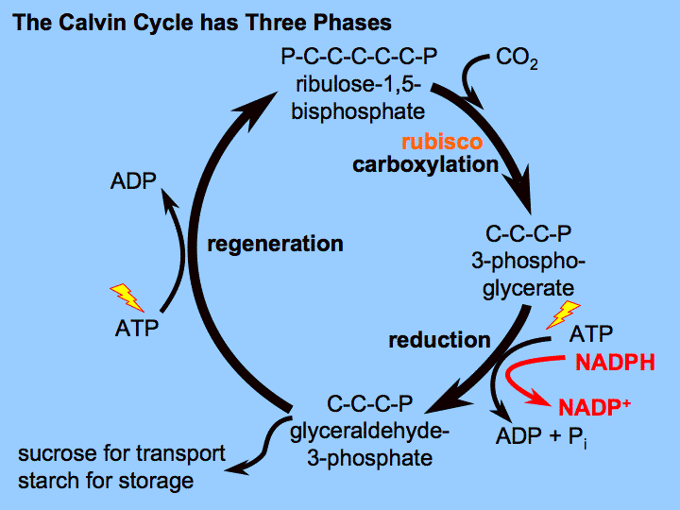
Glycerate 3-phosphate
Triose phosphate

Slide 9
Phase 1 – Carbon dioxide combines with ribulose bisphosphate (RuBP)
CO₂ enters the leaf through stomata and diffuses into the stroma of chloroplasts
Here, it’s combined with RuBP, a 5-carbon compound. This gives an unstable 6-carbon compound which quickly breaks down into two molecules of a 3-carbon compound called glycerate 3-phosphate (GP)
The enzyme Rubisco ( Ribulose bisphosphate carboxylase) catalyses the reaction between the two

Slide 11
Phase 2 – ATP and reduced NADP reduces GP to triose phosphate (TP)
ATP from the light-dependent reaction provides energy to turn the 3-carbon GP into a different 3-carbon compound called triose phosphate (TP)
This reaction also requires H⁺ ions which come from reduced NADP (also from the light-dependent reaction. Reduced NADP is recycled to NADP
TP is then converted into many useful organic compounds such as glucose

Slide 12
Glycerate 3-phosphate
Triose phosphate

Slide 13
Phase 3 – RuBP is regenerated
Five out of every six molecules of TP is used to regenerate RuBP
Regenerating RuBP takes the rest of the ATP produced by the light-dependent reaction

Slide 14
Glycerate 3-phosphate
Triose phosphate

Slide 15
Useful organic substances
Calvin cycle is the starting point for making all organic substances a plant needs
TP and GP are used to make carbohydrates, lipids and proteins
Hexose sugars – two TP
Starch – many hexose sugars
Lipids – fatty acids from GP and glycerol from TP
Proteins – some amino acids from GP

Slide 16
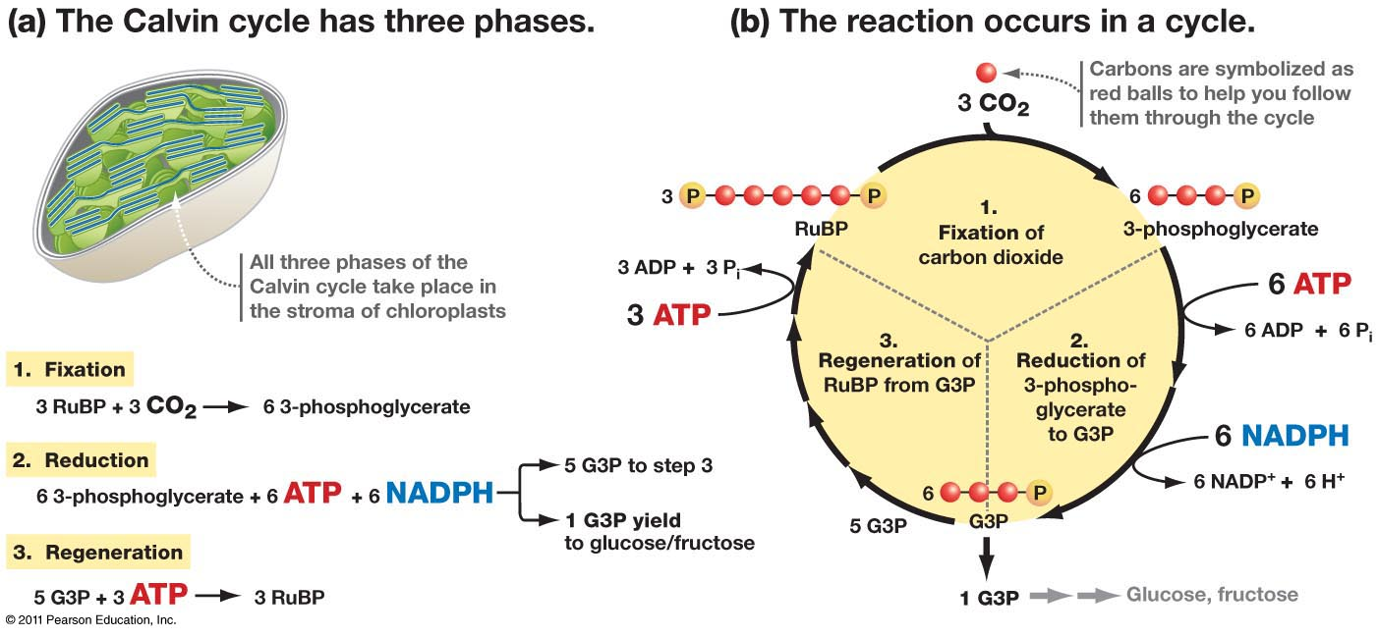
How many turns does the Calvin cycle need to make one hexose sugar?
The Calvin cycle needs six turns to make one hexose sugar
Why?
Three turns of the cycle produces six molecules of TP – two molecules of TP are made for every one CO₂ used
Five out of six of these TP molecules are used to regenerate RuBP
So, for three turns, only one TP is produced that’s used to make a hexose sugar
A hexose sugar has six carbon atoms, so two TP molecules are needed to make one hexose sugar
This means the cycle must turn six times to produce two TP molecules to make one hexose sugar
Six turns of the cycle need 18 ATP and 12 reduced NADP from the light-dependent reaction
Glycerate 3-phosphate
Triose phosphate

Slide 17
light strikes the photosynthetic pigments of photosystem II on grana membrane
Light energy is focussed on electrons in a chlorophyll A molecule
The electrons rise in energy content and leave PSII
Light stimulates an enzyme to break a molecule of water in photolysis
The 2 electrons from this molecule replace the electrons lost from PSII
The electrons that left PSII pass down electron carriers; energy is tapped off to join a phosphate group from the stroma to an ADP molecule to make ATP
Light hits PSI; the energy is passed down accessory pigments to chlorophyll on the grana membrane
The electrons from PSII replace the electrons that have left PSI
The electrons in this chlorophyll molecule in PSI absorb the energy, rising them to a higher energy level
The electrons pass down a sequence of electron carriers; energy is tapped off and used to join H+ from water to NADP to make NADPH
Two oxygens from photolysis combine and are evolved as 0₂
The light independent stage now occurs. It uses 2 products from the light dependent stage
These are ATP and NADPH
CO₂ binds with 5 C RuBP
This makes a 6 C molecules which immediately breaks down to 2 3 C molecules
These are called G 3 P or glycerate 3 phosphate
ATP provides energy and NADPH provides H to reduce G 3 P to triose phosphate
5 out of 6 triose phosphates reform 3 RuBP
The sixth triose phosphate is the building block of carbohydrates
These can be modified into proteins or fats

