Slide 1
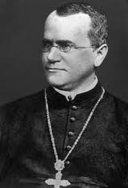
Germ or Legend (1822 – 1884)
Gregor Mendel (1822 – 1884)

Slide 2
Look at the characters below:
1) Who are their parents? What could they be called?
2) Why do they look like their parents?

Slide 3
Inheritance
Most families have characteristics which we can see clearly from generation to generation.
Many characteristics like eye colour and dimples are inherited (passed on to you from your parents).

Slide 4
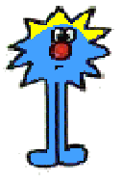
Inheritance
This resemblance of children to their parents is the result of genetic information passed on in gametes (sex cells).

Slide 5
Inherited or Environmental
Sort into three lists inherited, environmental or not sure.
Add two of your own environmental and inherited characteristics.
Being skinny
Freckles
Blue eyes
Skin colour
Curly hair
Being tall
Liking Mozart
Tongue rolling
Dark hair
Dimples
Hating tuna

Slide 6
Genes and Chromosomes
The genetic information which is passed from generation to generation during reproduction is carried in the nucleus of your cells.
Define these terms:
Chromosomes
Genes
Alleles

Slide 7
Chromosomes
Each type of organism has a different number of chromosomes in their body cells.
Humans have 46 chromosomes, 23 from their mother and 23 from their father.
Turkeys have 82 chromosomes.
Some animals can cross breed to produce hybrids

Slide 8
Bit of fun - Guess the hybrid…
Zeedonk!
Zebra and Donkey
In South Africa they are called zonkeys and are fairly common where zebras and donkeys are found in proximity to each other. Like mules, however, they cannot usually breed, due to an odd number of chromosomes disrupting meiosis.

Slide 9
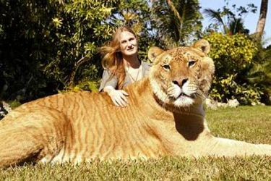
Guess the hybrid…
Liger
Lion and Tiger
Hercules the liger is the biggest cat ever! He is over 10ft long and weighs over 60 stone!!
A Liger looks like a giant lion with diffused stripes. Some male ligers grow sparse manes. Like tigers, but unlike lions, ligers enjoy swimming.

Slide 10
Guess the hybrid…
Cama
Camel and Llama
Though born even smaller than a Llama calf, the Cama had the short ears and long tail of a camel, no hump and llama-like cloven hooves rather than the dromedary like pads. The Cama apparently inherited the poor temperament of both parents

Slide 11
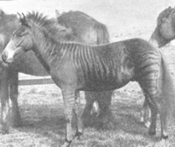
Guess the hybrid…
Zorse
Zebra and Horse
The zorse is shaped more like a horse than a zebra, but has boldly striped legs and, often, stripes on the body or neck. Like most other interspecies hybrids, it is infertile.

Slide 12
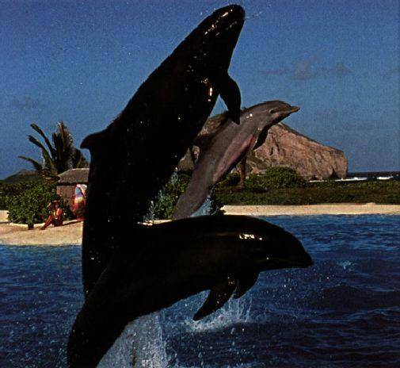
Guess the hybrid…
Wholphin
Whale and Dolphin
A wolphin or wholphin is a rare hybrid, formed from a cross between a bottlenose dolphin Tursiops truncatus (mother), and a false killer whale Pseudorca crassidens (father). The wolphin's size, colour and shape are intermediate between the parent species. Named Kekaimalu, she has 66 teeth - intermediate between a bottlenose (88 teeth) and false killer whale (44 teeth). The wolphin proved fertile.

Slide 13
Hybrids
Animals of the same species have the same number of chromosomes.
Different species cannot usually interbreed- but some do to produce a hybrid.
Often the hybrid offspring is infertile – due to the amount of chromosomes it has.
E.g Donkeys have 34 and horses have 32 so the offspring have 33 and the chromosomes cannot pair up!

Slide 14
Genes
Each of your chromosomes contains thousands of genes.
Each gene is a small section of DNA and controls a different characteristic.
The chromosomes are organised so that the genes controlling the same things are in the same place (locus)

Slide 15
Task:
Use a book or your internet enabled phone to write definitions of the following words:
Genetics
Dominant (genes)
Recessive (genes)
Phenotype
Genotype
Homozygous
Heterozygous

Slide 16
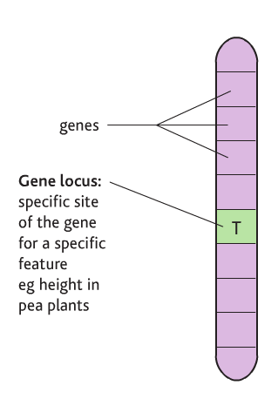
Architecture of a chromosome…
Contain 1000’s of genes
Homologous pairs carry the same genes – so you have 2 copies of the same gene
Genes are found at the same locus

Slide 17
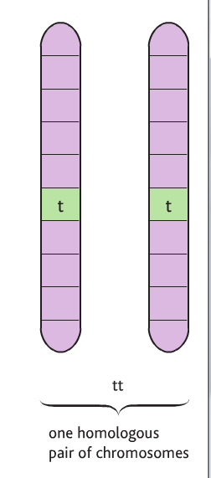
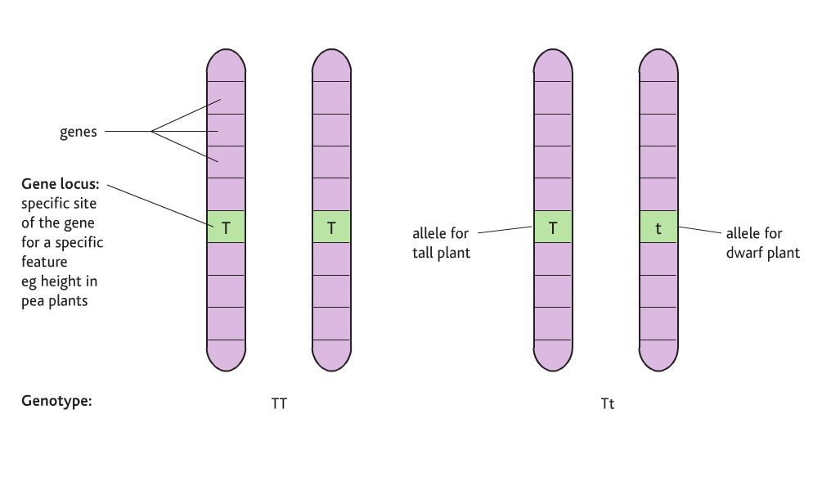
Architecture of a chromosome…
Alleles are different versions of the same gene
HOMOLOGOUS (the same)
HOMOZYGOUS (HOMOZYGOTE)
HETEROZYGOUS (HETEROZYGOTE)

Slide 18
Alleles and phenotype
Some alleles are DOMINANT some are recessive
Dominant genes are ALWAYS expressed
Recessive genes are only expressed if they are homologous

Slide 19
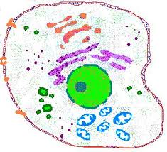
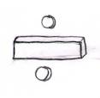
Cell Division

Slide 20
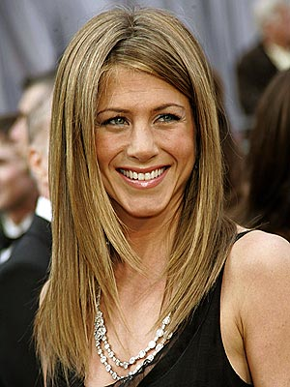
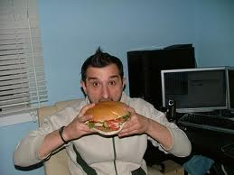
Genetics

Slide 21
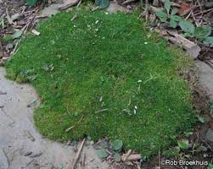
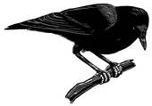
Chromosome

Slide 22
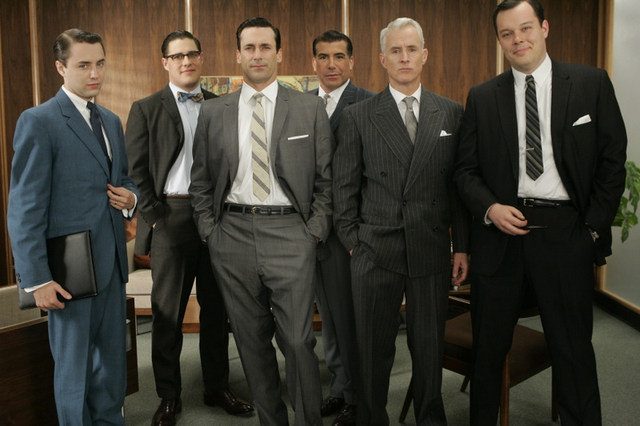
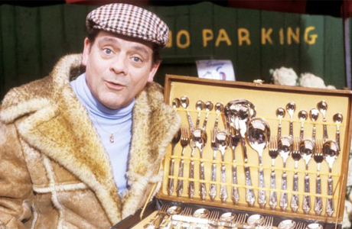
Mendel

Slide 23
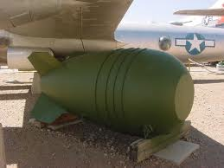
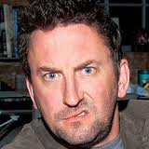
Nucleus

Slide 24
Testicle

Slide 25
Homologous

Slide 26
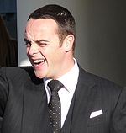
Dominant

Slide 27
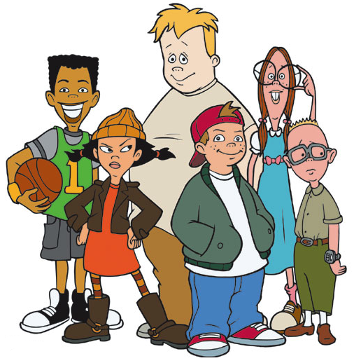
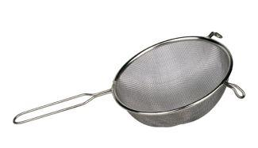
Recessive

Slide 28
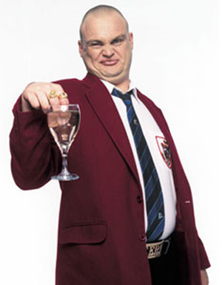
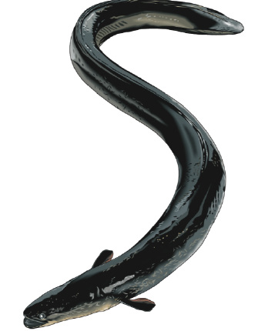
Allele

Slide 29
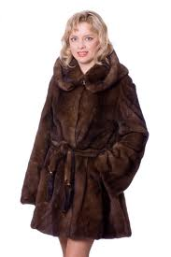
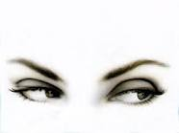
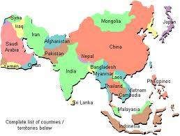
Fertilisation

Slide 30
http://www.bbc.co.uk/news/10579512

Slide 31
Objectives I should be able to discuss…
Alleles as different forms of the same gene.
The principles of monohybrid and dihybrid Mendelian inheritance.

Slide 32
Anagrams
Peg Ye Ton
Pee Python
Told nail enamel
Vesicle leer seal
Adolescent i'll moan
soul c
GOSH MY OUZO
HUGE OYSTER OZ
RICA ERR
COT STRESS
genotype,
phenotype,
dominant allele,
recessive allele,
codominant alleles,
locus,
homozygous,
heterozygous,
carrier
test cross.

Slide 33
Order?
Genotype | the alleles of an organism.
Phenotype | an allele that has the same effect on the phenotype whether it is present in the homozygous or heterozygous state.
Dominant allele | an allele that only has an effect on the phenotype when present in the homozygous state.
Recessive allele | an individual that has one copy of a recessive allele that causes a genetic disease in individuals that are homozygous for this allele.
Codominant alleles | having two different alleles of a gene.
Locus | having two identical alleles of a gene.
Homozygous | pairs of alleles that both affect the phenotype when present in a heterozygote.
Heterozygous | testing a suspected heterozygote by crossing it with a known homozygous recessive.
Carrier | the characteristics of an organism.
Test cross | the particular position on homologous chromosomes of a gene.

Slide 34
Answers
Genotype | the alleles of an organism.
Phenotype | the characteristics of an organism.
Dominant allele | an allele that has the same effect on the phenotype whether it is present in the homozygous or heterozygous state.
Recessive allele | an allele that only has an effect on the phenotype when present in the homozygous state.
Codominant alleles | pairs of alleles that both affect the phenotype when present in a heterozygote.
Locus | the particular position on homologous chromosomes of a gene.
Homozygous | having two identical alleles of a gene.
Heterozygous | having two different alleles of a gene.
Carrier | an individual that has one copy of a recessive allele that causes a genetic disease in individuals that are homozygous for this allele.
Test cross | testing a suspected heterozygote by crossing it with a known homozygous recessive.

Slide 35
Bingo

Slide 36
Genetic jargon revision test
What do these genetic terms mean?
gene
Section of DNA that codes for a particular trait or characteristic.
allele
A different form of a gene that codes for a different version of a characteristic.
genotype
A description of the pair of alleles present for a characteristic.
phenotype
The physical expression of the alleles.

Slide 37
What do these genetic terms mean?
homozygous
Pair of alleles that produce a characteristic that are the same, e.g. HH.
heterozygous
Pair of alleles that produce a characteristic that are different, e.g. Hh.
dominant
An allele that will always be expressed even when there is only one of these alleles present, represented by a capital letter.
recessive
An allele that will only be expressed when both alleles are of this type, represented by a lower case letter.

Slide 38
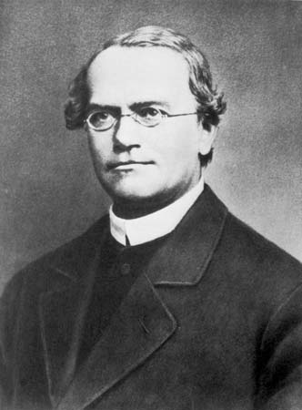
Gregor Mendel was born in 1822 in Czechoslovakia.

Slide 39
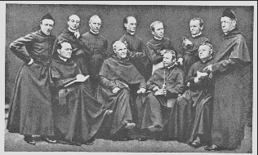
Mendel came from a very poor family and he decided to become a monk to get the education he desired.

Slide 40
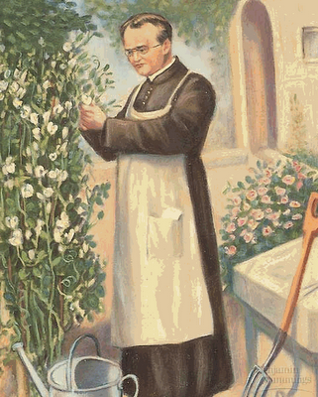
Mendel worked in the monastery gardens and he became fascinated with how peas grew.

Slide 42
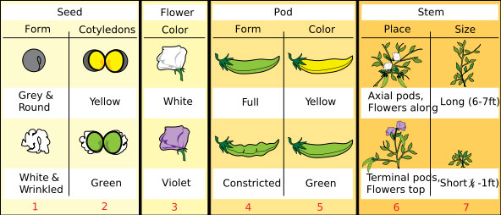
Mendel carried out research into how characteristics were passed on in pea plants.
He kept detailed records of all his findings.

Slide 44
Mendel studied the patterns of how physical traits passed from one generation to the next using peas

Slide 46
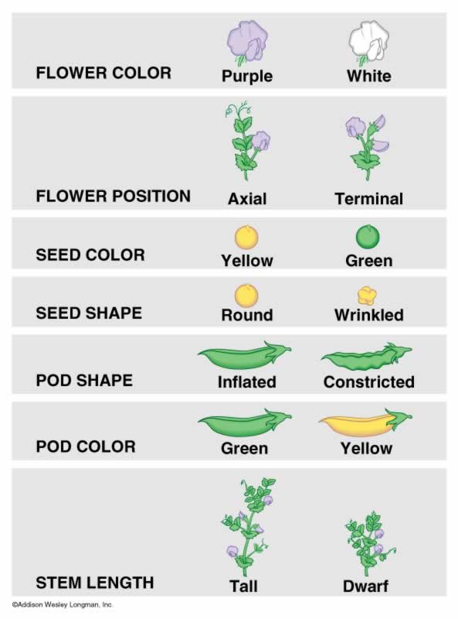
Mendel Studied The Inheritance Patterns of These Following Physical Traits in Peas
Seed (pea) shape
Round/Wrinkled
Seed Color
Yellow / Green
Seed Coat Color
Gray / White
Pod Shape
Smooth/Constricted
Pod Color
Green / Yellow
Flower Position
Axial / Terminal
Plant Height
Short / Tall
Flower Color
Purple / White

Slide 47
Wrinkled Peas Round Peas

Slide 48
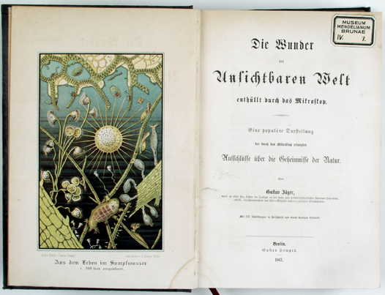
He published a book of his findings in 1866, when he was 44 years old.
People did not understand his theories as no one had seen chromosomes.
He died 20 years later with no one taking notice of his work.

Slide 49
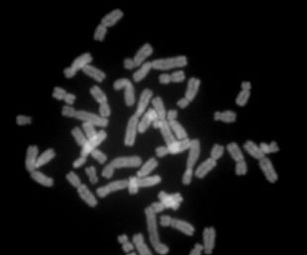
16 years after his death people could finally see chromosomes through a microscope and he was given the recognition for his findings.

Slide 50
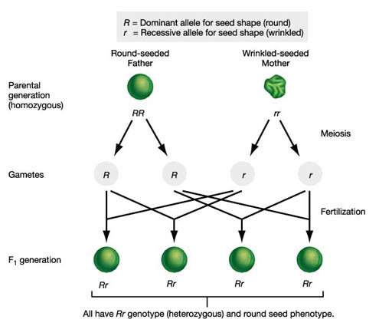
An Example of How Traits Passed from Parent to first offspring generation

Slide 51
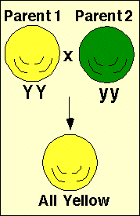
He came to the conclusion that some characteristics were dominant over others and they were never mixed.

Slide 52
All of the peas of the next (hybrid) generation were smooth. Why weren’t there any wrinkled peas? Why weren’t there any sort – of wrinkled/sort of smooth peas?

Slide 53
But when he allowed that first new (hybrid) generation of pea plants to self pollinate………….

Slide 54
9 Round Peas & 3 Wrinkled Peas
What Happened ???????????

Slide 55
When Mendel Cross pollinated Pea plant with different traits, only one trait seemed to be “expressed” in that firs generation of offspring. This trait “dominated” the other.
Yet, when that first generation of plants were self pollinated, on average, three of every four plants had the dominant trait, and one of every three had the weaker or recessive trait.

Slide 57
After he analyzed his results:
Mendel concluded that individual factors (genes) that do not blend with one another control each trait in living things.
Each of the traits that Mendel studied was controlled by one gene that occurred in two contrasting forms. These different forms are now referred to as alleles.

Slide 58
Mendel also concluded that some of these factors (genes) are dominant, (smooth peas/purple flowers) whereas others (wrinkled peas/white flowers) are recessive.

Slide 59
Online Mendel
Task:
http://www2.edc.org/weblabs/Mendel/mendel.html
Instructions:
Lesson 9 - Mendels Experiments Instructions.pdf

Slide 60
Modern Genetic experiments
Organism must be CHEAP and EASY to use (breeds fast!)
Short life cycle so that results of crosses can be seen
Produce large numbers of offspring so that results are statistically relevant
Have clearly distinguishable characteristics
E.g. Drosophila melanogaster (fruit fly)
Pea plants
Aspergillus spp.
Bacteria

Slide 61
1. In a monohybrid cross of a brown male hamster (from a very long line of brown only hamsters) and a black female hamster (from a very long line of black only hamsters) all the offspring produced are brown.
a) What are the genotypes of the male and female?
b) What are the genotypes of the offspring?
c) If you mate 2 of the F1 offspring with each other, what phenotypes of offspring will be expected in the F2 and in what proportions would you expect them?

Slide 62
2. Length of fur is also genetically determined. The allele L produces long fur and its corresponding allele, l, produces short fur. Long fur is dominant to short.
• You mate 2 hamsters. Both heterozygous for brown long fur. Would you expect any of the offspring to have black short fur? If so, what proportion would have black short fur?
• What proportion would have black long fur?

Slide 63
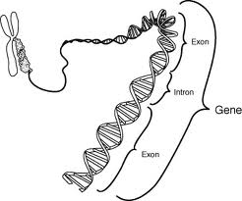
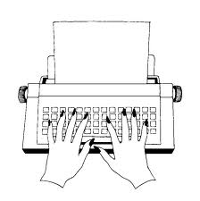
Notes:
Genotype

Slide 64
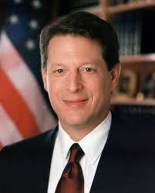
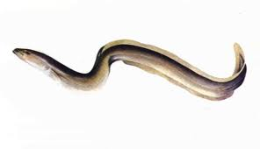
Notes:
Allele

Slide 65
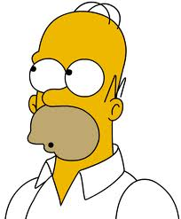
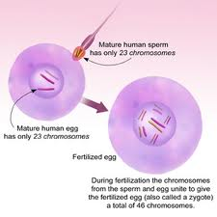
Notes:
Homozygote

Slide 66
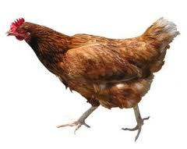
P
O
Notes:
Phenotype

Slide 67
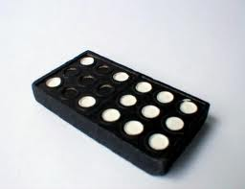
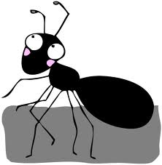
Notes:
Dominant

Slide 68
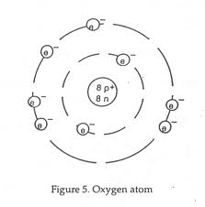
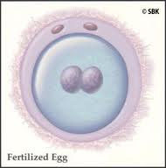
A
Notes:
Heterozygote

Slide 69
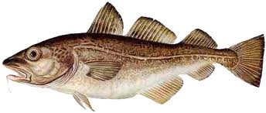
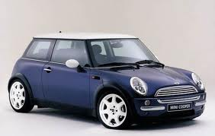
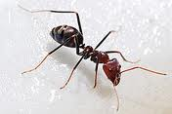
i
Notes:
Codominant

Slide 70
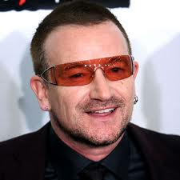
- B + M
Notes:
Monohybrid cross

Slide 71
Notes:
Recessive

Slide 72
Notes:
linkage

Slide 73
E
TER
Notes:
Epistasis

Slide 74
Notes:
Hypostatic

Slide 75
d
Notes:
Chi-squared test

Slide 76
T
Notes:
Locus

Slide 77
Alleles as different forms of the same gene.
An understanding of the principles of monohybrid and dihybrid
Mendelian inheritance. Chi squared. Codominance. Linkage.
Sex linkage as illustrated by haemophilia.

Slide 78
Chi-Square Table

Slide 79
Using the Table
In our example of 290 purple to 110 white, we calculated a chi-square value of 1.333, with 1 degree of freedom.
Looking at the table, 1 d.f. is the first row, and p = 0.05 is the sixth column. Here we find the critical chi-square value, 3.841.
Since our calculated chi-square, 1.333, is less than the critical value, 3.841, we “fail to reject” the null hypothesis. Thus, an observed ratio of 290 purple to 110 white is a good fit to a 3/4 to 1/4 ratio.

Slide 80
Another Example: from Mendel
phenotype | observed | expected proportion | expected number
round yellow | 315 | 9/16 | 312.75
round green | 101 | 3/16 | 104.25
wrinkled yellow | 108 | 3/16 | 104.25
wrinkled green | 32 | 1/16 | 34.75
total | 556 | 1 | 556

Slide 81
Finding the Expected Numbers
You are given the observed numbers, and you determine the expected proportions from a Punnett square.
To get the expected numbers of offspring, first add up the observed offspring to get the total number of offspring. In this case, 315 + 101 + 108 + 32 = 556.
Then multiply total offspring by the expected proportion:
--expected round yellow = 9/16 * 556 = 312.75
--expected round green = 3/16 * 556 = 104.25
--expected wrinkled yellow = 3/16 * 556 = 104.25
--expected wrinkled green = 1/16 * 556 = 34.75
Note that these add up to 556, the observed total offspring.

Slide 82
Calculating the Chi-Square Value
Use the formula.
X² = (315 - 312.75)2 / 312.75
+ (101 - 104.25)2 / 104.25
+ (108 - 104.25)2 / 104.25
+ (32 - 34.75)2 / 34.75
= 0.016 + 0.101 + 0.135 + 0.218
= 0.470.

Slide 83
D.F. and Critical Value
Degrees of freedom is 1 less than the number of classes of offspring. Here, 4 - 1 = 3 d.f.
For 3 d.f. and p = 0.05, the critical chi-square value is 7.815.
Since the observed chi-square (0.470) is less than the critical value, we fail to reject the null hypothesis. We accept Mendel’s conclusion that the observed results for a 9/16 : 3/16 : 3/16 : 1/16 ratio.
It should be mentioned that all of Mendel’s numbers are unreasonably accurate.

Slide 85
DNA deoxyribonucleic acid (Higher Tier)
DNA is made up of four different bases.
Three bases make one amino acid.
A gene is made up of hundreds of these bases.
A mutation can change the structure of the protein.

Slide 86
DNA Fingerprints
The unique pattern in your DNA can be used to identify you

Slide 87
How can you tell who’s saliva sample this is?

Slide 88
http://www.youtube.com/watch?feature=player_embedded&v=NWqgZUnJdAY

Slide 89
Genotype
Recessive
Chromosome
Allele
Phenotype
Gametes
Gene
Homozygous
Heterozygous
DNA

Slide 90
Genotype
Alternative forms of a gene
Recessive
Genetic make up of an individual
Chromosome
Sex Cell – egg (Ovum) or Sperm
Allele
The two alleles present are different
Phenotype
Strands of DNA
Gametes
The two alleles present are the same
Gene
Physical appearance of a gene
Homozygous
DeoxyriboNucleic Acid
Heterozygous
Sections of DNA (chromosome) that determine inherited characteristics
DNA
The characteristics of this allele will only be seen if there is no dominant gene present

Slide 91
Objectives I should be able to…
. 3.18 describe patterns of monohybrid inheritance using a genetic diagram
. 3.20 predict probabilities of outcomes from monohybrid crosses

Slide 92
Task 1: Use the table below to match each of the keywords in the word bank to its definition (grade D/C)
Task 2: Read the information about John and Carl then answer the questions below:
Describe Carl’s phenotype (grade C) ____________________________________________________________________________________________
What is Carl’s genotype (grade B)?
______________________________________________
What could John’s genotype be (grade B)?
____________________________________________________________________________________________
Why can we not be sure exactly what Carls genotype is? (Grade B/A) ____________________________________________________________________________________________ ____________________________________________________________________________________________
Word bank:
Phenotype ; Dominant ;Genotype ; Recessive ; Allele
Keyword | Definition
 | Different versions of the same gene.
 | Your physical appearance.
 | The combination of alleles you have for a gene.
 | An allele that is always expressed even if you only have one copy of it.
 | An allele that is only expressed if you have two copies of it.
John
Carl
Like all human beings, John and Carl each have two copies of the gene that controls whether or not they have dimples.
The version of the gene (allele) that causes dimples is dominant. It has the letter “D”.
The allele that causes you to not have dimples is recessive. It has the letter “d”.
Notes:
Students to complete questions.

Slide 93
Characteristic | Possible Alleles | Your monsters Genotype (its combination of alleles) | Your monsters Phenotype (what the monster looks like)
Skin colour | Red- Dominant (R) Blue -Recessive (r)
Spikes | Yes- Dominant (S) No -Recessive (s)
Tail | Short- Dominant (T) Long -Recessive (t)
Fire breathing | Yes- Dominant (F) No -Recessive (f)
Monster design:
What characteristic will my monster pass on?
Parents Genotypes:
Alleles in sex cells:
Possible genotypes of offspring:
Notes:
Students to use the table at the top of the page to determine the genotype of an imaginary animal. For each characteristic they flick a coin; heads their monster has a dominant allele, tails a recessive. They need to flip the coin twice for each characteristic i.e. For skin colour Head + Tails = genotype Rr.
Students complete the table then using the phenotype information draw a sketch of their monster in the box on the bottom left.
Then students work with a partner to breed their monsters together. They select one characteristic and use the genetic cross diagram (bottom right) to work out the genotypes of potential offspring. This could lead into a discussion on creating new variations.......

Slide 94
http://news.bbc.co.uk/1/hi/uk/7569064.stm

Slide 95
Harry Potter Genetics

Slide 96
Revision of key words 1
Different forms of the same gene are called alleles
Different forms of the same gene are called alleles
Different forms of the same gene are called alleles
Each gene controls a different feature (e.g. eye colour)
Each gene controls a different feature (e.g. eye colour)
Each gene controls a different feature (e.g. eye colour)
We have 23 pairs (or 46 single) chromosomes.
We have 23 pairs (or 46 single) chromosomes.
We have 23 pairs (or 46 single) chromosomes.
A gene is a short section of the chromosome
A gene is a short section of the chromosome
A gene is a short section of the chromosome
Chromosomes are found in the nucleus
Chromosomes are found in the nucleus
Chromosomes are found in the nucleus
…except for the sex cells (egg and sperm)
…except for the sex cells (egg and sperm)
…except for the sex cells (egg and sperm)
Chromosomes are found in pairs in most cells…
Chromosomes are found in pairs in most cells
Chromosomes are found in pairs in most cells…

Slide 97
Revision of key words 2
For each characteristic, a child inherits one allele from the mother and one allele from the father.
This means that we have two alleles for every characteristic (e.g. eye colour).
The alleles in a pair can be the same as each other or different.
Alleles can be dominant or recessive.

Slide 98
Revision of key words 3
B = brown eye allele
b = blue eye allele
There are only dominant brown eye alleles so the child will have brown eyes.
There are only dominant brown eye alleles so the child will have brown eyes.
There are only dominant brown eye alleles so the child will have brown eyes.
2 dominant alleles
BB
2 recessive alleles
bb
1 dominant and 1 recessive allele
Bb
There are only recessive blue eye alleles so the child will have blue eyes.
There are only recessive blue eye alleles so the child will have blue eyes.
There are only recessive blue eye alleles so the child will have blue eyes.
The dominant brown eye allele ‘wins’ so the child will have brown eyes.
The dominant brown eye allele ‘wins’ so the child will have brown eyes.
The dominant brown eye allele ‘wins’ so the child will have brown eyes.

Slide 99
Discussion Task:
Is the ‘magical allele’ dominant or recessive?
Discuss the following information with your partner and use it to decide whether the ‘magical allele’ is dominant or recessive.
Harry’s parents were both wizards.
Ron’s parents are both magical – and all
of his brothers and sisters are witches and
wizards too.
Both of Hermione’s parents are Muggles
but she has still inherited magical abilities.

Slide 100
Harry’s mum’s family
Remember:
The ‘magical’ (m) allele is RECESSIVE
The ‘muggle’ (M) allele is DOMINANT
Your task:
Mm
Mm
Harry’s grandparents
M
m
M
m
MM
Mm
mM
Harry’s mum
Aunt Petunia
mm
Muggle
Muggle
Muggle
MAGIC
So, what was the % chance of Harry’s mum being magic?

Slide 101
The Dursley family
Remember:
The ‘magic’ (m) allele is RECESSIVE
The ‘muggle’ (M) allele is DOMINANT
Your task:
Aunt Petunia
Uncle Vernon
Mm
MM
M
m
M
M
Cousin Dudley
MM
MM
mM
mM
Muggle
Muggle
Muggle
Muggle
So, what was the % chance of Dudley being magic?

Slide 102
The Weasley family
Your task:
Mr Weasley
Mrs Weasley
mm
mm
m
m
m
m
Bill Weasley
Charlie Weasley
Percy Weasley
Fred and George Weasley
Ron Weasley
Ginny Weasley
mm
mm
mm
mm
MAGIC
MAGIC
MAGIC
MAGIC
What was the % chance of the Weasley children being magic?

Slide 103
Muggle-born witches and wizards
Hermione’s mum and dad are both Muggles…
(Some people question how Muggles are able to produce magical children. It is likely that they would have a magical ancestor, possibly several generations ago.)
…but Hermione is a witch.
What combination of alleles must Mr and Mrs Granger have?

Slide 104
Is it possible for a child with one magical parent and one Muggle parent to be born with magical abilities?
(Voldemort (Tom Riddle) was a half-blood as his father, another Tom Riddle (snr) was a Muggle and his mother was pure-blood.)

Slide 105
Squibs
A Squib is a child born to magical parents but who has no magical ability.
(It is often considered embarrassing to have a Squib in the family.)
So how come Argus Filch is a Squib even though both of his parents are magic?

Slide 106
Your task:
One way of drawing genetic cross diagrams…
Another way of drawing genetic cross diagrams… Punnet squ...
Choose 2 examples of Harry Potter genetics.
Draw a genetic cross diagram for each one.
Next to each diagram, give the % chance of a child being a witch or wizard in that family.
1. Mm and Mm (The Grangers or Harry’s mum’s family)
2. mm and mm (The Weasleys)
3. MM and Mm (The Dursleys)
4. MM and mm
5. Mm and mm (Voldemort’s family)
Slide 5
Slide 7
Slide 6

Slide 107
Extension task:
Your task:
Write a paragraph to explain how witches and wizards can be born of Muggle parents.
Add another paragraph to explain why it is very rare for Squibs to be born into wizarding families.
Mr and Mrs Weasley have had 6 boys and 1 girl. If they had another child, what would be the % chance of it being a girl? Draw a genetic cross diagram to help you explain. (Girl = XX. Boy = XY)

Slide 108
One way of drawing genetic cross diagrams…
Your task:
Mother’s alleles
Father’s alleles
Mm
Mm
M
m
M
m
MM
Mm
mM
mm

Slide 109
Another way of drawing genetic cross diagrams… Punnet squares

Slide 110
Another way of drawing genetic cross diagrams… Punnet squares

Slide 111
Another way of drawing genetic cross diagrams… Punnet squares
 | M | m
Mother’s alleles →

Slide 112
Another way of drawing genetic cross diagrams… Punnet squares
 | M | m
M
m
Mother’s alleles →
Father’s alleles ↓

Slide 113
Another way of drawing genetic cross diagrams… Punnet squares
 | M | m
M | MM | Mm
m | mM | mm
Mother’s alleles →
Father’s alleles ↓

Slide 114
Another way of drawing genetic cross diagrams… Punnet squares
Your task:
 | M | m
M | MM | Mm
m | mM | mm
Mother’s alleles →
Father’s alleles ↓

Slide 116
You should be able to discuss…
Alleles as different forms of the same gene.
An understanding of the principles of monohybrid and dihybrid Mendelian inheritance. Chi squared. Codominance. Linkage.
Sex linkage as illustrated by haemophilia.

Slide 121
Caster Semenya

Slide 122
Write down the sex chromosomes during the chorus…
http://www.youtube.com/watch?v=WDswiT87oo8

Slide 123
Sex linkage occurs when the genes for a certain characteristic are carried on the sex chromosomes.
They do not determine the sex of the organism, they just happen to occur on the sex chromosomes.
The Y chromosome is shorter than the X chromosome, so it carries fewer alleles.

Slide 124
The allele for colour vision is carried on the part of the X chromosome that is missing from the Y chromosome.
There is a recessive allele that causes colour blindness.
Females inherit 2 alleles for colour vision, one on each X chromosome, if they inherit one faulty allele, they are unaffected.
Males only inherit one allele from their mother, if they inherit the faulty allele they are colour blind.
As a result, colour blindness is more prevalent in males.

Slide 125
http://www.youtube.com/watch?v=CWyrp3hu4KE

Slide 129
Haemophilia is another example of sex linked inheritance, where females can be unaffected carriers, but males will suffer from the disease if they inherit the faulty allele.
Normal Carrier
Gametes | X^{H} | X^{h}
X^{H} | X^{H}X^{H} | X^{H}X^{h}
Y | X^{H}Y | X^{h}Y
Normal Sufferer

Slide 130
Tortoiseshell Cats
All tortoiseshell cats are female, this is because the allele for coat colour is carried on the X chromosome.
If a female cat inherits a black allele and a ginger allele she will be tortoiseshell.
X^{B}X^{G}
A male cat can only inherit one of these alleles so he will be either black or ginger.
X^{B}Y or X^{G}Y

Slide 131
X Chromosome Inactivation
Early in a female’s embryonic development, one of the X chromosomes is inactivated. This supercoils to form a Barr Body.
This occurs randomly in each cell, so all the cells that descend from that cell will have either their maternal or paternal X chromosome switched off.
Tortoiseshell cats will have a unique pattern depending upon which chromosome is switched off, as one carries the black gene and one carries the orange gene.

Slide 132
Lethal Genes
Some genes when expressed in the homozygous condition can be fatal for the developing embryo, e.g. the manx cat

Slide 133
The manx gene is dominant over the gene that produces a tail.
If the cat inherits a heterozygous allele combination the gene will be expressed and the cat will not have a tail.
If the cat inherits a homozygous dominant allele the combination, the foetus will not survive.

Slide 134
Birds, insects like butterflies, frogs and some species of fish have a different system for determining gender. In these animals it is the female gamete that determines the sex of an individual. Female gametes can either contain a Z chromosome or a W chromosome. Male gametes contain only the Z chromosome. Females of these species are ZW and males are ZZ.
http://www.nature.com/news/2004/041025/full/news041025-1.html

Slide 135
Questions
1. The genotype and phenotype of certain cat coat colours are shown in the table:
Phenotype | Genotype
 | Male | Female
Black | X^{g}Y | X^{g}X^{g}
Ginger | X^{G}Y | X^{G}X^{G}
Tortoiseshell | - | X^{G}X^{g}
A breeder has a number of black, ginger, and tortoiseshell cats.
If she wants all the female kittens to be tortoiseshell, what are the genotypes and phenotypes of the parents she should use?
What will be the phenotypes of the male kittens in the crosses you have suggested?

Slide 143
http://www.youtube.com/watch?v=vtW3dMZLrtE&feature=relmfu

Slide 149
Cancer

Slide 150
http://www.anorak.co.uk/288298/scare-stories/the-daily-mails-list-of-things-that-give-you-cancer-from-a-to-z.html/

Slide 151
Cancer
Cancer cells do not respond to the mechanisms that control cell cycle
They divide rapidly to form a mass of cells or tumour
Tumours may split (metastasis) and clumps of cells may lodge in different parts of the body causing seconday tumours
Tumours that invade surrounding tissues are malignant

Slide 152
Cancer causin’ mutations
Mutations that cause cancer affect the cell cycle
Multiple mutations that cause cancer usually affects DNA repair mechanisms
Single mutations can cause cancer

Slide 153
Proto-oncogenes code for the proteins that control the cell cycle
If one of these genes mutates it forms an oncogene
Oncogenes produce too much protein so the cell is continually stimulated.
They are dominant genes.

Slide 155
Role of the environment
Environmental factors increase the likelihood of mutations occurring.
Factors like tar in fags, asbestos, chemicals in booze and radiation all increase risk of cancer.
Ultraviolet light is a good example

Slide 156
Melanoma

Slide 157
Read the article and…
Grade B
Explain, using the idea of protein synthesis, how

