Slide 1
Objectives I should be able to…
Grade C
State that mitosis occurs during growth, repair, cloning and asexual reproduction
Grade B
Describe division of a diploid cell by mitosis producing two cells which contain identical sets of chromosomes
Describe division of a cell by meiosis producing four cells, each with half the number of chromosomes, and that this results in the formation of genetically different haploid gametes
Grade A / A*
Compare and contrast mitosis and meiosis

Slide 2
Mitosis
The division of the nucleus
REVISION!!!!!!

Slide 3
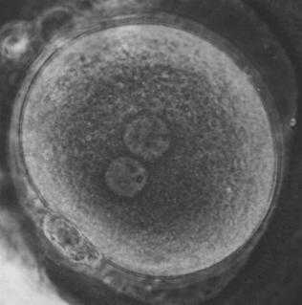
Conception
All animals begin as a fertilised egg cell (a zygote)
Image Credit: Zygote

Slide 4
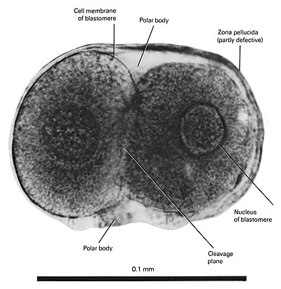
Then it divides…
Image Credit: www.ehd.org/

Slide 5
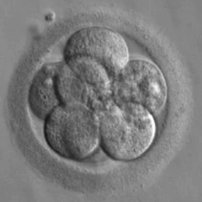
… and divides
Released into the Public Domain by Jrockley

Slide 6
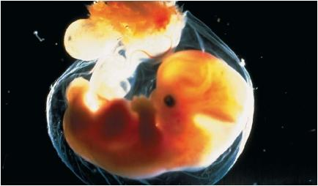
Until it becomes an embryo
Image Credit: www.scienceclarified.com

Slide 7
But what actually happens when a cell divides?
http://www.johnkyrk.com/mitosis.html

Slide 8
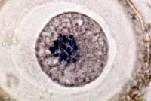
Image Credit: www.bioweb.uncc.edu/

Slide 9
Interphase: In between cell divisions
Centriole
Cytoplasm
Nucleus
Plasma membrane
Nucleus envelope
Nucleolus
The working cell
It grows in size (protein synthesis)
It copies it’s genetic material (replication)

Slide 10
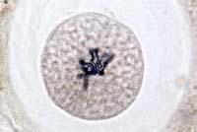
Image Credit: www.bioweb.uncc.edu/

Slide 11
Prophase: Division begins
Centriole divides
Treads appear in the nucleus =
Chromosomes condensing
Nucleus swells
Nucleolus disappears

Slide 12
End of prophase: The nucleus disappears
Nucleus envelope breaks down
Spindle fibres grow out from the ends of the cell
Chromosomes appear as two threads (the chromatids) joined by a constriction (the centromere)
Sister chromatids
Centromere

Slide 13
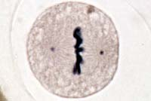
Image Credit: www.bioweb.uncc.edu/

Slide 14
Metaphase: The chromosomes are organised
Chromosomes line up across the equator of the spindle
Joined to fibres by their centromeres

Slide 15
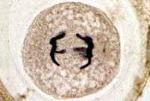
Image Credit: www.bioweb.uncc.edu/

Slide 16
Anaphase: The chromosomes split
The sister chromatids of each chromosome split
The spindle pulls one to each pole

Slide 17
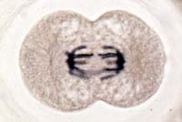
Image Credit: www.bioweb.uncc.edu/

Slide 18
Telophase: The end of mitosis
The nuclei reform
Each one contains a complete set of chromosomes
A new nuclear envelop forms
The chromosomes uncoil
The cytoplasm divides in two to form two identical daughter cells
The cells goes back to work

Slide 19
See the modelling video on lovat.weebly.com

Slide 20
Chromosomes and cell division
Multicellular organisms copy their chromosomes before cell division
They must grow to a mature size
Interphase
The nucleus divides, distributing the chromosomes into two equal groups
Mitosis
The cytoplasm then divides each part taking a nucleus
Cytokinesis

Slide 21
The cell cycle
Some cells may stay in this stage for over a year
Cytokinesis division of the cytoplasm
G₀
M
First growth phase.
Varies in length
Mitosis
G₁
G₂
INTERPHASE
Second growth period
Copying of chromosomes
S
G₁ + S + G₂ = INTERPHASE

Slide 22
Cell cycles are not uniform
Cell type | Cell cycle / h
Bean root tip | 19.3
Mouse fibroblast | 22
Chinese hamster fibroblast | 11
Mouse small intestine epithelium | 17
Mouse oesophagus epithelium | 181

Slide 23
Look at root tips under the microscope. Spot the different phases.
Image Credit: www.bioweb.uncc.edu/
Image Credit: www.bioweb.uncc.edu/
Image Credit: www.bioweb.uncc.edu/
Image Credit: www.bioweb.uncc.edu/
Image Credit: www.bioweb.uncc.edu/

Slide 24
http://www.bbc.co.uk/learningzone/clips/mitosis/13512.html

Slide 25
Objectives I should be able to…
Grade C
State that mitosis occurs during growth, repair, cloning and asexual reproduction
Grade B
Describe division of a diploid cell by mitosis producing two cells which contain identical sets of chromosomes
Describe division of a cell by meiosis producing four cells, each with half the number of chromosomes, and that this results in the formation of genetically different haploid gametes
Grade A / A*
Compare and contrast mitosis and meiosis

Slide 26
Objective You should be able to…
. 3.25 understand that division of a cell by meiosis produces four cells, each with half the number of chromosomes, and that this results in the formation of genetically different haploid gametes

Slide 27
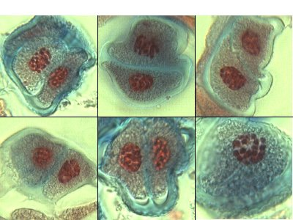
MEIOSIS
The great gene shuffling machine
(From the Greek: meioun to diminish)
Image credit: http://www.smartscience.net/

Slide 28
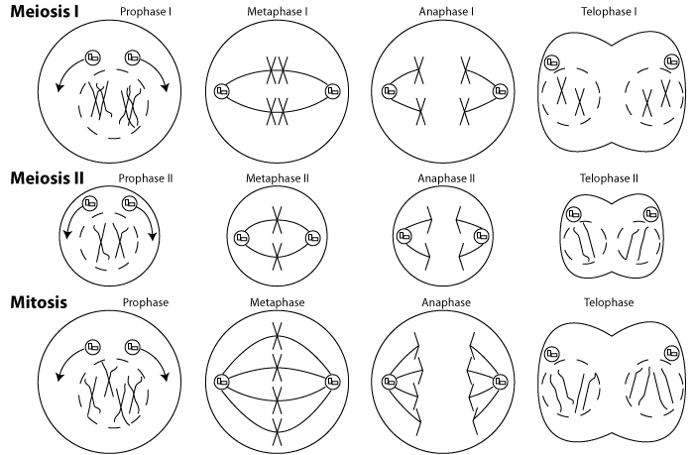

Slide 29
Meiosis performs two functions
It halves the number of chromosomes to make haploid sets
It shuffles the genes to produce new combinations (recombinations)

Slide 30
Meiosis and sexual reproduction
Meiosis is needed to produce sex cells (gametes) with unpaired sets of chromosomes (haploid)
Sex cells are used in fertilisation
At fertilisation two sets of genes come together to form a hybrid with a set of paired chromosomes (diploid)
The hybrid, whilst similar to the parents, is unique

Slide 31
Haploid and Diploid
Karyotypes of somatic cells show paired sets of chromosomes
The origin of the pairs are the maternal and paternal chromosomes of the egg and the sperm
The number of types of chromosomes of a species is constant = n
So the diploid (paired set) = 2n

Slide 32
The sexual reproduction life cycle
Diploid (2n)
Fertilisation
Meiosis
Haploid (n)

Slide 33
Meiosis a two step process
Meiosis 1 is the reduction division
Meiosis 2 resembles mitosis

Slide 34
Meiosis 1: Early Prophase 1
Chromosomes condense
Homologous pairs linked by chiasmata (chiasma sing.)

Slide 35
Meiosis 1: Late Prophase 1
Spindle fibres form and spread out between the centrioles

Slide 36
Meiosis 1: Metaphase 1
The pairs of chromosomes line up on the equator
The orientation of the maternal and the paternal chromosomes is random

Slide 37
Meiosis 1: Anaphase 1
Maternal and paternal chromosomes segregate (pulled separate on the spindle)
They move to opposite poles

Slide 38
Meiosis 1: Metaphase 1 revisited
The pairs of chromosomes could orientate in different ways

Slide 39
Meiosis 1: Anaphase 1 revisited
Resulting in different combinations of chromosomes
This means there are 2^{n} combinations
In humans this means 2²³ or over 8 million combinations

Slide 40
Meiosis 2: Prophase 2
Now the cells are haploid
The chromosomes do not decondense at the end of meiosis 1
Each chromosome has still two chromatids

Slide 41
Meiosis 2: Prophase 2
Spindles form again

Slide 42
Meiosis 2: Metaphase 2
The chromosomes line up on the spindle equator independently

Slide 43
Meiosis 2: Anaphase 2
The sister chromatids separate on the spindle
Each cell will receive a copy of each chromosome type (i.e. it will receive n chromatids all different)
The genes on the different chromosomes are recombined (shuffled)

Slide 44
Meiosis 2: Telophase 2
Four haploid sex cells are produced

Slide 45
Look at root tips under the microscope. Spot the different phases of meiosis.
Image Credit: www.bioweb.uncc.edu/
Image Credit: www.bioweb.uncc.edu/
Image Credit: www.bioweb.uncc.edu/
Image Credit: www.bioweb.uncc.edu/
Image Credit: www.bioweb.uncc.edu/

Slide 46
http://www.bbc.co.uk/learningzone/clips/cell-division-by-mitosis-and-meiosis/6022.html

Slide 47
Differences between Meiosis & Mitosis
Put these statements into the two different groups
Used for Growing
Used for producing Gametes
4 daughter cells made
2 daughter cells made
Genetically different to original cell
Genetically identical to original cell
Daughter cell with same number of chromosomes as original
Daughter cell with half number of chromosomes as original

Slide 48
1. The division of cells to create germ cells is called __________.
a. mitosis
b. cytokinesis
c. diploid split
d. meiosis

Slide 49
2. True or False: During meiosis, only one cell division takes place.

Slide 50
3. Homologous means _____________________________.
a. same trait with different information
b. same trait with the same information
c. different traits with the same information
d. different traits with different information

Slide 51
4. Chromosomes contain ____________________.
a. cells
b. diploid cells
c. genes, or genetic information
d. zygotes

Slide 52
5. True or False: When germ cells combine, they create life.

Slide 53
6. Meiosis divides one diploid cell into ____________________.
a. 4 diploid cells
b. 4 haploid cells
c. 2 haploid cells
d. 2 diploid cells

Slide 54
7. A gamete has ____________________.
a. 23 pairs of chromosomes
b. 46 chromosomes
c. 23 chromosomes
d. A and B

Slide 55
8. A zygote has ____________________.
a. 1 set of chromosomes
b. no chromosomes
c. 23 chromosomes
d. 2 sets of chromosomes

Slide 56
9. Our traits are determined from ____________________.
a. our germ cells
b. our homologous cells
c. our chromosomes
d. None of the above

Slide 57
10. A germ cell is ____________________.
a. haploid
b. diploid
c. triploid
d. sometimes haploid, sometimes diploid, never triploid

Slide 58
11. Crossing over is when ____________________.
a. sister chromosomes entangle and exchange DNA strands
b. parent chromosomes entangle and exchange DNA strands
c. chromosomes split
d. daughter chromosomes split and form sister chromosomes

Slide 59
12. Meiosis II _________ the number of chromosomes of the parent cell.
a. maintains
b. doubles
c. reduces
d. triples

Slide 60
13. True or False: In meiosis, the resulting cells have 23 pairs of chromosomes while
in mitosis the resulting cells have 23 chromosomes.

Slide 61
14. When the cytoplasm and organelles divide at the end of meiosis I,
it is called __________________.
a. telophase I
b. cytokinesis
c. telekinesis
d. metaphase II

Slide 62
15. A tetrad is ____________________.
a. a chromosome with two chromatids
b. a chromosome with four chromatids
c. a chromosomes with no chromatids
d. None of the above

Slide 63
16. Which is the very last phase of Meiosis?
a. metaphase II
b. anaphase I
c. telophase II
d. prophase II

Slide 64
17. Crossing over allows for ____________________.
a. more cells
b. less cells
c. each daughter cell to be identical
d. each daughter cell to be unique

Slide 65
18. In the second phase of Meiosis, or Meiosis II, the two daughter cells divide
into what?
a. 2 daughter cells with half the number of chromosomes
b. 4 daughter cells with half the number of chromosomes
c. 4 cousin cells with different chromosomes
d. None of the above

Slide 66
19. True or False: The random sorting of chromosomes during anaphase II helps
create unique gametes.

Slide 67
20. Which of the following are differences between mitosis and meiosis?
a. Number of times the cells divide
b. Number of chromosomes in the parent cells
c. Exchange of genetic information
d. A and C

Slide 68
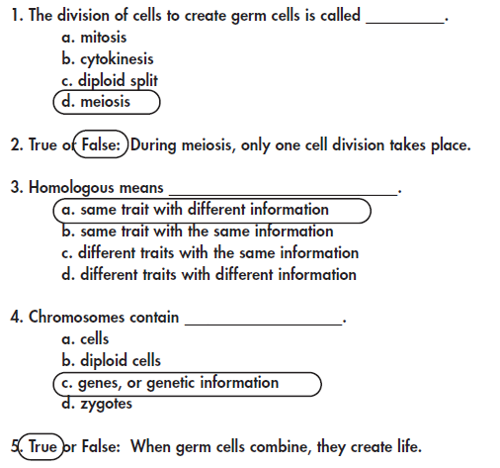

Slide 69
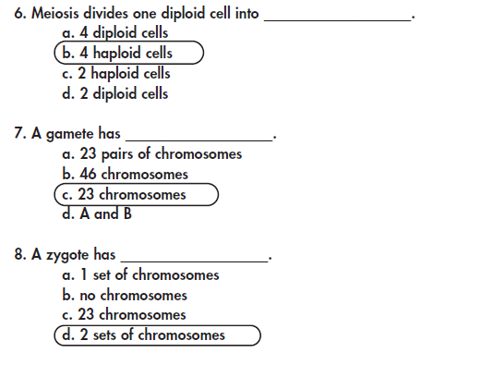

Slide 70
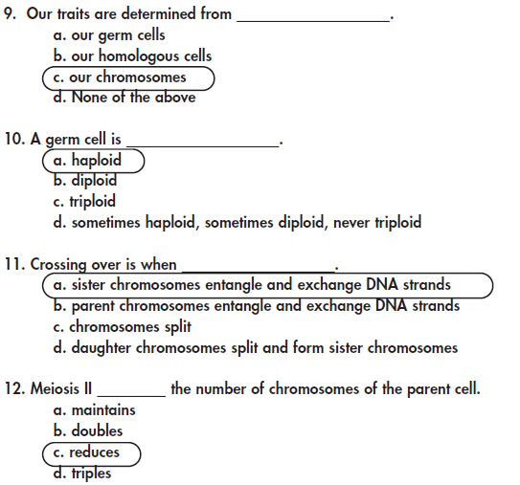

Slide 71
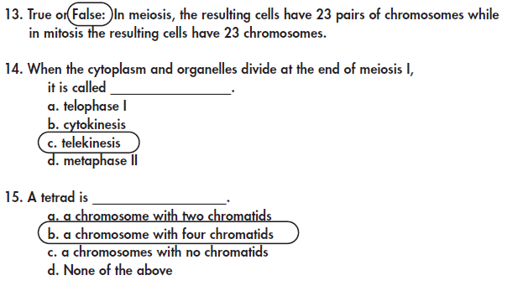

Slide 72
