Slide 1
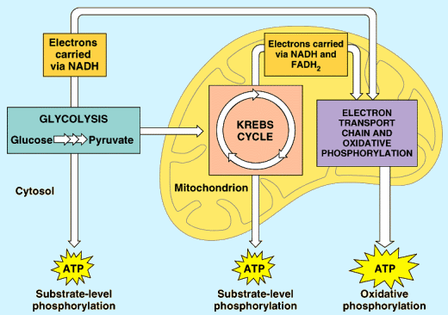
Respiration: Metabolic Pathway Stages

Slide 2
The reactions occur in four stages:
Glycolysis
Link reaction
Krebs cycle
Electron transport chain

Slide 3
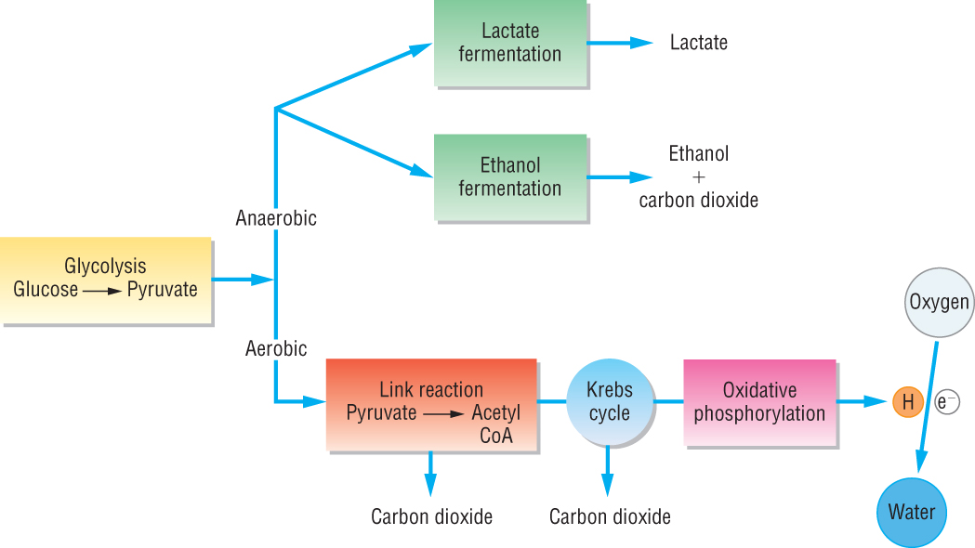

Slide 4
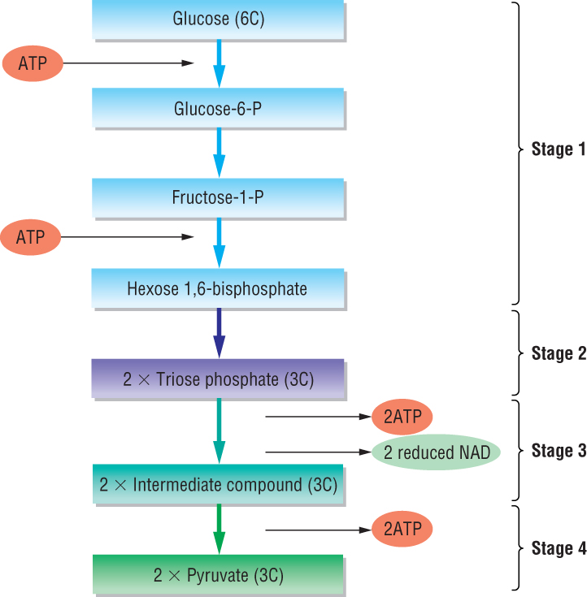
Pyruvate is actively transported into the mitochondria
Notes:
Pyruvate is actively transported into the mitochondria

Slide 5
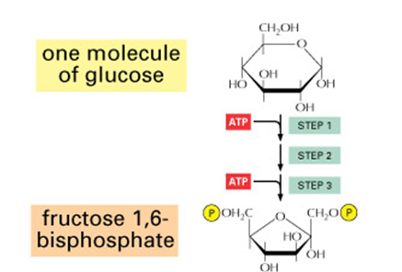
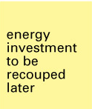
Glycolysis - phosphorylation

Slide 6
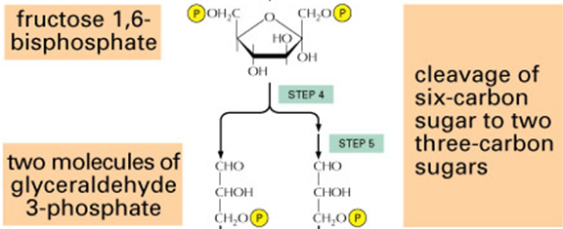
Glycolysis -Lysis
Triose Phosphate

Slide 7
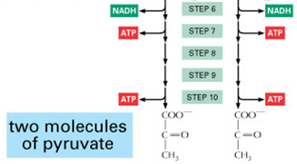
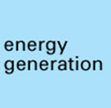
Glycolysis – Oxidation and ATP formation
http://www.youtube.com/watch?v=O5eMW4b29rg&feature=related
7 minute video of Glycolysis
Triose Phosphate
Triose Phosphate
http://highered.mcgraw-hill.com/sites/0072507470/student_view0/chapter25/animation__how_glycolysis_works.html

Slide 8
Production of Acetyl-CoA
©1998 by Alberts, Bray, Johnson, Lewis, Raff, Roberts, Walter. http://www.essentialcellbiology.com
Published by Garland Publishing, a member of the Taylor & Francis Group.

Slide 9
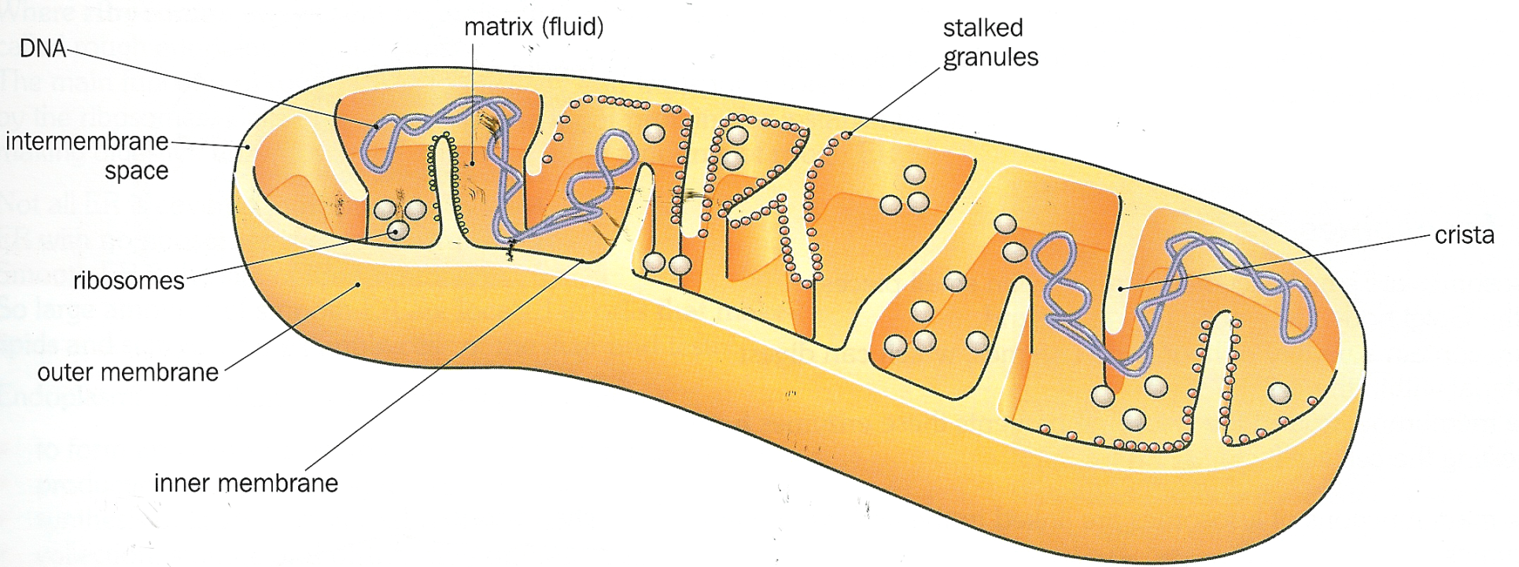
Mitochondria
Contains enzymes (proteins)
ATP synthase
Greatly increases the surface area for attachment of enzymes
Codes for protein
For protein synthesis
The outer membrane is permeable to small molecules such as sugars, salts and nucleotides
The inner membrane is selectively permeable, which allows mitochondria to control the composition of the matrix
http://www.youtube.com/watch?v=RrS2uROUjK4&NR=1

Slide 10
Structure | Role
Matrix | Fluid filled. Contains enzymes required for the link reaction and Krebs cycle.
Cristae | Folded inner membrane. Electron transport system takes place here. Cristae create a large surface area for ATP synthesis.
ATP synthase (stalked particles) | Enzyme required for phosphorylation ADP + Pi → ATP
Outer membrane | Controls the entry and exit of substances into and out of the mitochondria. Pyruvate, O₂, ATP move in; ATP and CO₂ move out.

Slide 11
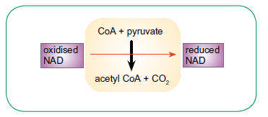
The Link Reaction
Occurs in mitochondrial matrix
Carbon dioxide is removed = decarboxylation
Hydrogen is removed (dehydrogenation) and picked up by hydrogen acceptor molecule, NAD
Enzymes are pyruvate dehydrogenase and pyruvate decarboxylase

Slide 12
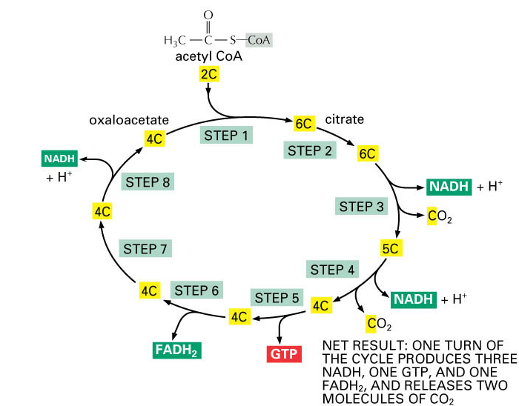
Notes:
GTP is guanosine triphosphate and it is easily converted to ATP

Slide 13
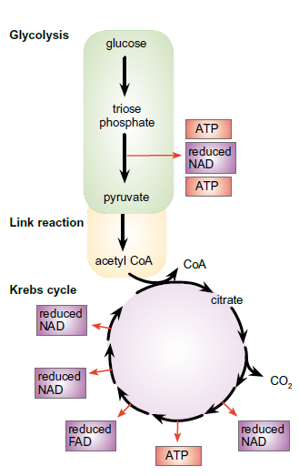
Summary of Glycolysis, Link Reaction and Krebs Cycle

Slide 14
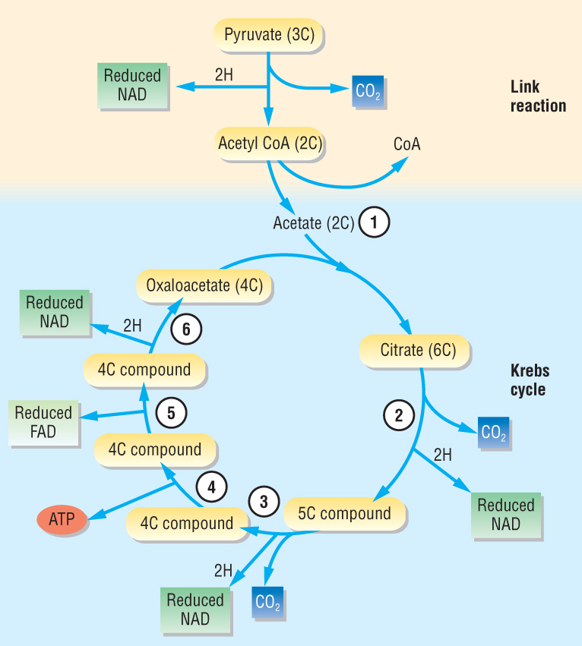
Krebs Cycle
Acetate joins with 4C oxaloacetate to form 6C citrate
Citrate is decarboxylated and dehydrogenated. NAD accepts a pair of H atoms and is reduced
5C compound is decarboxylated and dehydrogenated, forming more reduced NAD
ADP is phosphorylated – reacts with inorganic phosphate in substrate level phosphorylation
Dehydrogenation - FAD is reduced
Dehydrogenation - NAD is reduced and oxaloacetate is regenerated
http://highered.mcgraw-hill.com/sites/0072507470/student_view0/chapter25/animation__how_the_krebs_cycle_works__quiz_1_.html

Slide 15
Electron Transport Chain
In the electron transport chain:
Electrons are donated by reduced FAD and reduced NAD along with H⁺ ions.
The electrons provide the energy needed to pump H⁺ ions into the intermembrane space.
A high concentration gradient of H⁺ ions builds up and the only way the H⁺ can return is via a pore linked to ATP synthase.
This movement of H⁺ ions is called chemiosmosis. It drives the synthesis of ATP.
Once completed the H⁺ ions and electrons join with oxygen to form water.

Slide 16
http://www.funtrivia.com/playquiz/quiz300188225de28.html
Starter

Slide 17
Objectives I should be able to…
Outline the process of oxidative phosphorylation, with reference to the roles of electron carriers, oxygen and the mitochondrial cristae
Outline the process of chemiosmosis, with reference to the electron transport chain, proton gradients and ATPsynthase
State that oxygen is the final electron acceptor in aerobic respiration
Explain why the theoretical maximum yield of ATP per molecule of glucose is rarely, if ever, achieved in aerobic respiration

Slide 18
Inner membrane of mitochondria Electron carrier molecules make up electron transport chain
http://www.youtube.com/watch?v=KXsxJNXaT7w&feature=related
http://www.youtube.com/watch?v=KXsxJNXaT7w
http://highered.mcgraw-hill.com/sites/0072507470/student_view0/chapter25/animation__electron_transport_system_and_atp_synthesis__quiz_1_.html

Slide 19
Oxidative Phosphorylation

Slide 20
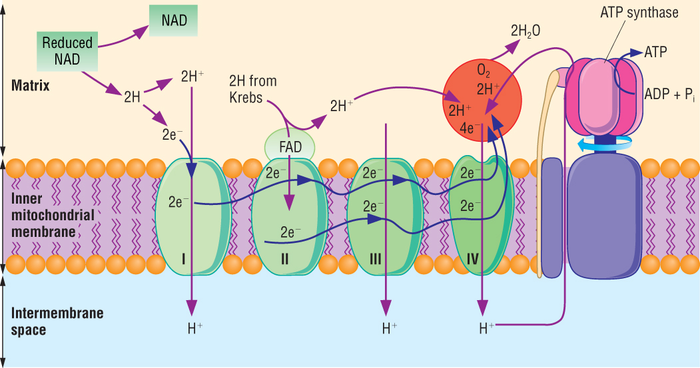
http://www.youtube.com/watch?v=3aZrkdzrd04&feature=related
Respiration Song

Slide 21
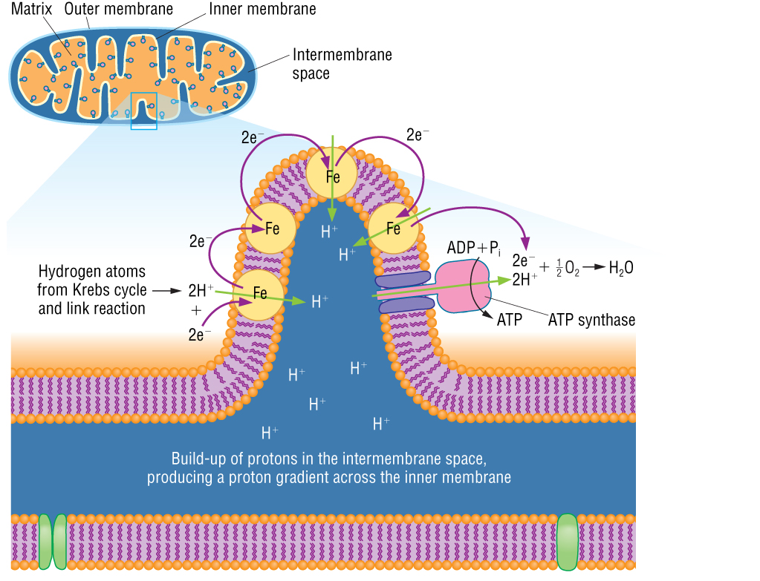

Slide 22
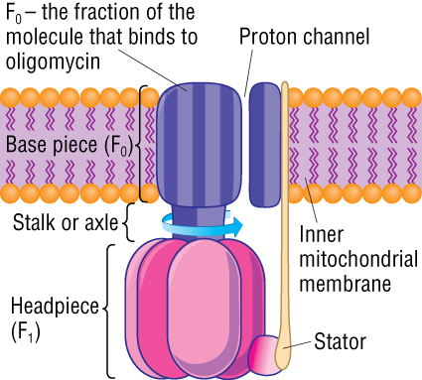
http://www.dnatube.com/video/104/ATP-synthase-structure-and-mechanism

Slide 23
http://www.youtube.com/watch?v=BGU-g4IYD7c

Slide 24
Roles of molecules in oxidative phosphorylation
Electron carriers:
– as they gain electrons they become reduced
– as they lose electrons they become oxidised
– energy released by the electrons as they pass along the chain is used to pump H⁺ ions from matrix into inter-membrane space
Oxygen: the final electron acceptor, combines with H⁺ ions to form water (H₂O).
Cristae: the infolded inner membrane, increases the surface area for enzyme attachment (site of ATP synthase). Chemiosmosis occurs across the membrane.

Slide 25
Yield of respiration
 | Aerobic respiration |  |  |  | Anaerobic respiration
 | ATP | NADH | FADH₂ | Total ATP | ATP
Glycolysis
Link reaction (2 × pyruvate)
Krebs cycle (2 cycles)
Total |  | (×3) | (×2)
Total ATP

Slide 26
 | Aerobic respiration |  |  |  | Anaerobic respiration
 | ATP | NADH | FADH₂ | Total ATP | ATP
Glycolysis | 4, -2 | 2 | 0 | 8 | 4, -2
Link reaction (2 × pyruvate) | 0 | 2 | 0 | 6 | 0
Krebs cycle (2 cycles) | 2 | 6 | 2 | 24 | 0
Total | 4 | 10 (X3) | 2(X2) | 38 | 2
Total ATP | 4 | 30 | 4 |  | 2

Slide 27
Theoretical versus real yield in aerobic respiration
The theoretical yield is greater than the actual yield owing to:
leakage of H ions when passing across membrane
ATP is used in active transport of pyruvate from cytoplasm into mitochondria
ATP is used to move the reducing power (hydrogen) from the cytoplasm into mitochondria*
Notes:
*Reduced NAD cannot pass through the inner mitochondrial membrane. So how does the reducing power get to the matrix? In the cytoplasm, oxaloacetate is reduced to malate by NADH2. Malate then enters matrix and is re-converted to oxaloacetate and NADH2, This leaves NAD outside in the cytoplasm to be re-cycled in glycolysis. Oxaloacetate is changed into aspartate which moves back into the cytoplasm and re-converted to oxaloacetate

Slide 28
Anaerobic Respiration
Summary
Lower yield because:
no oxygen, no final electron acceptor, no
oxidative phosphorylation
no Krebs cycle
no Link reaction
So only 2 ATP made in anaerobic respiration compared with 34 ATP in aerobic respiration

Slide 29
The fate of pyruvate under anaerobic conditions in mammals – the lactate pathway

Slide 30
The fate of pyruvate under anaerobic conditions in yeast – ethanol fermentation
Notes:
30

Slide 31
Anaerobic respiration in mammals versus yeast
 | Mammals | Yeast
Uses | Glucose | Glucose
What is oxidised | Reduced NAD to form NAD+ | Reduced NAD to form NAD+
Pyruvate is converted to | Lactate | Ethanal then ethanol
Hydrogen acceptor is | Pyruvate | Ethanal
Enzyme(s) involved | lactate dehydrogenase | ethanal dehydrogenase ethanol dehydrogenase

Slide 32
Summary of whole process
http://www.qcc.cuny.edu/BiologicalSciences/Faculty/DMeyer/respiration.html
Glycolysis
http://www.mcgrawhill.ca/school/applets/abbio/quiz/ch05/how_glycolysis_works.swf
Krebs Cycle
http://www.mcgrawhill.ca/school/applets/abbio/quiz/ch05/how_the_krebs_cycle_wor.swf
Electron Transport Chain
http://highered.mcgraw-hill.com/sites/0072437316/student_view0/chapter9/animations.html#
How NAD works
http://www.mcgrawhill.ca/school/applets/abbio/quiz/ch05/how_nad_works.swf

Slide 33
Oxidative phosphorylation
To the tune of californication:
http://www.youtube.com/watch?v=wqqYIgY40OE&feature=related
More silly songs:
http://www.youtube.com/watch?v=xmpd4WwOqks

