Slide 1
G5 Population Ecology

Slide 2
There are organisms that display extreme r- or K-strategies, but most organisms have life histories that are intermediate on the continuum, displaying some r-traits but also some K-traits.

Slide 3
 | K- strategy | S- strategy
Trees | Live a long time Good competitors | Very large number of seeds Spread over a large area
Turtles | Live a long time | Many eggs No care for young Many young die very early

Slide 4
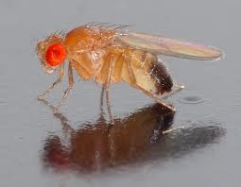
Some organisms such as the vinegar fly Drosophila melanogaster switch strategies depending on environmental conditions.

Slide 5
Techniques used to estimate the population size of an animal species based on a capture- mark- release- recapture method

Slide 6
If we want to know the size of a certain population, we can use the technique known as ‘capture - mark - release - recapture’ and a calculation known as Lincoln Index.

Slide 7
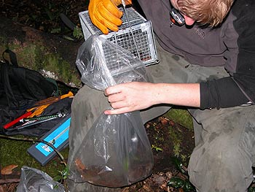
You capture, mark the animal without harming them then releasing to the original population.

Slide 8
The first sample (n1) is a number of individuals from the total population. The same applies for the second sample (n2) but, of course, they are different individuals so cannot be drawn the same as the first sample. Some individuals of the second sample are marked (n3).

Slide 9
The accuracy of using Lincoln index based on data from a mark-recapture investigation depends on several factors: - the population needs to have very low natality, mortality, immigration and emigration. - the method of capturing needs to have little effect on the animal.

Slide 10
- If being captured is pleasant (e.g. awarded with food), then animals become “trap-happy”. They will allow themselves to be caught again in larger numbers. This increases the size of n3 which will decrease the estimate for N. - If being captured is negative, they become “trapshy” which will decrease n3 and inflate N.

Slide 11
the method of being marked must have little effect on the animal. If the mark makes them more visible, they become prey in larger numbers, reducing n3 and inflating N and vice versa. Marks must also remain in place for the appropriate period but should disappear after some time. Insects have been marked with a text marker which turned out to be toxic to them.

Slide 12
Example calculation Mark-release-recapture is used to estimate the population of turtles in a small lake. In the first sampling, 23 turtles are captured and the backs of their shells are marked with paint. The turtles are released into the lake. In the second sampling, 28 turtles are captured, of which nine carry paint markings.

Slide 14
G.5.4 Describe the methods used to estimate the size of commercial fish stocks.

Slide 15
The International Council for the Exploration of the Sea (ICES) is an organization which provides estimates of fish stock in the North Atlantic. Scientists from 19 countries work together, collecting and interpreting data. In general, the scientists aim to take a sample of 200 fish from every 1000 tones of fish brought into port. They collect data on age, length, and breeding condition of the fish.

Slide 16
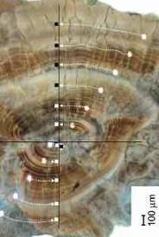
Every year, fish grow a ring on the small bones, involved in balance, on either side of the brain. This is used to decide their age. The fish caught should be a broad range of ages.

Slide 17
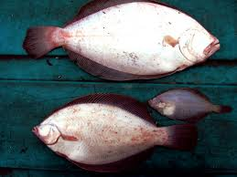
If only young fish are caught, it might mean that the total number of fish of that species (the stock) is reducing, possibly due to overfishing.

Slide 18
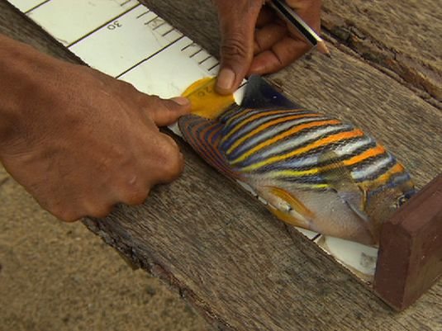

Slide 19
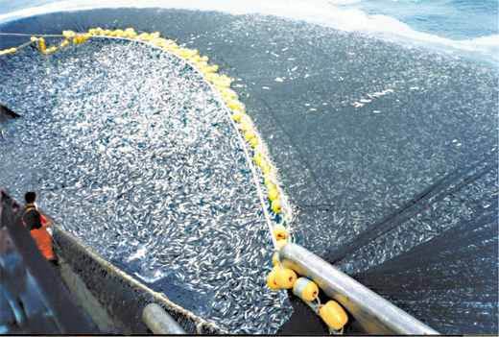

Slide 20
The scientists also catch fish in a standard manner. They go to a randomly assigned grid section, and fish for a standard amount of time, using standard equipment. The catch is then compared to that caught at other sites and/or at other times. This also provides information about fish stocks.

Slide 21
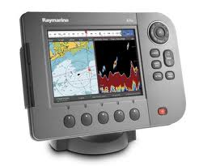
Research vessels also use echo sound equipment to detect schools of fish. The equipment can tell them the size of the school but sometimes it is difficult to decide exactly which species. In those cases, they may trawl (fish) to confirm the species they were studying.

Slide 22
Yet another method employed is to use a very fine net to catch eggs and larvae as they float in between plankton. As only adult fish produce eggs, the number of eggs and larvae gives an indication of the number of adult fish of the species. Every May and October, mathematical models are used to estimate the size of the fish stock.

Slide 23
One of the more commonly used models is the Virtual Population Analysis (VPA). It uses the number and age of fish caught to estimate the number of fish that were around before the start of the data collection. The estimates are given to the EU and to each of the 19 countries that are members of ICES.

Slide 24
G.5.5 Outline the concept of maximum sustainable yield in the conservation of fish stocks.

Slide 25
ICES gives advice on limits to catching fish. They base their advice on the concept that there should be enough fish left to ensure production of a sufficiently large next generation

Slide 26
The precautionary biomass limit is higher than the biomass limit. It allows for the difficulty of estimating the total biomass of a species.

Slide 29
G.5.6 Discuss international measures that would promote the conservation of fish.

Slide 30
Reducing the amount of fish allowed to be caught can cause fishermen severe economic difficulties as they often have made investments into the latest technology on their vessels which need to be paid off.

Slide 31
Aquaculture/Fish farming/ Hatc heries There are many fish farms throughout the world, successfully breeding and growing many different species.

Slide 32
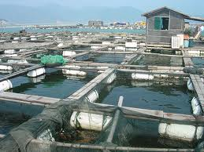
Areas or artificial ponds are created where fish eggs can be hatched and reared to be returned to the seas to support dwindling stocks.

Slide 33
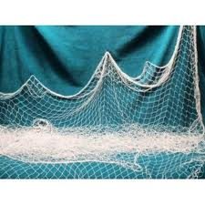
Mesh size Setting a minimum mesh size will allow small sized fish to escape the net.

Slide 34
Identifying no fishing zones Certain areas could be declared no fishing zones and become marine nature reserves. Fish could use these for breeding. This would promote the amount of eggs and increase the size of the next generation.

Slide 35
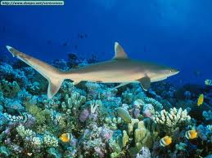
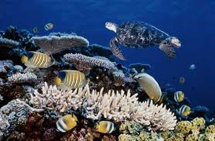
Great Barrier Reef in Australia

