Slide 1
Gas Exchange in Plants
Revision slides

Slide 2
Gas Exchange in Leaves
Plants, like animals, respire aerobically.
So they require oxygen and produce carbon dioxide
In daylight they also photosynthesise – and they do this faster than they respire
The oxygen produced in photosynthesis is enough to supply the leaf cells for respiration.

Slide 3
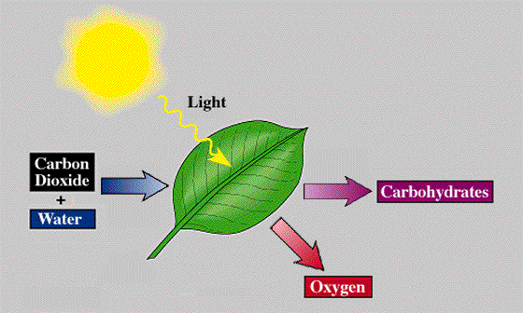
Reminder
Photosynthesis:

Slide 4
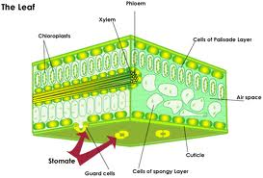
Darkness
In darkness there is no photosynthesis only respiration
The plant doesn’t use a transport system – each cell obtains gases it needs by diffusion

Slide 5
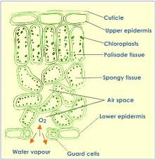
Structure of a leaf

Slide 6
Label your own

Slide 7
The gas exchange surface
The gas exchange surface is the surfaces of the mesophyll cells in contact with air spaces in the leaf.
The surface area is large and diffusion distances are small – carbon dioxide or oxygen molecules only have to travel from an air space across a single cell wall to get to the cytoplasm in the cell.

Slide 8
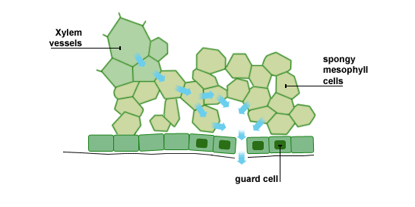

Slide 9
The plants problem
Losing water from the gas exchange surface by evaporation across the gas exchange surface.
Water evaporates from the wet cell walls in contact with air spaces in the leaf and it is lost by transpiration.

Slide 10
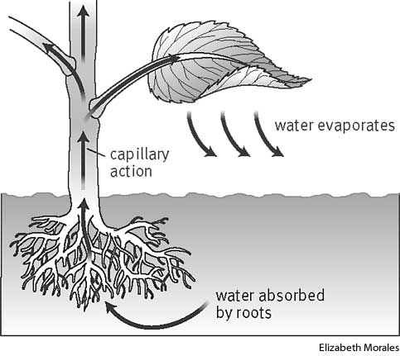
FYI: Transpiration

Slide 11
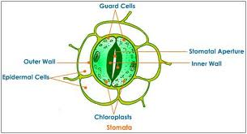
Reducing Water Loss
High humidity
Low temperatures
Out of the wind
Closing the stomata

Slide 12
Stomata

Slide 13
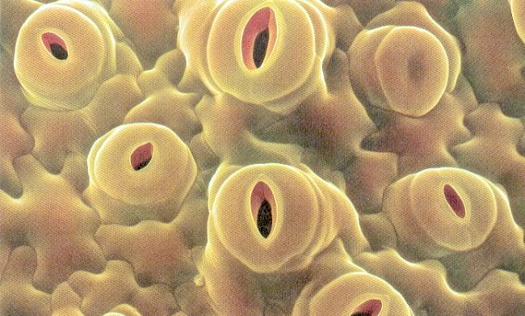
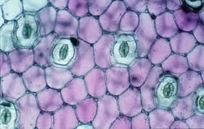
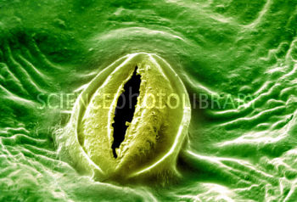
How stomata open and close
Carbon dioxide and oxygen diffuse in and out of leaves through small openings called stomata.

Slide 14
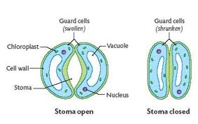
How stomata open and close
Most stomata are underneath the leaf
A stomata is surrounded by 2 guard cells
Guard cells control the opening and closing
this controls the diffusion of gas and water vapour

Slide 16
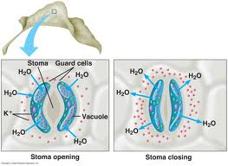

Slide 17
Guard Cells
Have chloroplasts
Cell walls are especially rigid
When cells absorb water it expands and becomes turgid
Their rigid inner wall resists expansion and they become more curved
When they lose water and become flaccid and collapse closing the stomata

