Slide 2
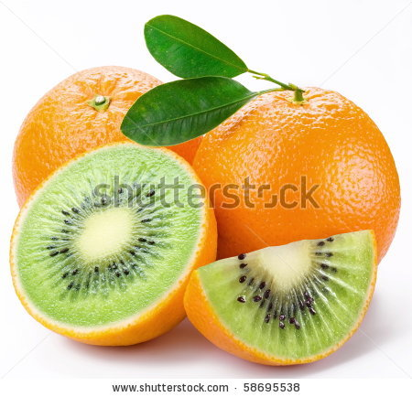
Definition
Genetic engineering refers to the scientific process of manipulating genetic material.
It involves altering, replacing or transferring genes from one organism to another for some specific purpose.
Usually, genes are transferred to impart some characteristic of the source organism to the target organism.

Slide 3
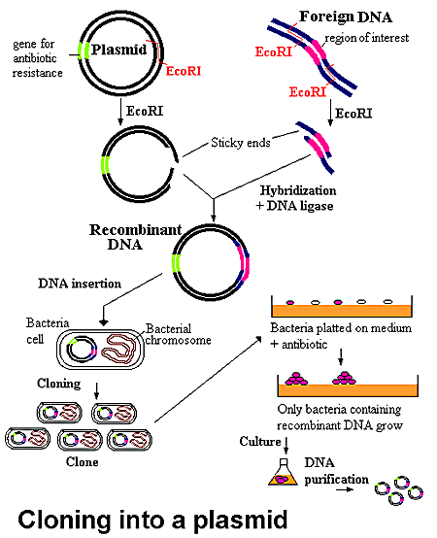
Gene Isolation
In genetic engineering, a gene of interest is first identified and isolated from the thousands of genes an organism may have.
The isolated gene is then cut from its source DNA molecule with restriction enzymes and, using a vector virus or bacterium carrier, is transferred or blasted (with a gene gun) into a target DNA molecule.

Slide 4
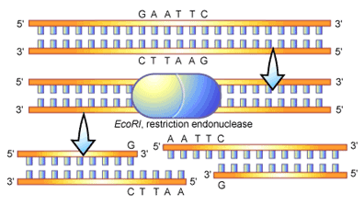
Restriction enzymes
Restriction enzymes, also called restriction endonucleases, are enzymes that cut DNA at a specific nucleotide sequence.
Restriction enzymes are usually found in bacteria. They are extracted from them for use in genetic engineering.

Slide 5
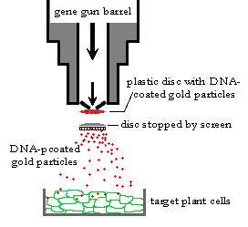
Vectors
Vectors are genetic sequences derived from viruses or bacteria. They are used to move genes into the target cell.
A gene gun is a machine that offers one way of getting genetic material into cells.

Slide 6
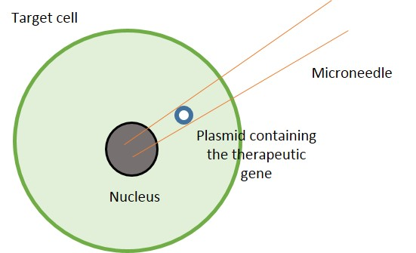
Gene uptake
Most organisms have defence mechanisms to prevent foreign genes from affecting them. They can stop a foreign gene by blocking its ability to express itself.
This is known as gene silencing. To get around gene silencing, a promoter gene is added. It promotes the source gene in the target DNA and makes it more acceptable to the host cell.

Slide 7
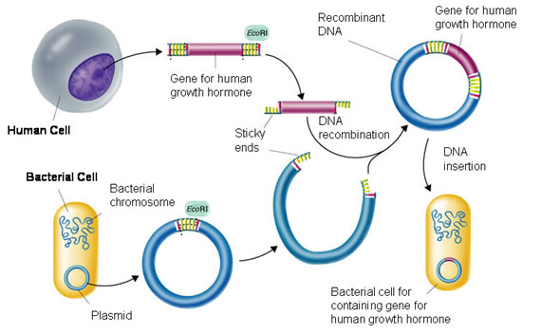
Process of genetic engineering

Slide 8
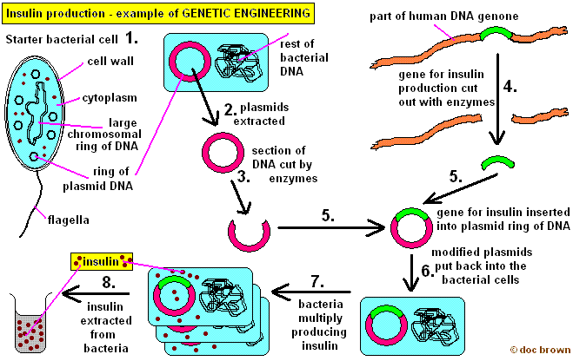
Production of insulin

Slide 9
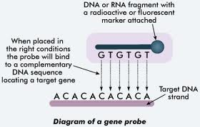
Gene identification
Insulin is a small protein. The gene coding for insulin is located using a gene probe and then isolated from the rest of the DNA in a human cell.

Slide 10
Gene isolation
The EcoR1 restriction endonuclease is used to cut the DNA into small pieces allowing individual genes to be isolated.
The enzyme cuts DNA between specific base sequences (G and A) which the enzyme recognises.
Most restriction enzymes split the strand in a staggered sequence. The unpaired bases at the cut form sticky ends.

Slide 11
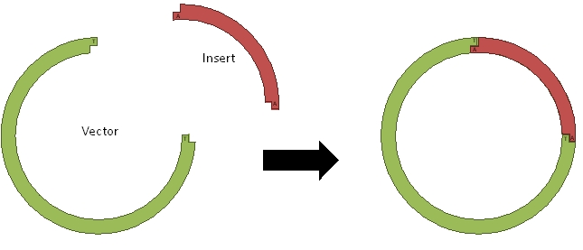
Plasmid vectors
To get the gene into a bacterium a go-between or vector is used. The vector in this process is a plasmid (circular DNA found in a bacterium) from E.coli.
To obtain the plasmids the bacteria containing them are treated to dissolve their cell walls and the plasmids are separated from the cell remains.

Slide 12
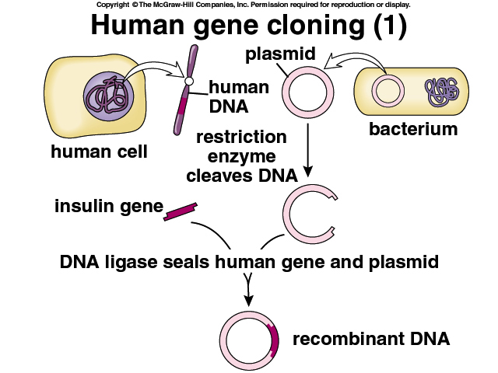

Slide 13
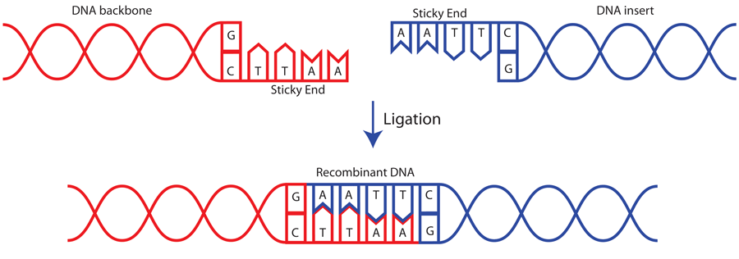
Plasmid vector
The plasmid is cut using the same enzyme, restriction endonuclease. Once again, sticky ends are formed, allowing the donor DNA to be spliced into the vector DNA when the donor and vector DNA are mixed.
The sticky ends are complementary to each other, and can be joined together using DNA ligases. The DNA created is called recombinant DNA.

Slide 14
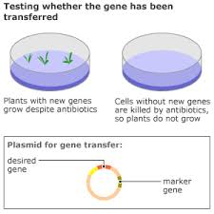
Marker genes
Marker genes that confer antibiotic resistance are included in the recombinant DNA forming the plasmids.
When the bacteria and plasmids are mixed together, only a small proportion of the bacteria take up the plasmids.
If the bacteria are then cultured on a growth medium treated with antibiotic, only those containing the plasmid with the marker will survive.

Slide 15
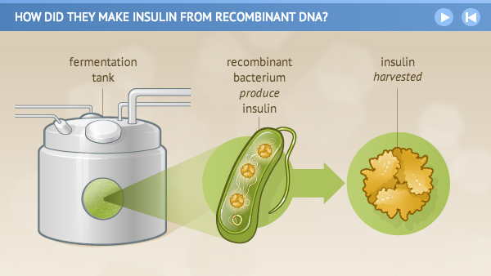
Manufacture
The genetically modified bacteria are cultured in a large scale using a fermenter and produce insulin which is then separated and purified.
Thus, human insulin can be used instead of extracting insulin from animals. Also large quantities of product are produced quickly and relatively cheaply.

Slide 16
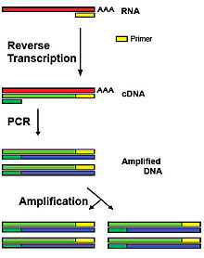
Reverse transcription
Locating the correct piece of DNA is not easy as the cell contains only two copies of the DNA. Cells that produce large amounts of a particular polypeptide will have large amounts of mRNA for that polypeptide.
If this mRNA can be isolated, its complementary DNA (cDNA) can be synthesised from it by a process called reverse transcription. This process is the reverse of normal transcription because the mRNA acts as a template for DNA synthesis.

Slide 17
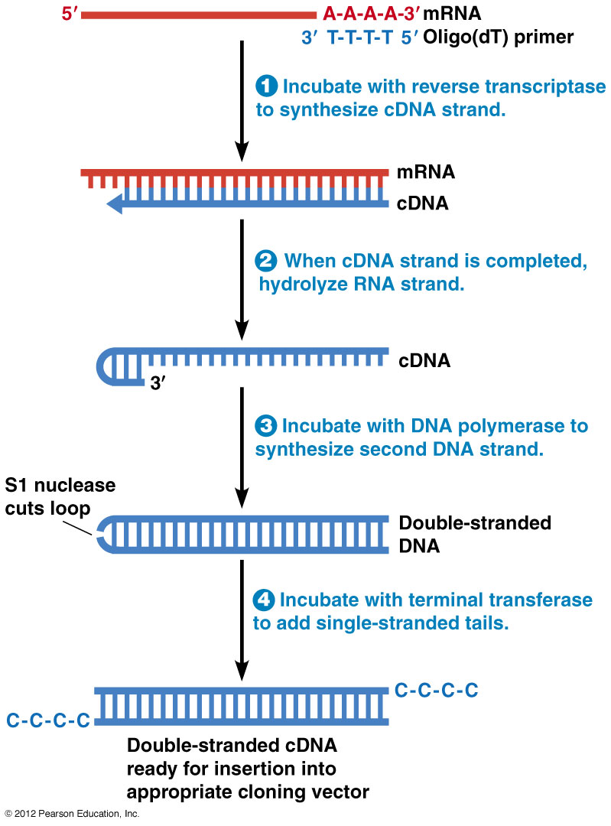
Reverse transcription
Reverse transcription requires DNA nucleotides and enzymes called reverse transcriptases.
After the mRNA has been copied into its cDNA, the mRNA is removed and a second strand of DNA is made by adding the enzyme DNA polymerase and more DNA nucleotides.
The result is a double-stranded DNA molecule identical to the original DNA molecule.

