Slide 1
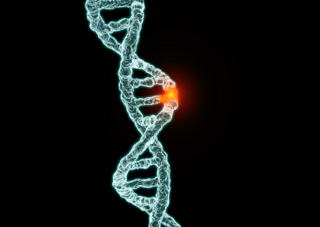
Mutations

Slide 2
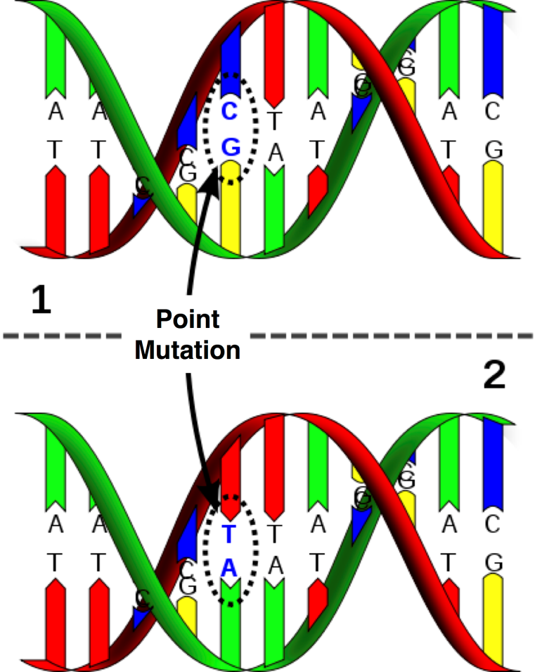
Mutations
Any unpredictable change in the structure or amount of DNA of an organism is called a mutation.
Most mutations occur in somatic (body) cells and are not passed from one generation to the next.
Only those mutations which occur in the formation of gametes can be inherited.

Slide 3
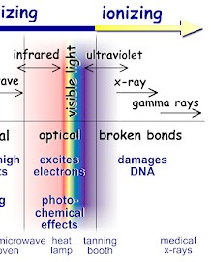
Mutation rate
Mutations occur continually. A typical rate of mutation is 1 or 2 new mutations per 100,000 genes per generation.
This natural mutation rate can be increased artificially by certain chemicals or energy sources. Any agent which induces a mutation is called a mutagen. Most forms of high energy ionising radiation are capable of altering the structure of DNA and thereby causing mutations. These include:
UV light
X-rays
Gamma rays

Slide 4
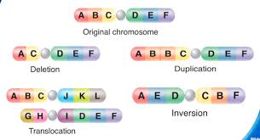
Methods of mutation
Mutations can happen in two ways:
DNA is not copied properly before cell division. Sometimes mistakes are made in the copying process so that new chromosomes are faulty. Usually they are small errors, involving only one gene, so they are called gene mutations or point mutations.
Chromosomes are damaged and break. If chromosomes break they will normally repair themselves (the DNA will rejoin) but they may not repair themselves correctly. This can lead to changed in the structure of the DNA and may affect large numbers of genes. These are called chromosome mutations.

Slide 5
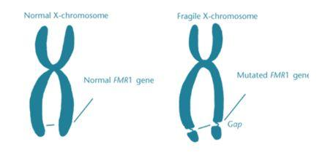
Effects of mutations
Most mutations, if expressed, are harmful. Note, however, that in diploid organisms such as us, mutations usually result in recessive alleles. These are expressed only in the homozygous condition unless the mutation is on the X chromosome.

Slide 6
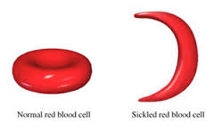
Effects of mutations
Many mutations result in a change in the shape of a protein so that the protein cannot function properly (e.g. sickle-cell anaemia).
Mutations that affect a large portion of the gene, and chromosome mutations, are often lethal.
Some mutations have no effect: a mutation may occur in a non-coding region of the DNA; it may produce a different codon for the same amino acid; or the altered amino acid sequence may not affect the protein’s shape or function.

Slide 7
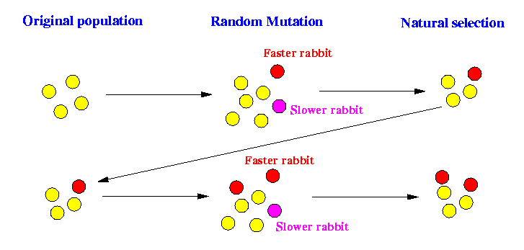
Effects of mutations
Occasionally, a mutation is beneficial, changing the phenotype so that an organism has a better chance of survival and reproduction. Although beneficial mutations are very rare events, they are bound to happen sooner or later if there are a large number of individuals in a population.
These mutations are of immense importance because they are the ultimate source of all variation: the raw material for the evolution of new species by natural selection.

Slide 8
Gene Mutations
A change in the structure of DNA which occurs at a single locus on a chromosome is called a gene mutation or point mutation.
Any change to one or more of the nucleotides which make up our DNA sequence, or any rearrangement of the sequence, will produce the wrong sequence of amino acids in the protein it makes.

Slide 9
Gene Mutations
There are many forms of gene mutations:
Duplication – a portion of a nucleotide chain becomes repeated
Addition (insertion) – an extra nucleotide sequence becomes inserted into the chain
Deletion – a portion of the nucleotide chain is removed from the sequence
Inversion – a nucleotide sequence becomes separated from the chain. It rejoins in its original position, only inverted. The nucleotide sequence of this portion is therefore reversed
Substitution – one of the nucleotides is replaced by another which has a different organic base

Slide 10
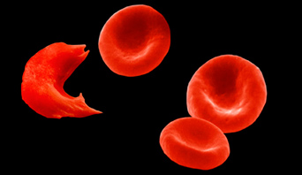
Sickle cell anaemia
Sickle cell disease is a disorder that affects the red blood cells, which use a protein called haemoglobin to transport oxygen from the lungs to the rest of the body.
Normally, red blood cells are round and flexible so they can travel freely through the narrow blood vessels.

Slide 11
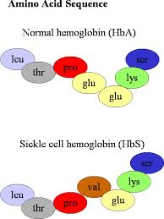
Sickle cell anaemia
The haemoglobin molecule has two parts: an alpha and a beta. Patients with sickle cell disease have a mutation in a gene on chromosome 11 that codes for the beta subunit of the haemoglobin protein.
Haemoglobin S is produced by a single base mutation that causes valine to be substituted for glutamic acid at the sixth position in the β globulin chain.

Slide 12
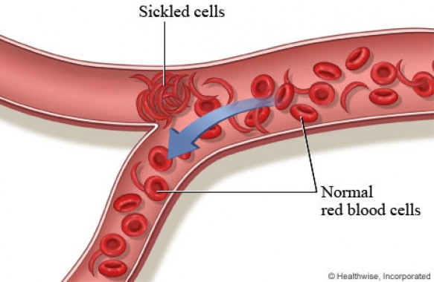
Sickle cell anaemia
DNA codes for glutamic acid are CTT or CTC. Two of the codes for valine are CAT or CAC. In either case, the substitution of A for T as the second base would bring about the formation of haemoglobin S.
Haemoglobin molecules don't form properly, causing red blood cells to be rigid and have a concave shape. These cells get stuck in the blood vessels and are unable to transport oxygen effectively, causing pain and damage to the organs.

Slide 13
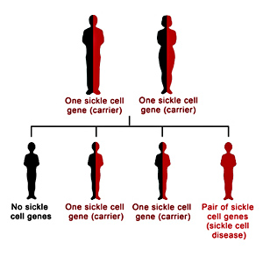
How do people get sickle cell disease?
The gene mutation which causes sickle-cell disease is codominant. In the homozygous state, the individual suffers sickle-cell disease and frequently dies.
In the heterozygous state, the individual has 30-40% sickle cells, the rest are normal. This is called the sickle-cell trait.

Slide 14
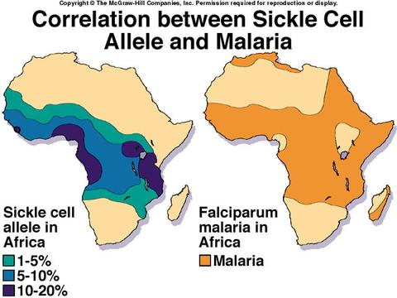
Why has sickle cell disease not been eradicated?
Sickle cell disease is common among people from Africa, India, the Caribbean, the Middle East, and the Mediterranean.
The high prevalence of the defective gene in these regions may be due to the fact that carriers of a mutation in the beta-subunit of haemoglobin are more resistant to malaria.

Slide 15
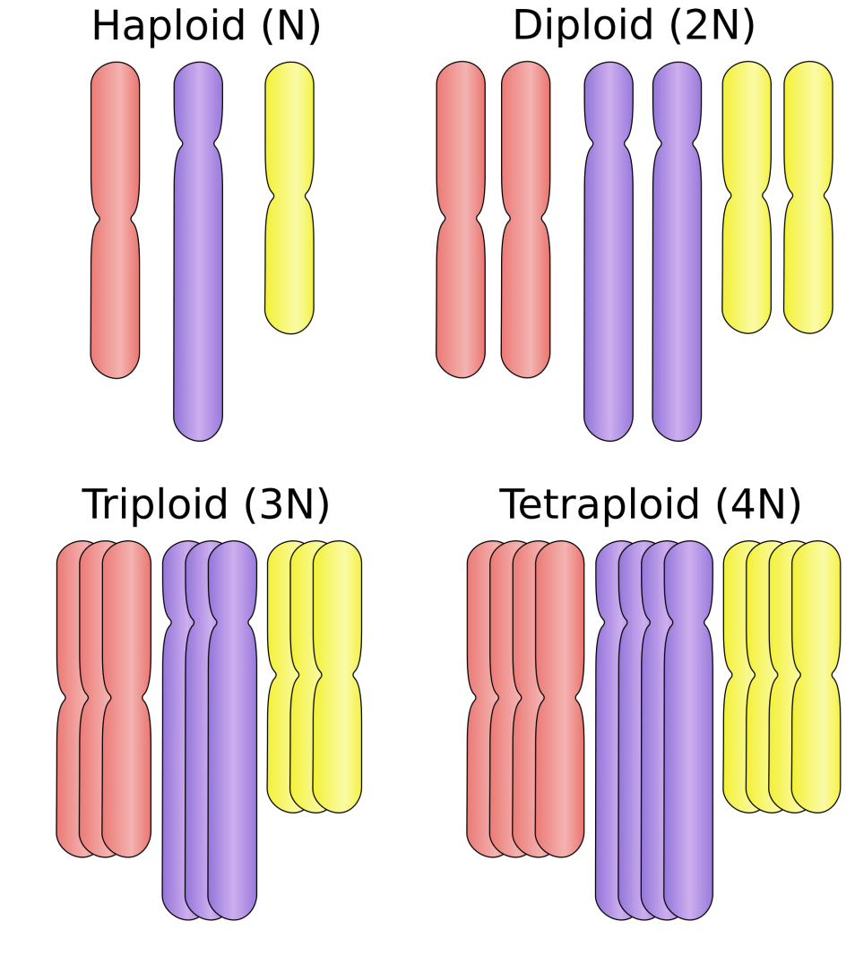
Chromosome Mutations
1. Changes in whole sets of chromosomes
Sometimes organisms occur that have additional whole sets of chromosomes.
Instead of having a haploid set in the sex cells and a diploid set in the body cells, they have several complete sets. This is known as polyploidy.

Slide 16
Chromosome Mutations
Polyploidy can arise in several different ways. If gametes are produced which are diploid and these self-fertilise, a tetraploid is produced. If the diploid gamete fuses with a normal haploid gamete, a triploid results. Polyploidy can also occur when whole sets of chromosomes double after fertilisation.
Tetraploid organisms have two complete sets of homologous chromosomes and can therefore form homologous pairings during gamete production by meiosis. Triploids, however, cannot form homologous pairings and are usually sterile. They can only be propagated by asexual means.

Slide 17
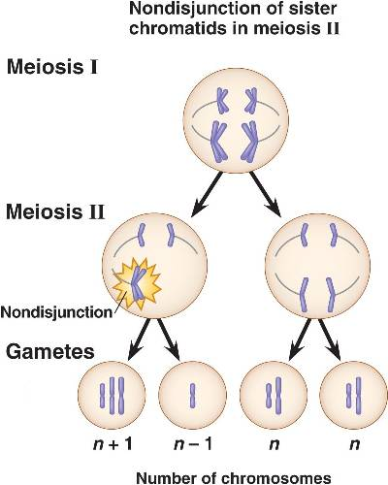
Chromosome Mutations
2. Changes in chromosome number
Sometimes it is an individual chromosome, rather than a whole set, which fails to separate during anaphase.
If, for example, in humans one of the 23 pairs of homologous chromosomes fails to segregate during meiosis, one of the gametes produced will contain 22 chromosomes and the other 24, rather than 23 each.
This is known as non-disjunction and is often lethal.

Slide 18
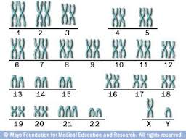
Down’s Syndrome
One frequent consequence of non-disjunction in humans is Down’s syndrome (mongolism), occurring in approximately 1 in 700 births. In this case, the 21st chromosome fails to segregate and the gamete produced contains 24 chromosomes.
The fusion of this gamete with a normal one with 23 chromosomes results in the offspring having 47 (2n+1) chromosomes.
Non-disjunction does occur with other chromosomes but these normally result in the foetus aborting or the child dying soon after birth.

Slide 19
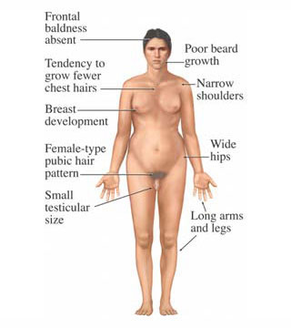
Klinefelter’s syndrome
Non-disjunction of the sex chromosomes can also occur. One example is Klinefelter’s syndrome.
This may result in individuals who have the genetic constitution XXY, XXXY or XXXXY.
These individuals are phenotypically male but have small testes and no sperm in their ejaculate.
As individually are phenotypically male, this indicates that the presence of a Y chromosome is the cause of maleness.

Slide 20
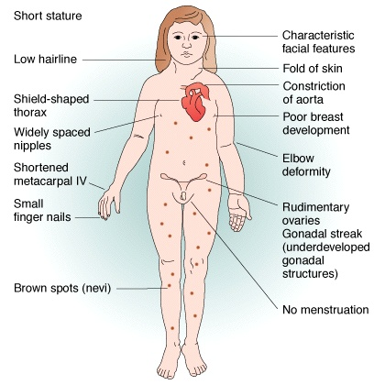
Turner’s Syndrome
A second abnormality of the sex chromosomes occurs in individuals with Turner’s syndrome who have one missing X chromosome. Their genetic constitution is therefore XO and they only have 45 (2n-1) chromosomes.
Individuals with this condition often do not survive pregnancy and are aborted. Those that do are phenotypically female, but small in stature and sexually immature.

Slide 21
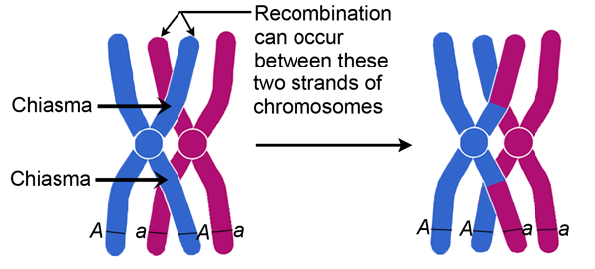
Chromosome Mutations
3. Changes in chromosome structure
During meiosis it is normal for homologous pairs of chromosomes to form chiasmata. The chromatids break at these points and rejoin with the corresponding portion of chromatid on its homologous partner.
It is not surprising that from time to time mistakes arise during this process.

Slide 22
Chromosome Mutations
There are four types of chromosome mutation:
Deletion – a portion of chromosome is lost. As this involves the loss of genes, it can have a significant effect on an organism’s development, often proving lethal.
Duplication – a portion of chromosome is doubled, resulting in a repetition of a gene sequence.
Inversion – a portion of chromosome becomes deleted, but becomes reattached in an inverted position. The sequence of genes on this portion is therefore reversed.
Translocation – a portion of chromosome becomes deleted and rejoins at a different point on the same chromosome or with a different chromosome.

Slide 23
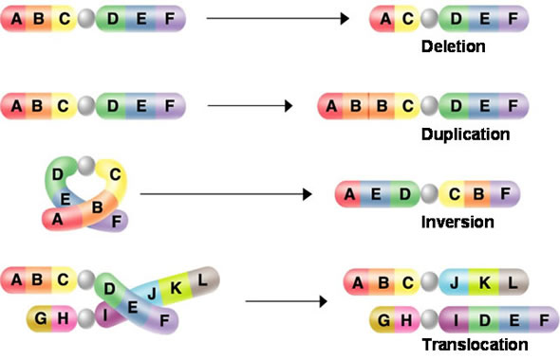

Slide 24
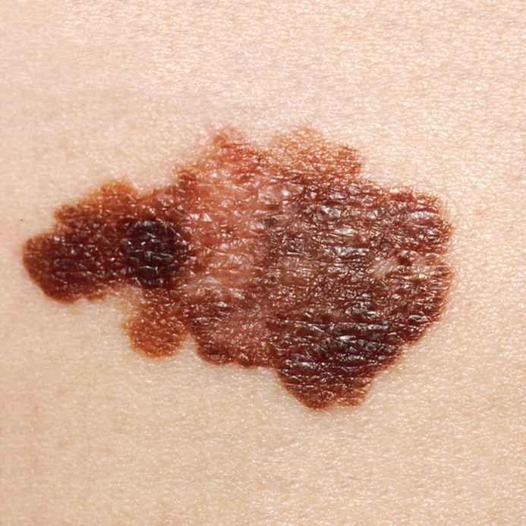
Carcinogens
Mutagens which cause cancer are called carcinogens. These affect the DNA in cells, resulting in mutations.
Carcinogens include radiation, UV light from the Sun, and X-rays, all of which can damage DNA and cause mutations which may lead to cancers. UV light from the Sun is the most common form of carcinogenic radiation.
Exposure to certain wavelengths of UV light is linked to the development of skin cancers, including a highly malignant form called a melanoma.

Slide 25
Cancer
The process of cell division is carefully controlled by specific genes and other mechanisms. For example, proto-oncogenes are thought to stimulate cell division, whereas tumour suppressor genes inhibit cell division.
In a healthy cell the activities of these two types of gene are in balance.
Problems arise when the genes mutate or other control mechanisms break down so that cells can divide uncontrollably.

Slide 26
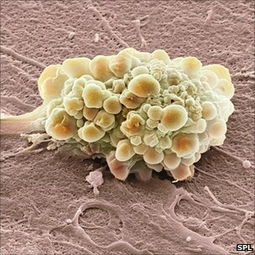
Tumours
Carcinogens probably trigger cancers by causing the proto-oncogenes that stimulate cell division to mutate into oncogenes (onkos means tumour).
Most mutated cells are either destroyed by the body’s immune system or die, causing no harm to the body. However, a single mutated cell may divide to form a clone of identical cells.
Eventually a mass of abnormal cells called a tumour is formed.

Slide 27
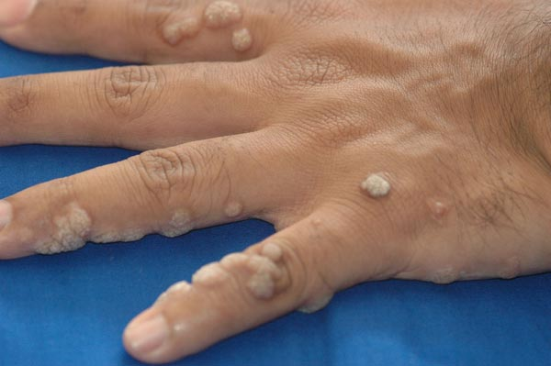
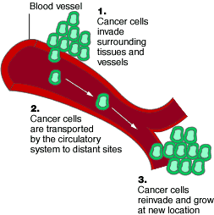
Types of tumour
Most tumours, such as common warts, are benign. Benign tumours do not spread from their point of origin.
Tumours which can spread through the body are called malignant tumours.
Malignant tumour cells can be carried by the bloodstream or lymphatic system to invade other tissues, causing secondary cancers. This process is called metastasis.

