Slide 1
Echalk response experiment

Slide 2
Assessment Statements |  | Obj.
E1.1 | Define the terms stimulus, response and reflex. | 1
E1.2 | Explain the role of receptors, sensory neurons, relay neurons, motor neurons, synapses and effectors in the response of animals to stimuli. | 3
E1.3 | Draw and label a diagram of a reflex arc for a pain withdrawal reflex, including the spinal cord and its spinal nerves, the receptor cell, sensory neuron, relay neuron, motor neuron and effector. Include white and grey matter, dorsal and ventral roots. | 1
E1.4 | Explain how animal responses can be affected by natural selection, using two examples. Sylvia atricapilla (blackcap bird) migration changes Heliconius cydno butterflies and changes in mate preference | 3

Slide 3
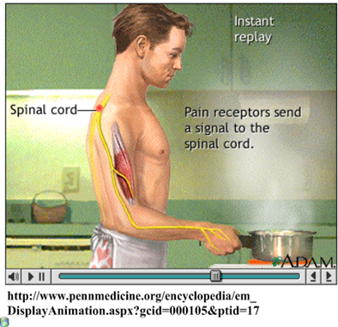
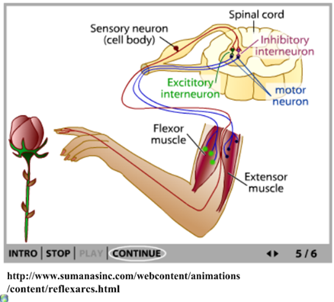

Slide 4
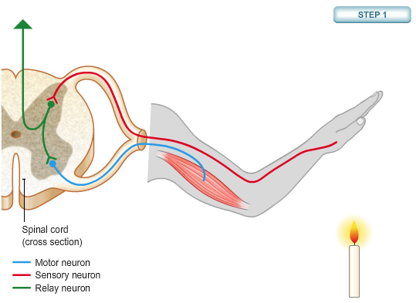
The pain withdrawal reflex is a rapid, unconscious response to danger or injury. It is mediated by the spine’s grey matter.
The Pain Reflex
A GCSE overview from the BBC:
Reflex animation from: http://www.bbc.co.uk/schools/gcsebitesize/science/add_ocr_pre_2011/brain_mind/reflexactionsrev1.shtml

Slide 5
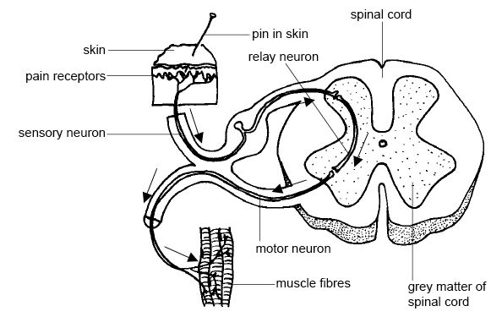
The pain withdrawal reflex is a rapid, unconscious response to danger or injury. It is mediated by the spine’s grey matter.
The Pain Reflex
(nociceptors)
Spine-mediated pain reflex arc, from: http://en.wikibooks.org/wiki/Anatomy_and_Physiology_of_Animals/Nervous_System

Slide 6
Rope

Slide 7
The pain withdrawal reflex is a rapid, unconscious response to danger or injury. It is mediated by the spine’s grey matter.
The Pain Reflex
(nociceptors)
propagates the AP along the
axon (review action and resting potentials!)
Injury stimulates pain receptors (nociceptors), causing Ca²⁺ ions to rush in. This depolarises the sensory neuron and starts an action potential.
http://www.vet.ed.ac.uk/animalpain/Pages/animation2.htm

Slide 8
The pain withdrawal reflex is a rapid, unconscious response to danger or injury. It is mediated by the spine’s grey matter.
The Pain Reflex
(nociceptors)
Finally, the motor neurons conduct the AP from the relay neuron to the effector (muscle).
Muscles that need to contract receive and excitatory signal.
Muscles that need to relax receive an inhibitory signal.
The response is rapid movement away from the source of pain.

Slide 10
A
Dorsal root ganglion (passage for neurons)
B
C
D
E
F
Ventral root ganglion (passage for neurons)
G

Slide 11
Objectives
E.1.1 Define the terms stimulus, response and reflex in the context of animal behaviour.
E.1.2 Explain the role of receptors, sensory neurons, relay neurons, motor neurons, synapses and effectors in the response of animals to stimuli.
E.1.3 Draw and label a diagram of a reflex arc for a pain withdrawal reflex, including the spinal cord and its spinal nerves, the receptor cell, sensory neuron, relay neuron, motor neuron and effector.
E.1.4 Explain how animal responses can be affected by natural selection, using two examples.

Slide 12
http://www.expertafrica.com/tanzania/info/serengeti-wildebeest-migration/gallery
https://www.youtube.com/watch?v=vUNZv-ByPkU

Slide 13
