Slide 2
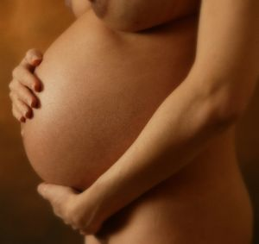
True or false?
You can’t get pregnant the first time you have sex.

Slide 3
True or false?
You can’t get pregnant the first time you have sex.
FALSE

Slide 4
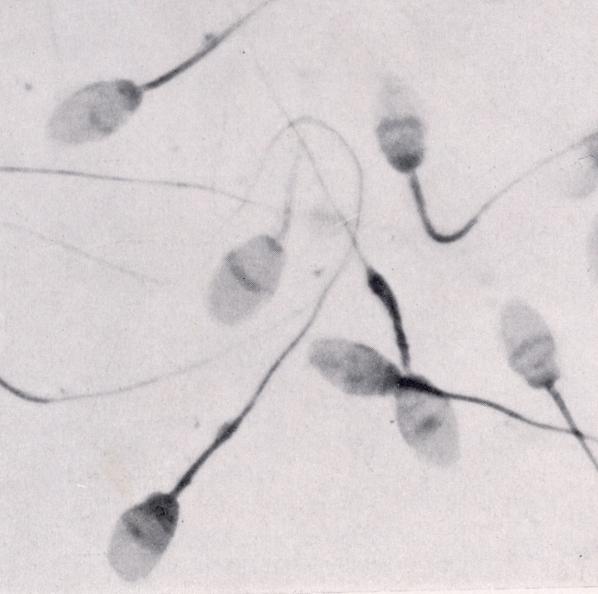
True or false?
Sperm can live for up to 3 days inside a woman’s body.

Slide 5
True or false?
Sperm can live for up to 3 days inside a woman’s body.
TRUE

Slide 6
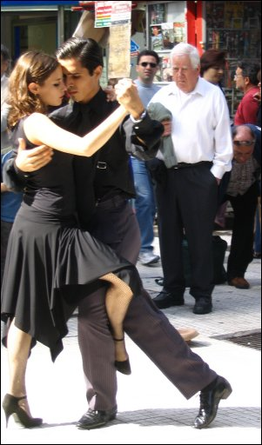
True or false?
You can’t get pregnant if you have sex standing up

Slide 7
True or false?
You can’t get pregnant if you have sex standing up
FALSE

Slide 8
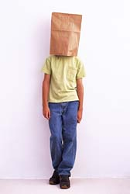
True or false?
Boys start to have wet dreams when they reach puberty

Slide 9
True or false?
Boys start to have wet dreams when they reach puberty
TRUE

Slide 10
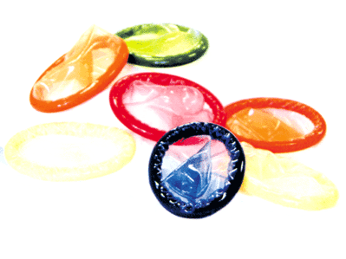
True or false?
Condoms help to prevent the spread of sexually transmitted diseases.

Slide 11
True or false?
Condoms help to prevent the spread of sexually transmitted diseases.
TRUE

Slide 12
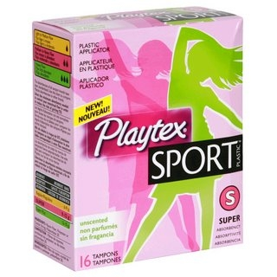
True or false?
Girls should not swim or play sport during their period.

Slide 13
True or false?
Girls should not swim or play sport during their period.
FALSE

Slide 14
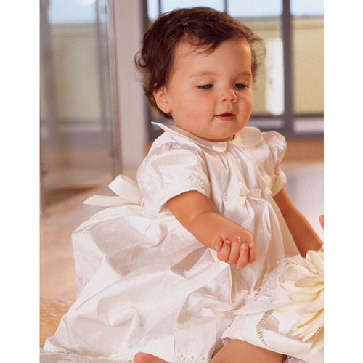
True or false?
A baby girl has eggs already inside her.

Slide 15
True or false?
A baby girl has eggs already inside her.
TRUE

Slide 16
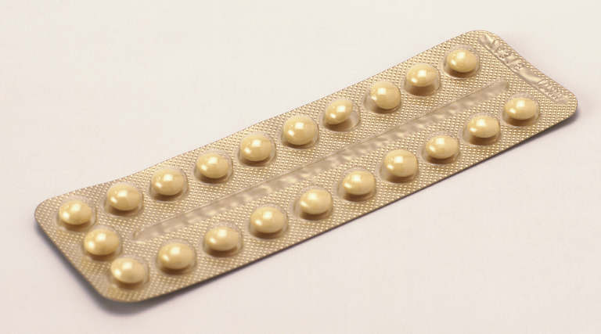
True or false?
Taking the pill means you can’t get pregnant.

Slide 17
True or false?
Taking the pill means you can’t get pregnant.
FALSE

Slide 18
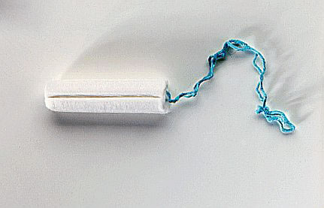
True or false?
You can’t get pregnant during a period.

Slide 19
True or false?
You can’t get pregnant during a period.
FALSE

Slide 20
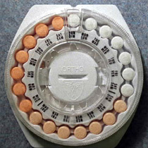
True or false?
The pill stops you from getting diseases

Slide 21
True or false?
The pill stops you from getting diseases
FALSE

Slide 22
Objectives
. 3.1 understand the differences between sexual and asexual reproduction
. 3.2 understand that fertilisation involves the fusion of a male and female gamete to produce a zygote that undergoes cell division and develops into an embryo
. 3.7 understand that plants can reproduce asexually by natural methods (illustrated by runners) and by artificial methods (illustrated by cuttings)

Slide 23
Shark virgin birth article

Slide 24
Cloning plants
Plants can be easily and cheaply cloned by taking cuttings
This is possible because plant cells retain the ability to develop in to any type of cell and can give rise to a whole new plant!

Slide 25
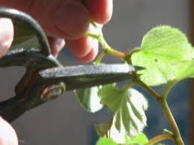
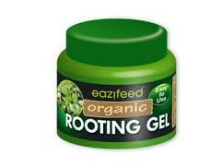
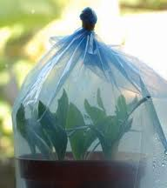
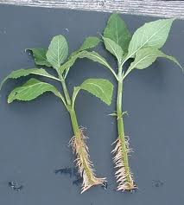
Producing cuttings

Slide 26
Producing cuttings
Cut part of the stem of the plant or sometimes a leaf
Dip in hormone rooting powder to stimulate roots to develop
Plant in damp compost
The cutting will grow in to a whole new plant after a few weeks if kept in the right conditions!
Cuttings are genetically identical to parent plants- why is this useful for gardeners?

Slide 27
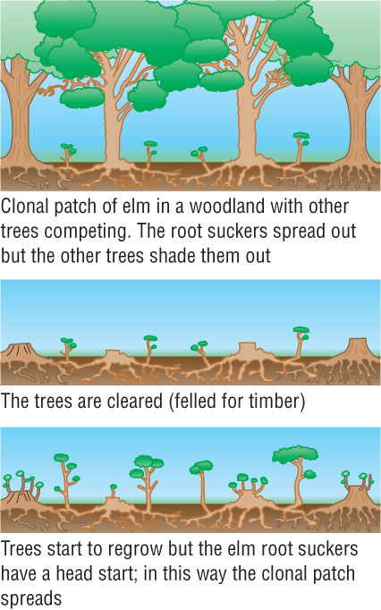
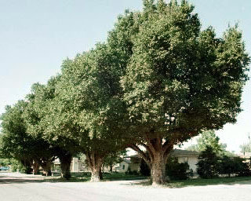
Vegetative propagation
Production of structures in an organism that can grow into new individuals → these are clones of the parent
English Elms (Ulmus procera) reproduce asexually when damaged.
After ~2months, basal sprouts grow from meristem tissue close to ground (less chance damage is here).
Notes:
Meristem tissue will form any tissue...they’re stem cells!

Slide 28
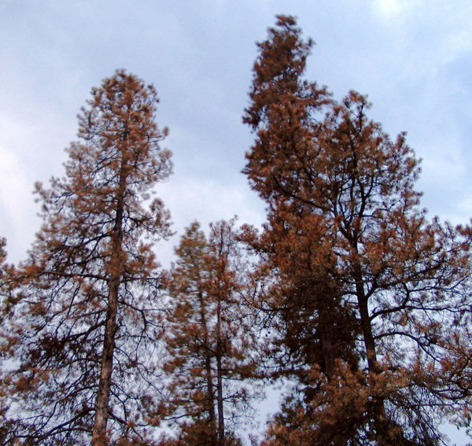
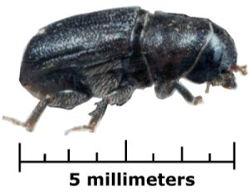
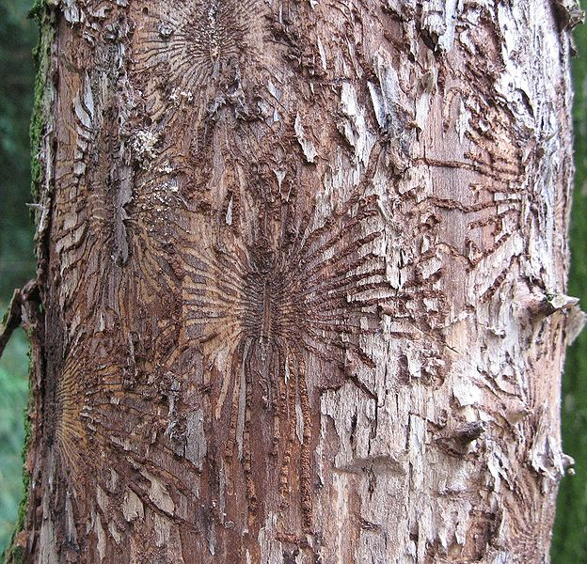
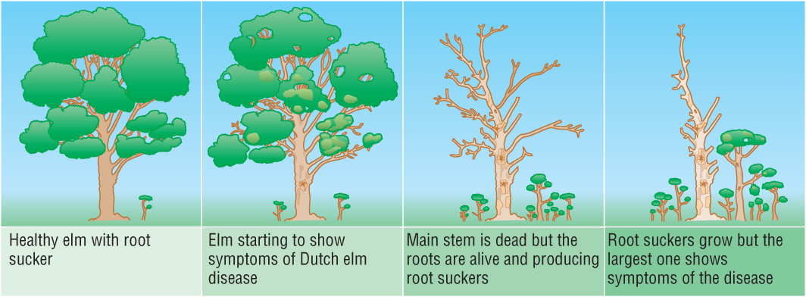
Dutch Elm Disease
Disease caused by fungus Ophiostoma ulmi carried by Elm Bark Beetle
Causes tree to block its xylem with gum → killing it
Use the diagrams to explain why basal sprouting has not being successful in maintaining population levels?
Notes:
Most trees are clones of each other, therefore little genetic variation in teh population. Introduced hybrid varieties which are resistant

Slide 29
http://www.newscientist.com/article/mg19025513.700-a-future-with-no-bananas.html

Slide 30
discuss the advantages and disadvantages of plant cloning in agriculture
Advantages:
All plants genetically identical
Plants will mature at the same time and be harvested at the same time
Plants can be grown out of season
Disadvantages:
Arrival of new pathogen or climate change will affect all clones
High costs involved

Slide 31
Asexual
and
Sexual
Reproduction
Explain the difference!
You must use the words:
Offspring, genes, fertilisation, variation, clones, sex cells (gametes), inherit
In your answer

Slide 32
Mark your neighbour’s work and give them a score out of 7 – 1 mark for each correct used word
Asexual
and
Sexual
Reproduction
Explain the difference!
You must use the words:
Offspring, genes, fertilisation, variation, clones, sex cells (gametes), inherit
In your answer

Slide 33
Objectives You should be able to…
. 3.5 understand the conditions needed for seed germination
. 3.6 understand how germinating seeds utilise food reserves until the seedling can carry out photosynthesis

Slide 34
Plan an investigation to find out the height at which you can drop a prep school student without them being killed
(6 marks)

Slide 35
C O R M S
Plan an investigation to find out the height at which you can drop a prep school student without them being killed. (6 marks)
OMPARE
What will you investigate? e.g. the activity of an enzyme at 0, 20, 40, 60 & 80ºC
RGANISM
What organism will you investigate?
EPEAT
How many times will you repeat the experiment?
How will you make your measurements? Apparatus, units, frequency, duration?
EASURE
AME
What you will you keep the same? Fair test. (2 marks)

Slide 36
Exam style question
Design an experiment that investigates the effect of temperature on seed germination
(6 marks).

Slide 37
This answer will score 0 marks on an exam! You need to write an answer that will score 6 marks!
Set up 4 petri dishes with cotton wool in each one.
Add water to the cotton wool and place the seeds on top.
Label your petri dishes.
Leave your dishes at 4 different temperatures.
Leave for a week and see what happens.

Slide 38
C O R M S
Design an experiment that investigates the effect of temperature on seed germination
OMPARE
What will you investigate? e.g. the activity of an enzyme at 0, 20, 40, 60 & 80ºC
RGANISM
What organism will you investigate?
EPEAT
How many times will you repeat the experiment?
How will you make your measurements? Apparatus, units, frequency, duration?
EASURE
AME
What you will you keep the same? Fair test. (2 marks)

Slide 39
Objective
I can describe the structures of an insect-pollinated and a wind-pollinated flower and explain how each is adapted for pollination

Slide 40
Dissection guide

Slide 41
Plenary – exam style question
Draw the structure of a dicotyledenous animal-pollinated flower.
(Total 6 marks)

Slide 42
Plenary answers
Award [1] for each of the following structures clearly drawn and labelled correctly.
petals; sepal; stigma; style; ovary; stamen / anther and filament; receptacle / nectary;
[6]

