Slide 1
Pair up to the person next to you
White board and ask the audience
Each question write A B C or D on your board
If you don’t know you can ask one of the other teams who has written the answer – they must explain why they have given the answer they have
I will add marks up and the winner gets a prize..... Not one billion pounds though!

Slide 2
Diffusion in single celled organisms is made easy by?
TRANSPORT
A) Having a small surface area to volume ratio
B) Having a large surface area to volume ratio
C) Ventilation Systems
D) All of the above

Slide 3
Which of the following is not responsible for a transport in multicellular organisms ?
TRANSPORT
A) Xylem
B) Phloem
C) Liver
D) Heart

Slide 4
The Phloem’s role is to:
TRANSPORT
A) Transport water from roots to the leaf
B) Transport water and mineral salts from the roots to the leaf
C)Transport sucrose and amino acids from the roots
D) Transport sucrose and amino acids from the leaf

Slide 5
Water absorption in plants occurs because ?
TRANSPORT
A) The network of roots create a small surface area
B) Active transport of minerals to the roots encouraging water uptake via osmosis
C) Osmosis of minerals to the roots encouraging uptake of water via active transport
D) Osmosis of waters occurs through the leaf

Slide 6
Which of the following statements is true?
TRANSPORT
A) Transpiration is the loss of water from the plant through diffusion
B) Light energy from the sun is responsible for the conversion of water from a liquid to a gas in transpiration
C) Low humidity, high temperatures and high wind speed all increase the rate of transpiration
D) All of the above

Slide 7
Asexual reproduction involves....?
Plant Reproduction
A) A male and female gamete
B) Offspring with a broad range of variation
C) No cell fusion or fertilisation
D) Meiosis

Slide 8
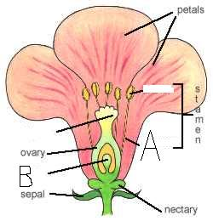
Which labels are correct?
Plant Reproduction
A) A is Anther and B is Stigma
B) A is filament and B is Stigma
C) A is filament and B is Anther
D) A is filament and B is ovule

Slide 9
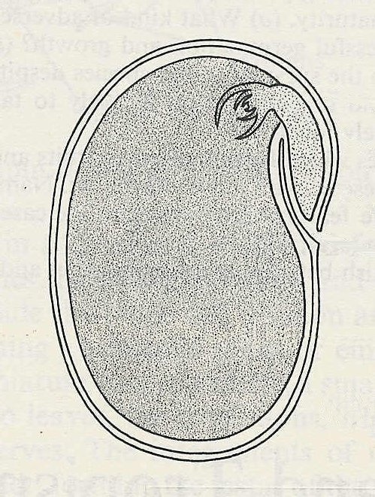
Energy for seed germination comes from ?
Plant Reproduction
A) Photosynthesis carried out in the testa
B) Chloroplasts producing energy in the cotyledons
C) Energy stored in the cotyledons
D) Energy stored in the testa
SEED
Cotyledon
Testa

Slide 10
REVISION Lesson
Transport
Students will be assessed on their ability to:
2.49 understand why simple, unicellular organisms can rely on diffusion for
movement of substances in and out of the cell
2.50 understand the need for a transport system in multicellular organisms
Flowering plants
2.51 describe the role of phloem in transporting sucrose and amino acids
between the leaves and other parts of the plant
2.52 describe the role of xylem in transporting water and mineral salts from the
roots to other parts of the plant
2.53 explain how water is absorbed by root hair cells
2.54 understand that transpiration is the evaporation of water from the surface of
a plant
2.55 explain how the rate of transpiration is affected by changes in humidity,
wind speed, temperature and light intensity
2.56 describe experiments to investigate the role of environmental factors in
determining the rate of transpiration from a leafy shoot

Slide 11
Reproduction
Students will be assessed on their ability to:
3.1 understand the differences between sexual and asexual reproduction
3.2 understand that fertilisation involves the fusion of a male and female gamete
to produce a zygote that undergoes cell division and develops into an
embryo
Flowering plants
3.3 describe the structures of an insect-pollinated and a wind-pollinated flower
and explain how each is adapted for pollination
3.4 understand that the growth of the pollen tube followed by fertilisation leads
to seed and fruit formation
3.5 understand the conditions needed for seed germination
3.6 understand how germinating seeds utilise food reserves until the
seedling can carry out photosynthesis
3.7 understand that plants can reproduce asexually by natural methods
(illustrated by runners) and by artificial methods (illustrated by cuttings)

